Slide 1
GAINS-IGP Training Session Registration to the GAINS Model Robert Sander
October 9, 2020

Slide 2
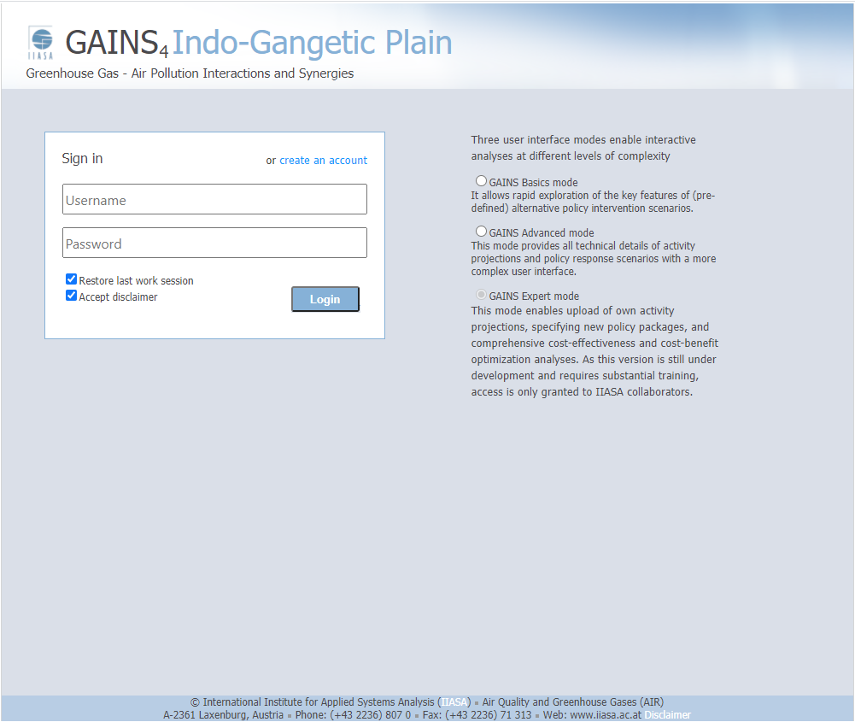
The GAINS Model
http://gains.iiasa.ac.at/gains4/IGP/index.login?logout=1

Slide 3
The GAINS Model
http://gains.iiasa.ac.at/gains4/IGP/index.login?logout=1

Slide 4
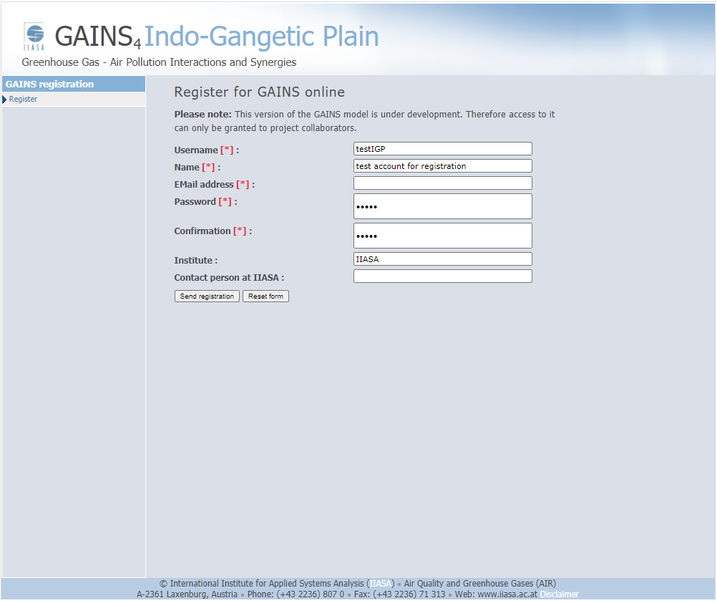
Registration
Username
Name
Email address
Password
------------
Institute
Contact person at IIASA

Slide 5
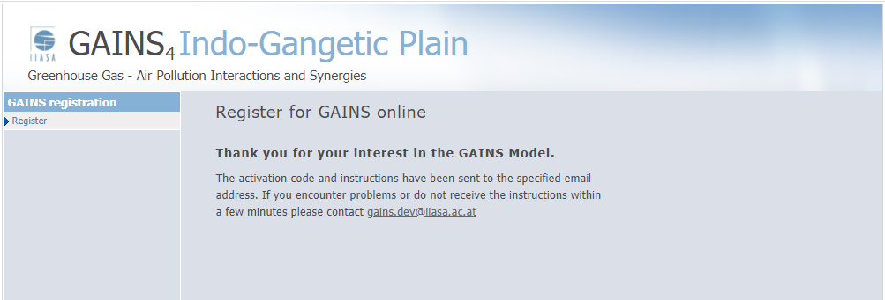
Confirmation of registration

Slide 6
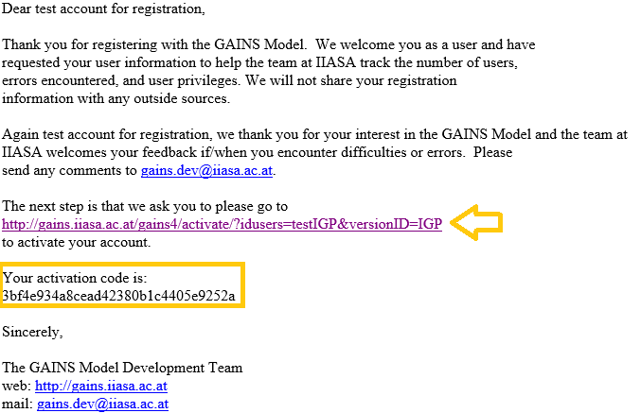
Email with Activation code
Content of the email
Follow the link
Copy the activation code

Slide 7
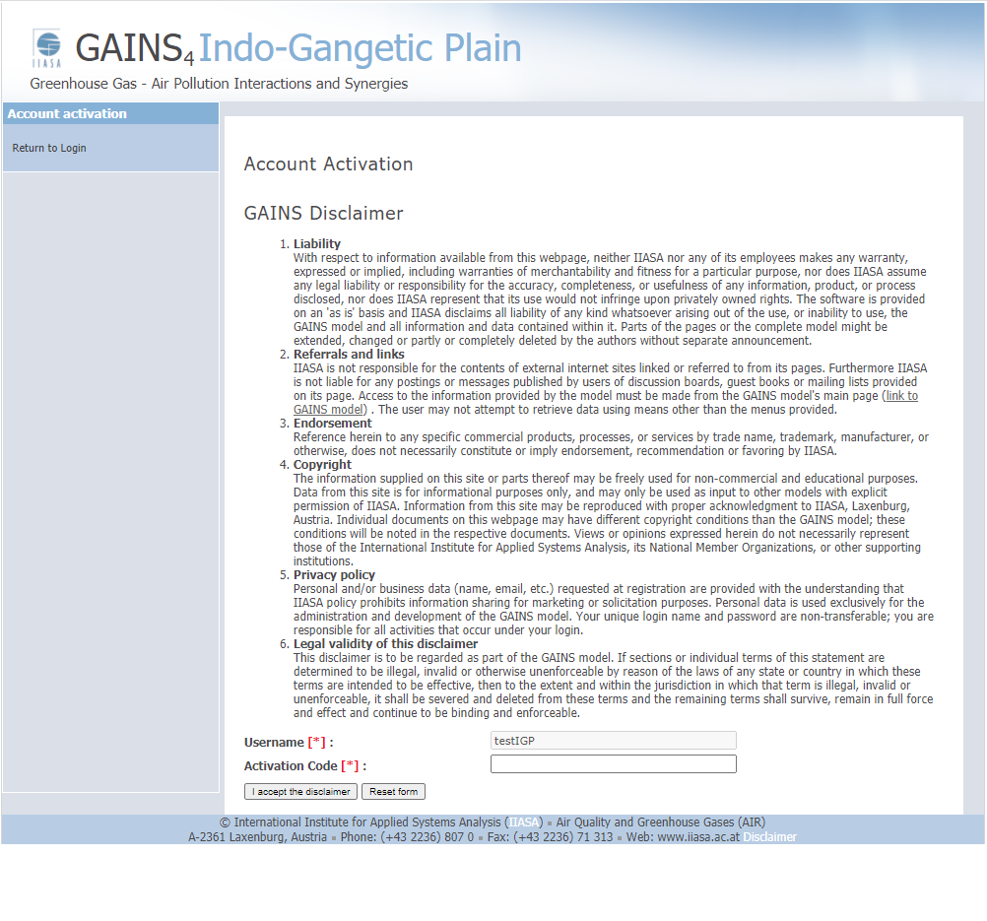
Enter the Activation code
Paste / Enter the activation code
Click accept

Slide 8
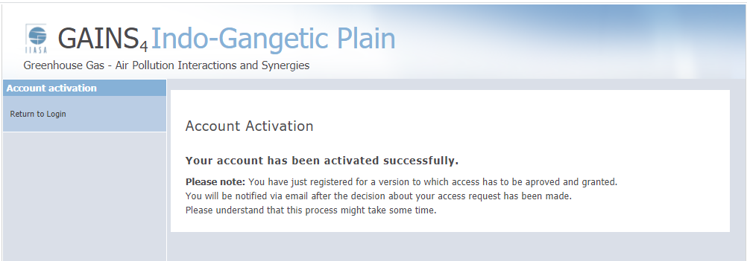
Ready …
Note: private versions
Access must be granted

Slide 9
Enter the model
With the notification of the version administrator, the user can access the particular GAINS version.
http://gains.iiasa.ac.at/gains4/IGP/index.login?logout=1
Note: Public GAINS version (e.g. Europe) can be accessed with the same user credentials.

