Slide 1
The Greenhouse Gas and Air Pollution Interactions and Synergies (GAINS) model: Solid waste – Indo Gangetic Plain Adriana Gómez-Sanabria
October 2020

Slide 2
Data Sources
Inventories: identify waste generation, composition, management
Current Policies - commitments regarding waste management but also emission reductions from waste
’Calibration’ historical years
Projections
Identify emission sources
Suggest technical and behavioural measures

Slide 3
Waste and wastewater sector in GAINS
Country/region
Behavioral Policies (e.g. Waste reduction - less water consumption)
Technical measures: Development and efficiency improvement
Socio-economic drivers
(i.e. Population growth, GDP per capita, Urbanization rate, value added, etc.)
Waste and wastewater generation
Waste and wastewater treatment facilities
Emissions and environmental impacts
Municipal solid waste
Landfill
GHGs, water and air pollution
Incinerator
Industrial solid waste
Anaerobic digester
Clean Environment
(e.g. reduction of pollutants in wastewater)
Domestic wastewater
Composting facilities
Recycling facilities
Circularity of resources
(e.g. Prolonging lifetime of materials, energy provision)
Industrial wastewater
Centralized wastewater treatment plants
Decentralized wastewater treatment
Unmanaged

Slide 4
Waste management technologies

Slide 5
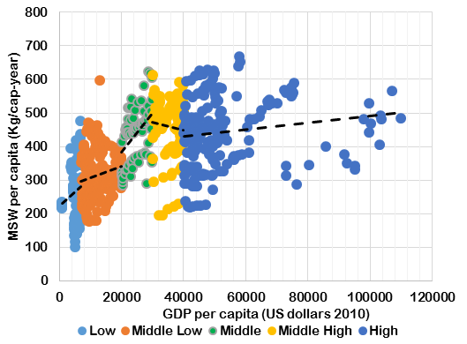
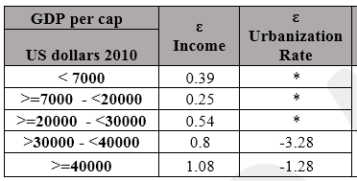
MSW generation - projections
Activity drivers: GDP per capita – Urbanization rate
Projections of Total MSW generation based on the elasticity to GDP/cap and urbanization rate for different income groups. Future growth in food waste generation suppressed at higher income levels due to its inferior goods nature.
Waste fraction | ε Income
Food waste | 0.43

Slide 6
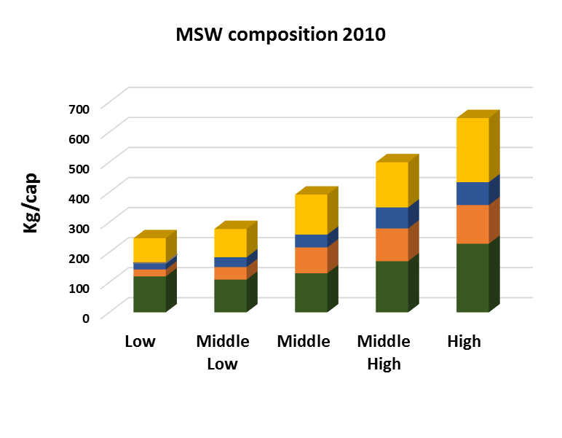
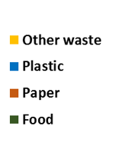
MSW generation - Composition

Slide 7
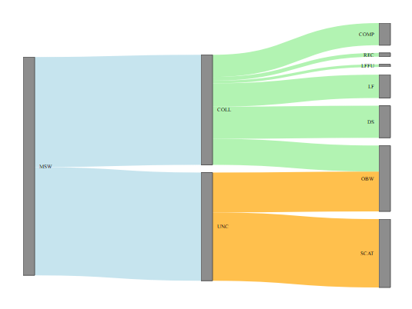
India MSW generation and treatment - 2015
25
4
3
122
26
35
241
29
44
119
76
Values in Mton

Slide 8
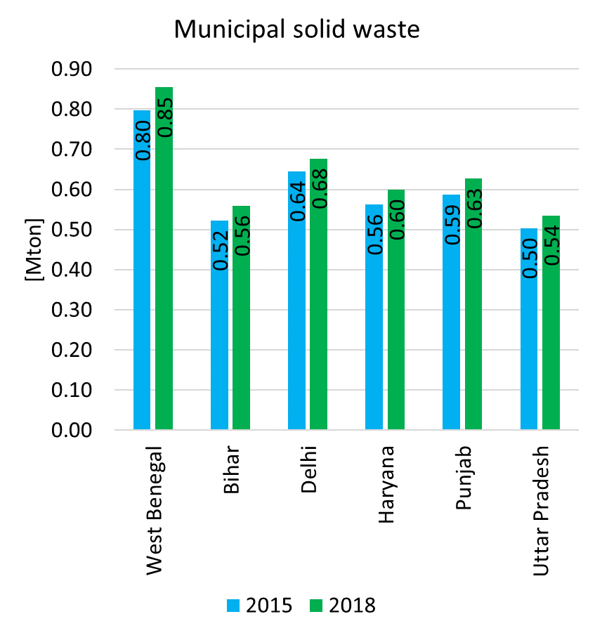
Municipal Solid Waste Generation

Slide 9
MSW up to 2050
Current IGP 104 Mt → 242 Mt in 2050
IGP 43% of MSW generates in India

Slide 10
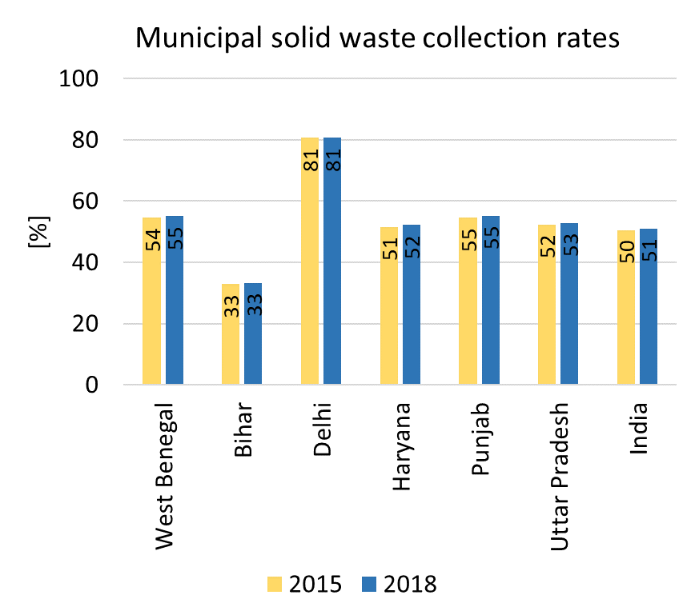
Municipal Solid Waste Collection Rates
Most of the waste collected is mixed. Not waste segregation at source.

Slide 11
Municipal solid waste treatment 2015
~ 29% of the total waste generated is openly burnt
~31% is scattered waste (with high probability of contaminating water courses)
Although urban areas have high collection rates, ~23% end up in dumpsites
Informal recycling
Waste to energy technologies are limited and also methane recovery from landfills
Composting plays a significant role in rural areas

Slide 12
Emissions PM2.5
Currently PM2.5 emissions from municipal solid waste account for ~10% of the total PM2.5 emissions in India
IGP accounts for 40% of PM2.5 emissions from municipal solid waste
IGP 2015 - 257 kt PM2.5 – Projected to grow to 585 kt by 2050

Slide 13
Emissions PM2.5
Currently PM2.5 emissions from municipal solid waste account for ~10% of the total PM2.5 emissions in India
Projected to be 19% in 2050 under the current conditions

Slide 14
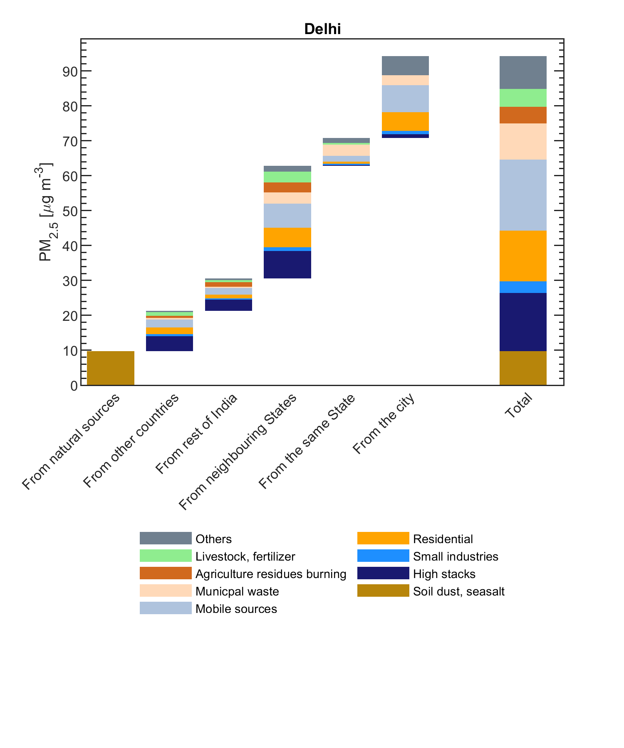
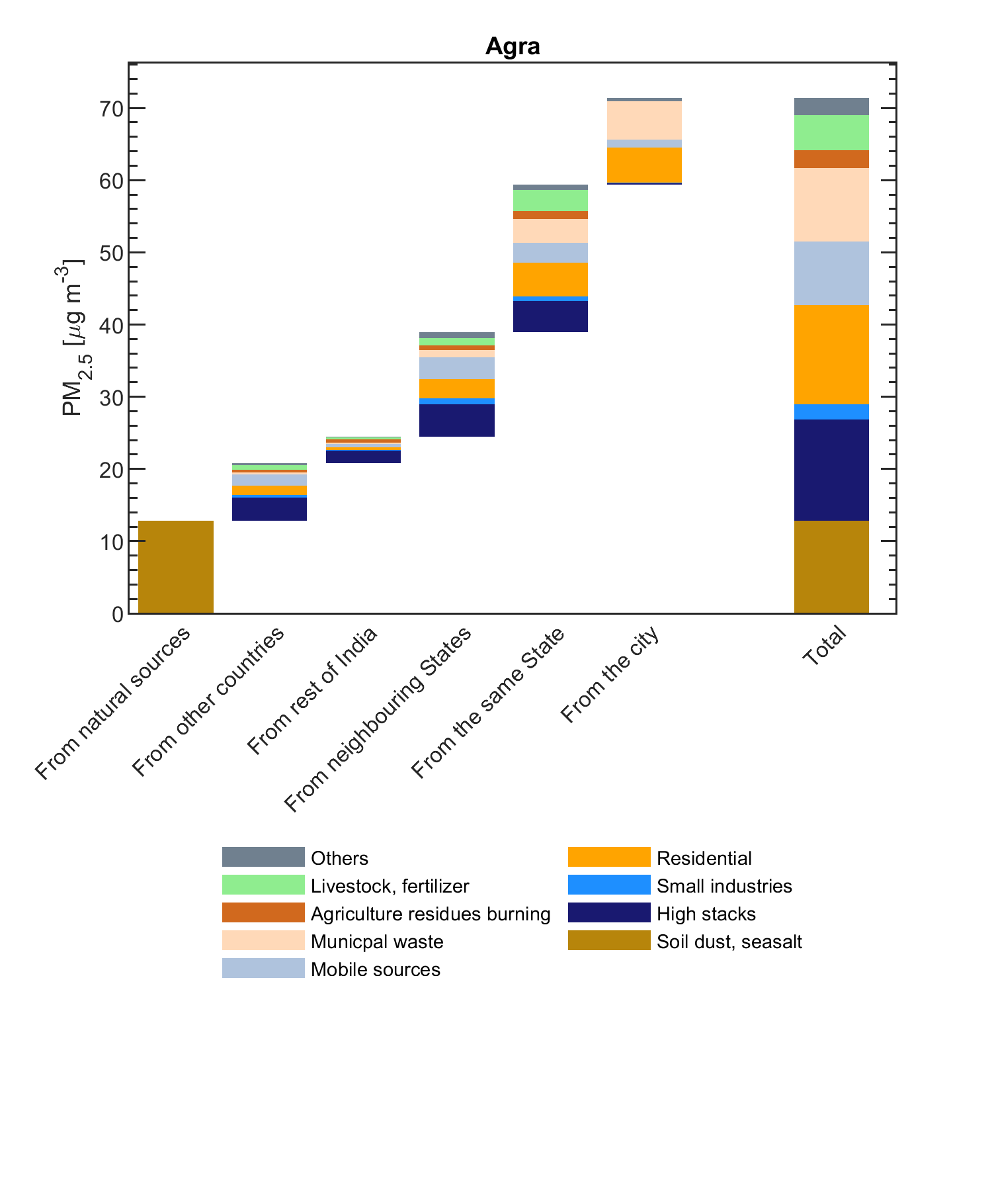
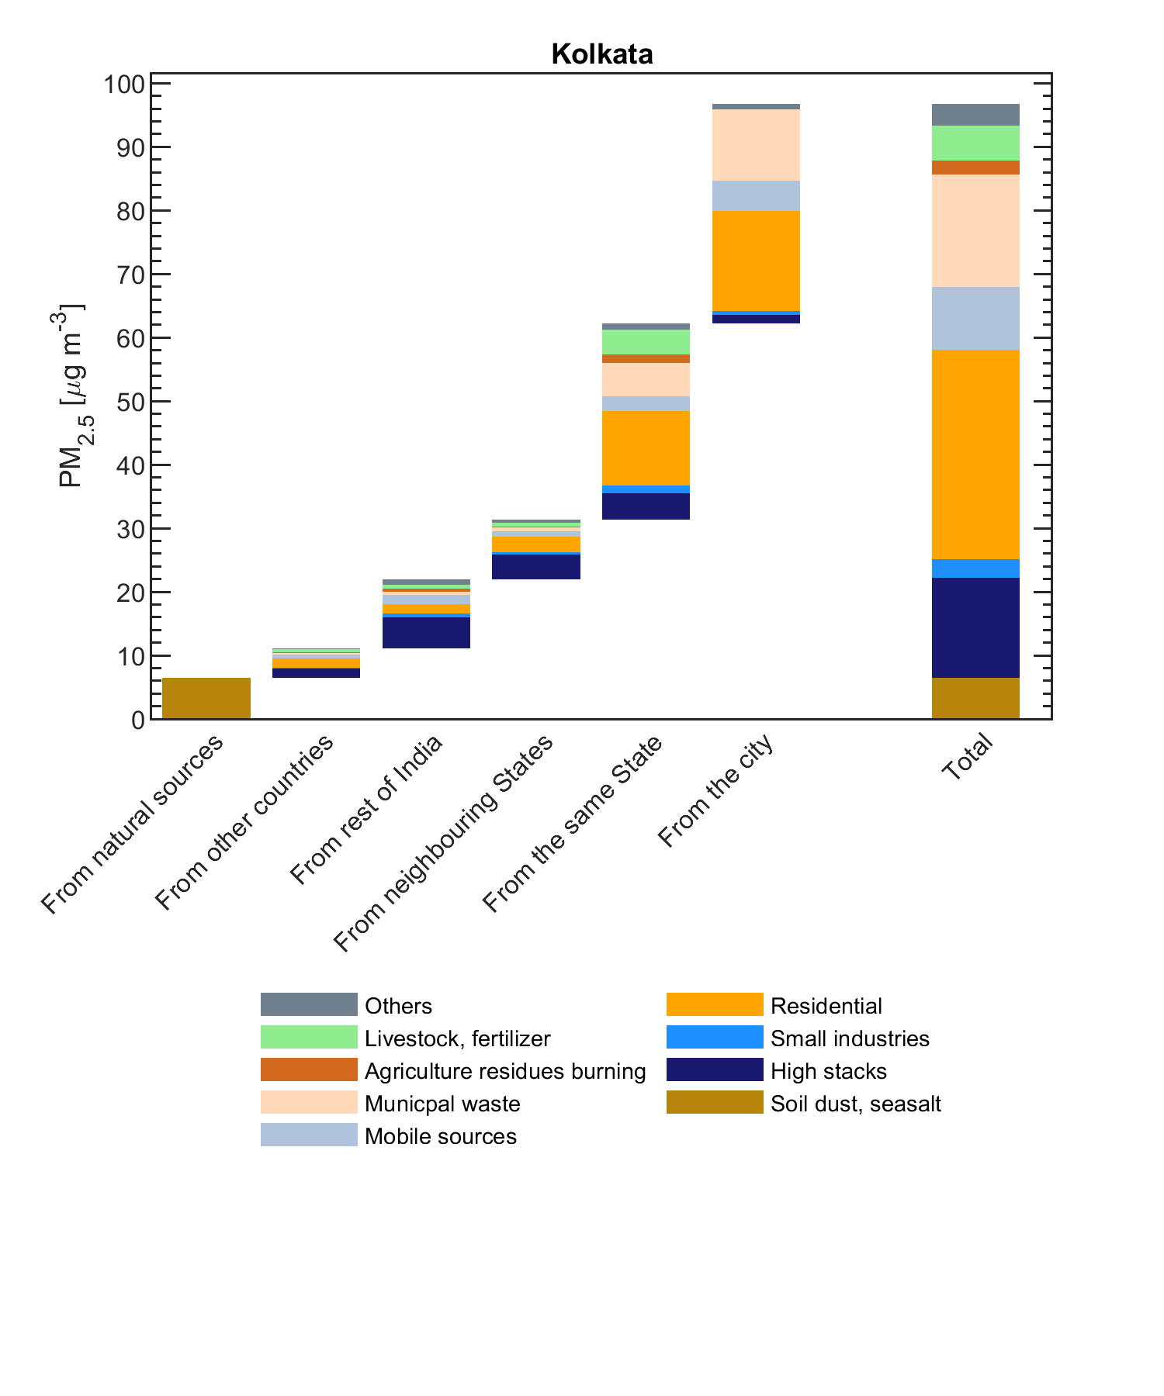
Sectoral contribution PM2.5
Notes:
Secondary PM it is created by secondary formation from precursor emissions such as sulfur dioxide (SO2), nitrogen oxides (NOx), volatile organic compounds (VOCs) and ammonia (NH3). Items 1 and 2 are generally known as primary emissions of PM2.5. Secondary formation occurs due to chemical reaction in the atmosphere generally downwind some distance from the original emission source. Efforts to determine the contribution of each of these PM2.5 emission mechanisms has shown a great deal of variability, as seen from an examination of current literature.

Slide 15
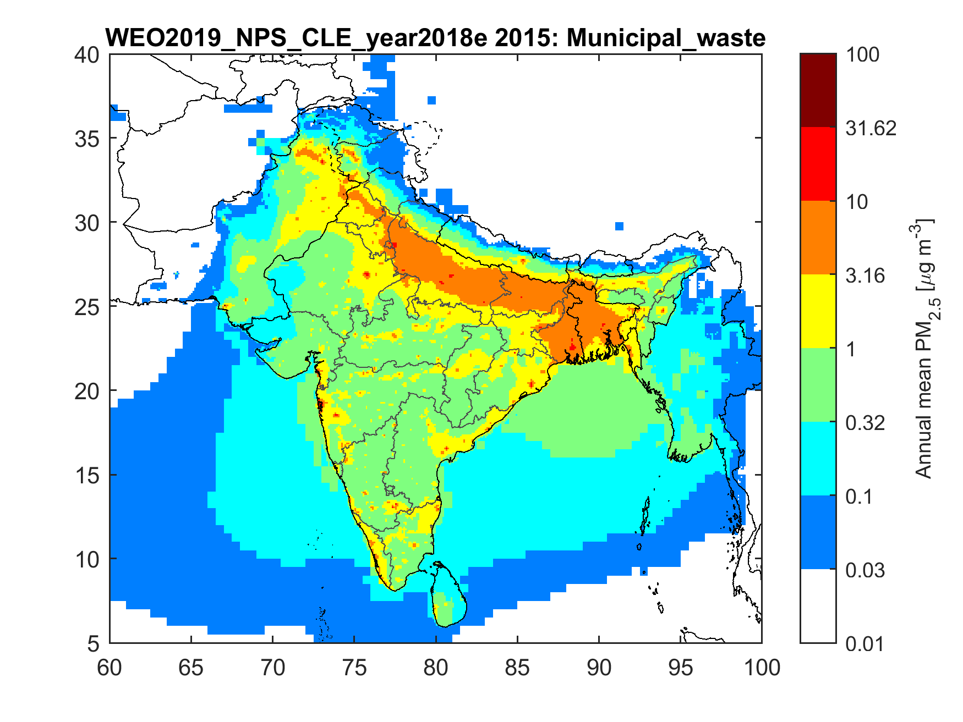
Notes:
Secondary PM it is created by secondary formation from precursor emissions such as sulfur dioxide (SO2), nitrogen oxides (NOx), volatile organic compounds (VOCs) and ammonia (NH3). Items 1 and 2 are generally known as primary emissions of PM2.5. Secondary formation occurs due to chemical reaction in the atmosphere generally downwind some distance from the original emission source. Efforts to determine the contribution of each of these PM2.5 emission mechanisms has shown a great deal of variability, as seen from an examination of current literature.

Slide 16
Questions /discussion
Activity data can still be refined
Not really information on quantities of municipal solid waste open burnt…..data comparison difficult
Information on policy implementation is missing …..current state of policy implementation
………………
Hands on….….

Slide 17
GAINS IGP
Activity data:
Total municipal solid waste generation
Municipal solid waste generated in urban areas: MSW_URB
Municipal solid waste generated in rural areas: MSW_RUR
Composition of waste
8 fractions → sum of the fraction should be 1 for each group.
MSW_URB_FOOD
MSW_URB_GLA
MSW_URB_MET
MSW_URB_OTH
MSW_URB_PAP
MSW_URB_PLA
MSW_URB_TEX
MSW_URB_WOOD
MSW_RUR_FOOD
MSW_RUR_GLA
MSW_RUR_MET
MSW_RUR_OTH
MSW_RUR_PAP
MSW_RUR_PLA
MSW_RUR_TEX
MSW_RUR_WOOD

