Slide 1

Towards cost-effective air pollution strategies
Fabian Wagner, IIASA
Principal Research Scholar, Pollution Management Group
Energy, Climate and Environment Program
Dean of Capacity Development and Academic Training
EECCA workshop – IIASA – 9 November 2023

Slide 2
Content
Why cost-effectiveness analysis?
  cost-benefit analysis vs cost-effectiveness analysis applied to air pollution control
  Challenges in cost-effectiveness analysis
Clean air targets: what to target? The approaches of the European Commission
The gap closure approach for target setting – efficient and fair?
Some example results
Conclusions

Slide 3

Method: the GAINS tool
[Greenhouse gas–Air pollution Interactions and Synergies]
Social development
and economic activities
National Emissions Ceilings
Emission control options: ~2000 measures,
co-control of 10 air pollutants and 6 GHGs)
Emissions
Costs
Optimization
Atmospheric dispersion
Health, ecosystems and climate impact indicators
Policy targets
GAINS is an online tool available at https//gains.iiasa.ac.at
Notes:
recap: this is the GAINS framework
We take socio-economic drivers as input. We then furnish these activity data with information on existing policies to control emissions from different sources. This information is translated into application rates of representative technologies (so-called control strategies).
The representative control technologies are characterized by emission factors (which in turn reflect the technology’s removal/reduction efficiency) and a unit cost
Given these two characteristics, together with the application rates of technologies and the activity data, for a given year both national emissions and emission control costs can be calculated.
For a given base year, the GAINS model results are calibrated to/reconciled with a national emission inventory. This will involve comparisons of emissions at various levels of aggregation, and – if available – of underlying drivers, emission factors and control strategies. The calibrated data are then proejcted into the future
The emissions of air pollutants and their precursors are then plugged into an atmospheric dispersion/chemical transport model that can calculate concentration fields at grid level. GAINS then converts these into impact indicators, such as population-weighted concentrations (exposure), ecosystems impacts etc.
We can used the GAINS framework to formulate and asses policy targets, and we do this by identifying cost-effective strategies to reach these targets, using the optimization tool of GAINS. This tool finds the overall cost-effective solution, assigning specific emission reduction targets to individual emission sources. Aggregated, these result in national emission ceilings for relevant air pollutants. These national emissions ceilings and associated portfolios of emission reduction measures form the basis for political negotiations and for considerations for how to formulate policies that would implement such a portfolio.

Slide 4
Why cost-effectiveness analysis?
There are many possible strategies to reduce air pollution. Which one should be followed?
Start with formulating a target on air quality
Even for reaching a certain air quality target, there are many different strategies? Which one of these should be followed?
Cost-effectiveness analysis identifies the most cost-effective solution to reach that target; i.e. the target is reached at the lowest costs -> no one wants to waste money
Notes:
Still, the question may be asked, why do we need cost-effectiveness analysis in the first place, why not any other method?
The challenge in general is that for a given target, there are many possible ways of reaching the target, so we need a method of finding a specific solution.
So among the many feasible solutions we select the one that is most cost-effective, because it is economically prudent not to waste money on ineffective policies.
There exists mathemtical methods to find the most cost-effective solution and is a unique solution.

Slide 5
Cost-benefits vs cost-effectiveness analysis
(context: air pollution control)
Cost-benefits analysis
Cost-effectiveness analysis
For which measures are the (marginal) monetized benefits larger than their costs?
Emission control
measures
Which set of measures delivers the policy target
at least cost?
Emission control
costs
Policy choice: Targets
(e.g., achieve AQ limit values, or reduce health impacts by 50%)
Physical benefits
e.g., air quality, prem. deaths
Policy choice:
Monetary value (€) of human life, ecosystems, etc.
Monetization of
(health) benefits (€/life)
Monetized benefits
(€/year)
Notes:
Here I would like to emphasize the contrast between cost-effectiveness analysis and cost-benefit analysis
As discussed before, for a given portfolio/set of control measures we can use GAINS to calculate on the one hand the physical benefits of taking these measures (e.g. a reduction in the concentration of PM2.5 etc), and also the corresponding costs.
In cost-effectiveness analysis, we set a target on the physical benefits (e.g. “reduce concentrations by 5 microgram per cubic meter”, or “reduce the number of air pollution related deaths by 100” etc), and then calculate backwards what would be the most cost-effective strategy for reaching that target.
Thus, the real policy choice is the target on the physical benefit, and this choice needs to be made very explicit
In cost-benefit analysis, in contrast, after quantifying the physical benefits are translated into economic units, using a kind of “exchange rate”, e.g. valuing a statistical life year or an ecosystem, by putting a price on it, which should reflect the value that benefit to society.
Valuation of non-marketable benefits (like a life year) is controversial and often ranges of the “exchange rates” need to supplied to reflect wildly diverging views on which methodology for valuation should be used. The real policy choice in cost-benefit analysis thus is not the physical benefit target, but the economic valuation of the physical benefits.
Using the monetized benefits, cost-benefit analysis identifies the level of benefits (and costs) at which the marginal economic benefits equal the marginal costs. At this level, a further reduction in emissions (and increase in benefits) would increase the emission control costs by more than the corresponding economic benefit would increase; and conversely, any reduction in ambition relative to the optimal strategy (e.g. higher emission levels), would leave opportunities to reap additional benefits at costs lower than the additional monetized benefits.
Cost-effectiveness avoids the controversies around economic valuation of benefits. Policy targets need to be formulated as targets for physical benefits.

Slide 6
Central question for policy makers:
To what level should air quality standards be improved [or: the emissions of air pollutants be reduced]
in some future year 20XX?
Where will emissions and effects be in year 20XX just with current policies in place?
What further reductions are technically feasible?
What measures are effective?
How much would measures they cost?
What are their cost-effectiveness?
Who should take action?
Who (which countries/regions/sectors) pays?
How much are they willing to pay?
Who benefits?
Is it enough?
Is it fair?
Feasible?
Cost-effective?
“biggest bang for the buck”
Distribution of costs?
Notes:
In our experience, policy makers whose job it is to regulate air quality typically have an overarching question, that a tool like the GAINS framework can help to find answers to:
This overarching question can be broken down into three blocks of sub-questions:
Blue: What would be feasible targets? By feasible we mean, technically feasible [political feasibility cannot be assessed with GAINS]. The feasibility question can be further broken down into subquestions:
Baseline analysis
What additional measures woluld be technically feasible? This is what in GAINS is called an maximum technically feasible reduction (MTFR) analysis
Green policy options: What options should be considered? Principle of cost-effectiveness
Purple: distributional. This is particularly relevant in a multi-stakeholder setting, especially in international negotiations (e.g. LRTAP)

Slide 7
Why is it difficult to find cost-effective measures?

Slide 8


Slide 9

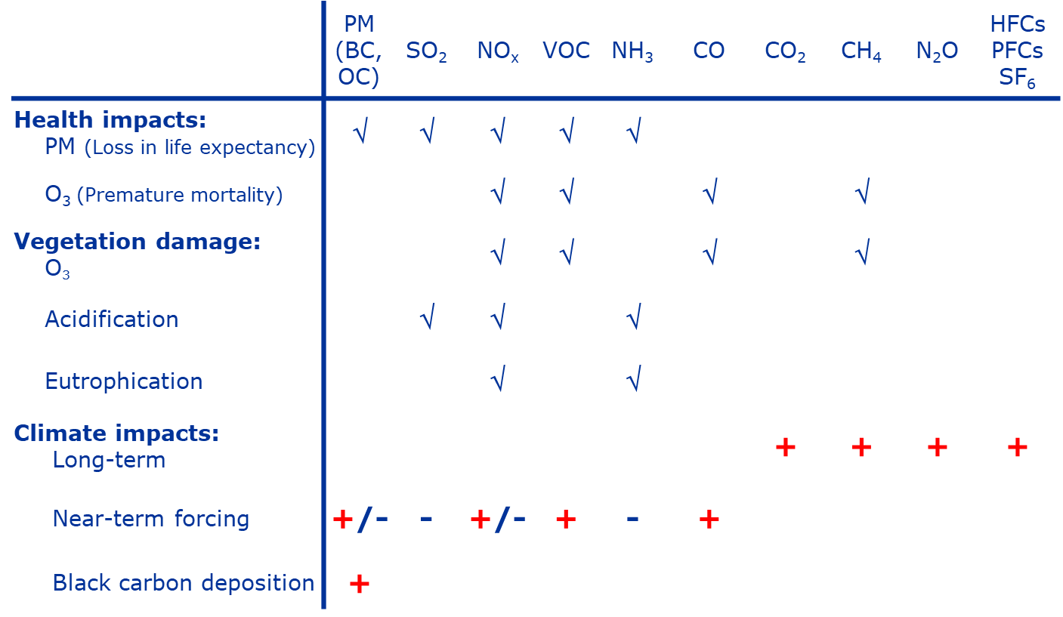
The Matrix
Notes:
Rows: different environmental impacts
Columns: different pollutants and precursors
Bad news: for a given impact, we need to take into account multiple pollutants. Need to understand the atmospheric physics and chemistry
Good news: once a particular is targeted for reduction, more than one impact will be affected -> potential for economic benefits when setting targets on multiple indicators simultaneously. This is a strong argument for multi-effect environmental regulation/policies

Slide 10
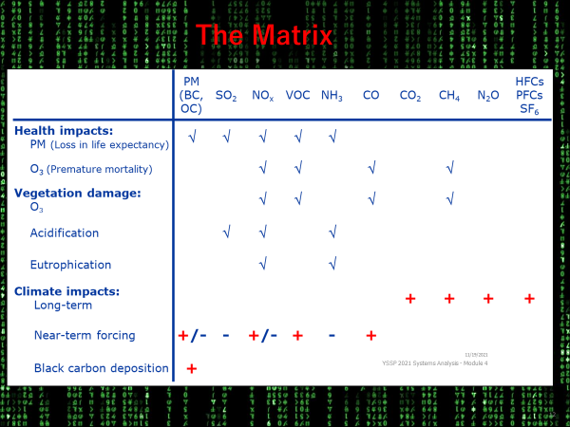
Why is it difficult to find cost-effective measures?
Multiple pollutants are
responsible for environmental
impacts
-> Which pollutants should be targeted?

Slide 11
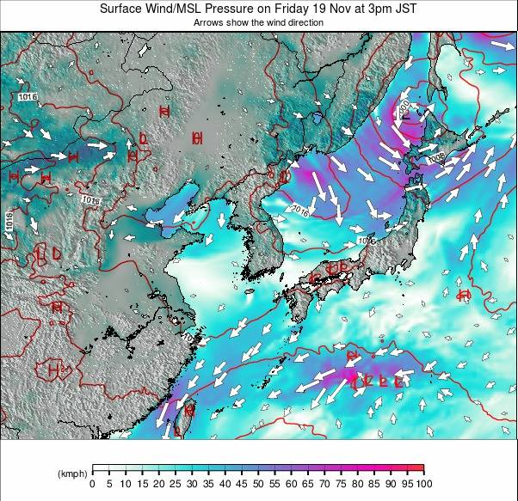
Why is it difficult to find cost-effective measures?
Transboundary transport:
pollution may come from
far-away sources
Is it best to reduce local emissions
or transboundary fluxes?

Slide 12
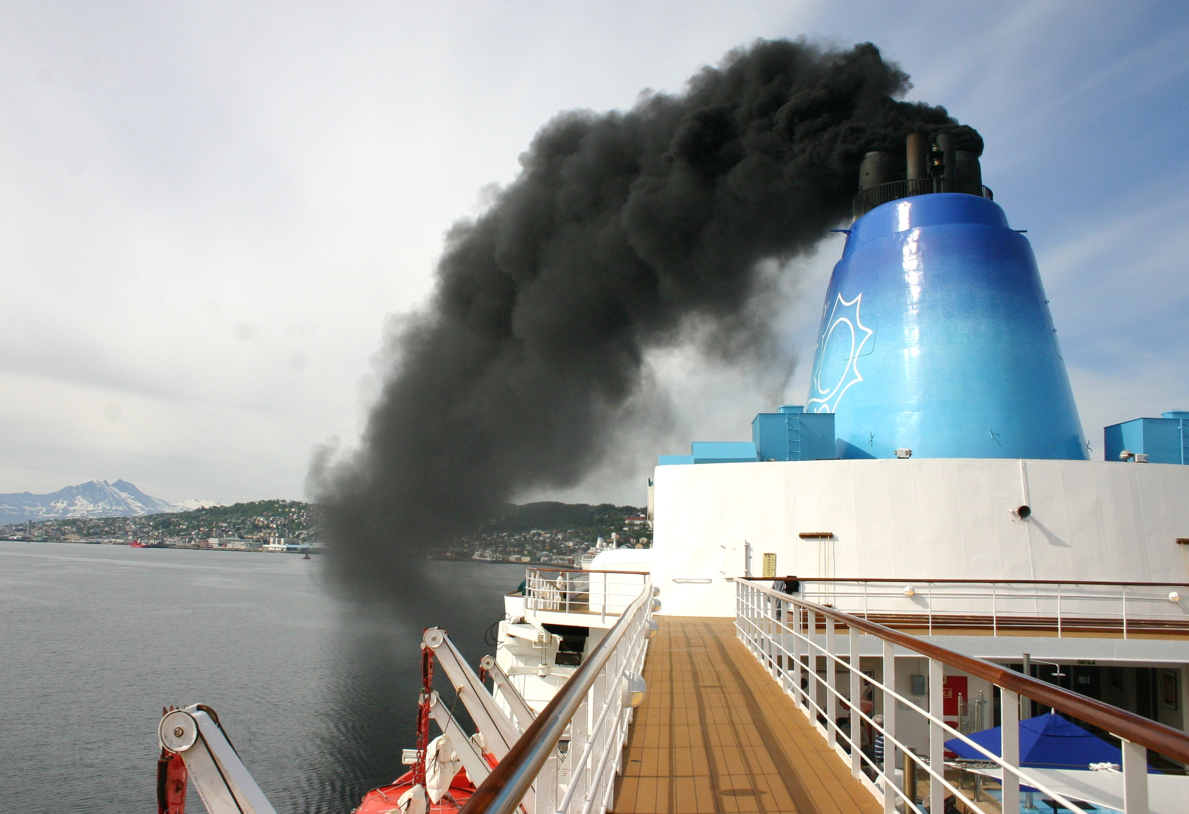






Why is it difficult to find cost-effective measures?
Emission occur in many
different economic sectors,
many different technologies
are available
Which sectors should be targeted?

Slide 13


Why is it difficult to plan with cost-effective measures?
The future is uncertain
So even if we plan for the best
solution for the future, the actual
future may turn out to be
different

Slide 14
Method: the GAINS tool
[Greenhouse gas–Air pollution Interactions and Synergies]
Social development
and economic activities
National Emissions Ceilings
Emission control options: ~2000 measures,
co-control of 10 air pollutants and 6 GHGs)
Emissions
Costs
Optimization
Atmospheric dispersion
Health, ecosystems and climate impact indicators
Policy targets
GAINS is an online tool available at https//gains.iiasa.ac.at
Notes:
The GAINS framework can handle the above challenges, because it is a comprehensive framework.
Next:
What indicators should we set targets on?

Slide 15
What indicator should policy targets be set on?
Option
Pros
Cons
Ambient air quality standards
at every location in a domain
[e.g. 10 mug/m3]
No one is left behind:
Everyone can experience a minimum air quality standard
Targets are highly constrained
by how much can be improved in the worst polluted areas
PM2.5 impacts have no lower threshold:
Reductions below the target are ignored
Total aggregate exposure
of the population
to PM2.5 concentrations
(~health burden)
Maximizes public health
benefits for a given budget
Cannot guarantee minimum air quality standards for everyone

Slide 16
Which is the approach taken by the EU Commission?
2013
National Emission Ceilings Directive
2023
Revision of the Ambient Air Quality Directive
Reduce aggregate mortality impact
of PM2.5 by 67% relative to 2005.
Uniform limit values at all locations
(grid cell averages, e.g. 5, 10 or 15µg/m3)
National Emission Ceilings for 2020
of PM2.5 and precursors
National Emission Ceilings [?] for 2030
of PM2.5 and precursors
Notes:
Summary:
- Two seperatey air quality management processes

Slide 17
What indicator should policy targets be set on?
Option
Pros
Cons
Ambient air quality standards
at every location in a domain
[e.g. 10 mug/m3]
No one is left behind:
Everyone can experience a minimum air quality standard
Targets are highly constrained
by how much can be improved in the worst polluted areas
PM2.5 impacts have no lower threshold:
Reductions below the target are ignored
Total aggregate exposure
of the population
to PM2.5 concentrations
Maximizes public health
benefits for a given budget
Cannot guarantee minimum air quality standards for everyone
Notes:
We have seen above that both target types of target indicators have drawbacks. Can we develop indicators that avoid the short-comings?
Not fully, but the next slide introduces the highly efficient “gap closure” approach to target setting, and applying this approach ensures that
on the one hand very ambitious targets can be set also in an international context, and the ambition levels of different countries (and for different impact indicators) can be compared
while at the same time, the distribution of benefits across high- and low-polluted areas follows principles of equity and efficiency
and no-threshold effects can be targeted in an effective way.

Slide 18
A fair method for target setting: “gap closure”
Example: pop-weighted PM2.5 concentration in 1 region
50
Current Legislation (“CLE”) (baseline)
“Gap”
35
Gap = 50-20=30
Close the gap by 50%:
50-50% x Gap = 50-0.5 x 30 = 35
35 brings us 50% closer to 20 (MTFR) than 50 (CLE)
20
Maximum technically feasible reduction - MTFR
0
Notes:
Explanation of the example

Slide 19
A fair method for target setting: gap closure
Example: pop-weighted PM2.5 concentration in 2 regions
Region 2
68
Region 1
50
CLE
48
Close the gap by 50%
“Gap”
35
28
20
MTFR
0
Absolute targets are different – but the ambition level is the same

Slide 20
Target setting:
“Nice properties” of the gap closure approach
A common level across regions establishes a sense of fairness, as all regions make the same progress towards their maximum ambition level (“Fairness within capabilities”)
Gap closure percentages intuitively translate into ambitions:
  0% = stay at current legislation
  100% = do maximum reductions
The gap closure approach can be applied to different indicators: emissions, concentrations, [health impacts, ecosystem impacts, …]

Slide 21
Setting a specific target:
Examples of the resulting cost-effective measures
SO₂
Notes:
We have used the gap closure approach in numerous policy applications, incl. for EU and CLRTAP
Procedure:
Choose a uniform gap closure percentage for each target indicator
Run cost-effectiveness analysis
The resulting measures represent the most-effective strategy
They will be different for each country and pollutant (see above)
IE: start with a uniform target, get very country-specific policy recommentations that reflect the full complexity of the system

Slide 22
Setting a specific target:
Examples of the resulting cost-effective measures
NO_{x}
Notes:
See above, here for NOx

Slide 23
Targets used in the Revision of the Gothenburg Protocol
50% gap closure on PM2.5 exposure (population-weighted concentration)
AND 60% gap closure on accumulated area exceeded (eutrophication)
PM2.5 concentration
Eutrophication
CLE
CLE
50%
60%
MTFR
MTFR
Notes:
Example from revision of Gothenburg Protocol

Slide 24
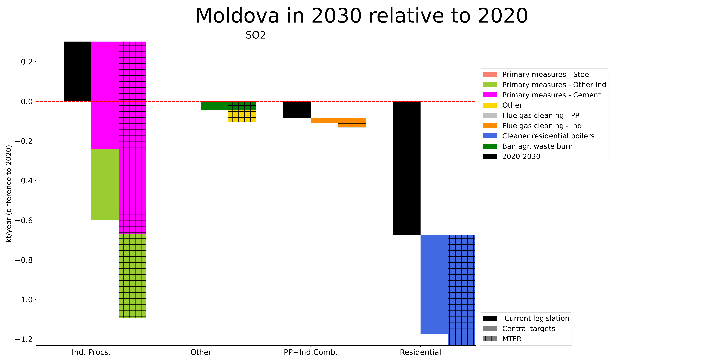
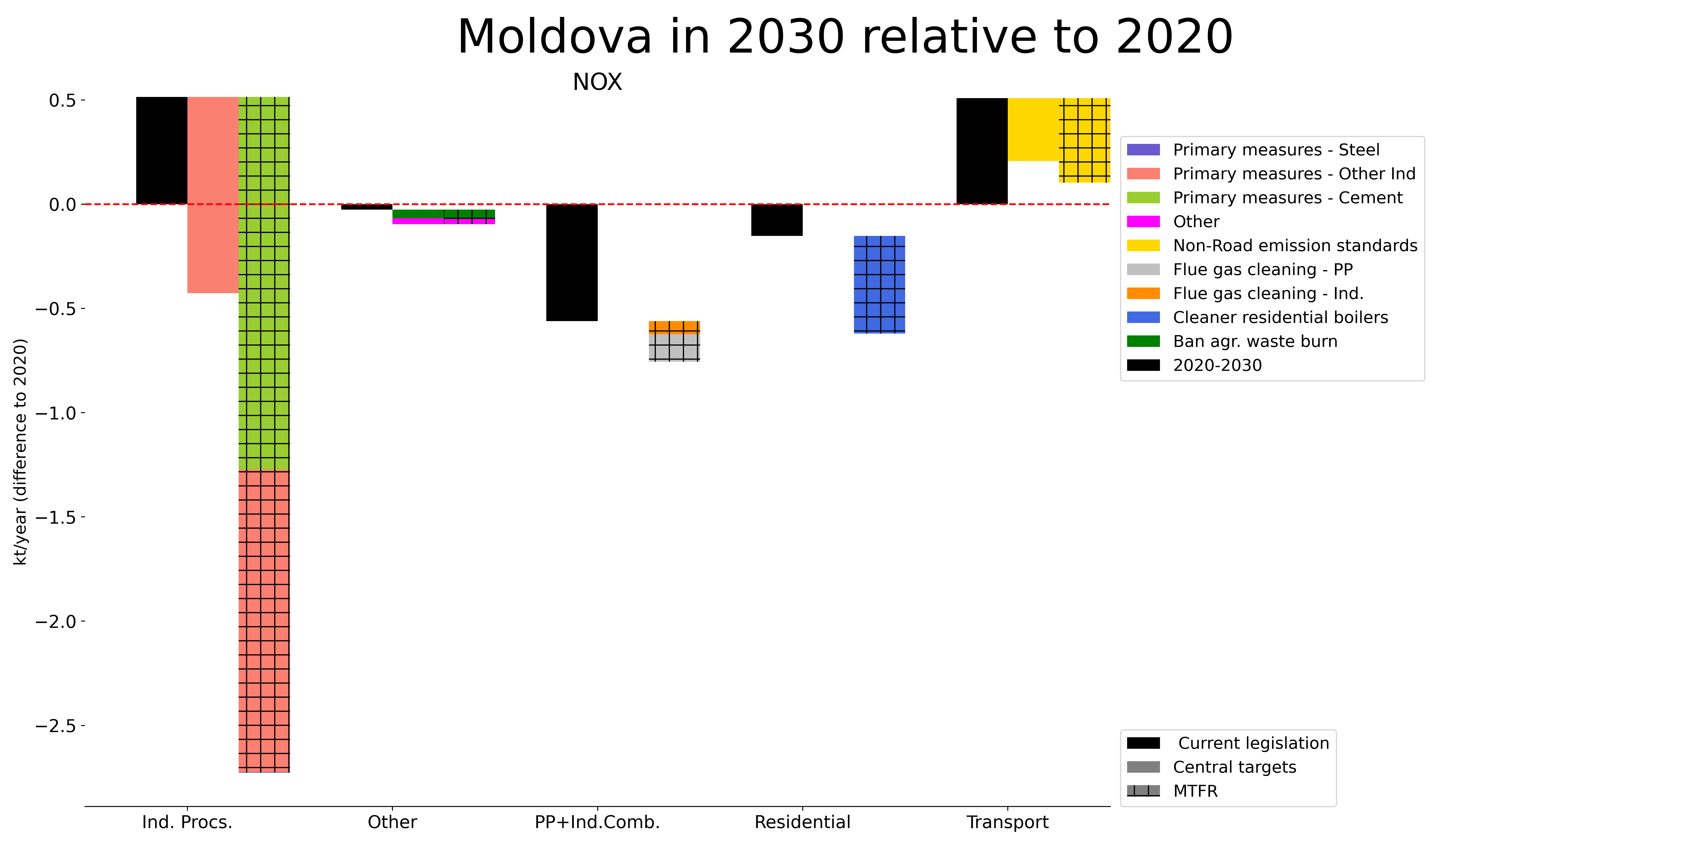
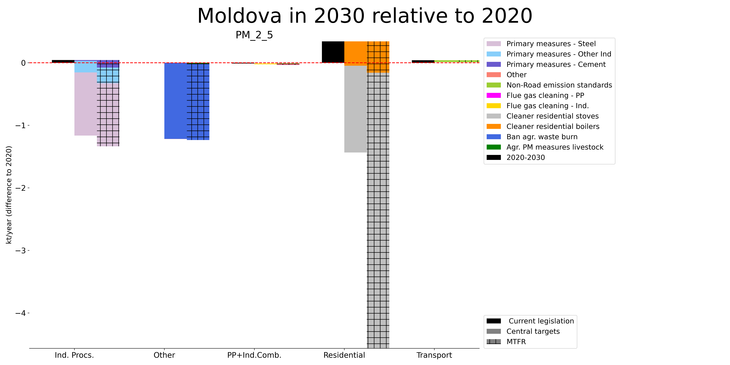
Example Moldova

Slide 25
Method: the GAINS tool
[Greenhouse gas–Air pollution Interactions and Synergies]
Social development
and economic activities
National Emissions Ceilings
Emission control options: ~2000 measures,
co-control of 10 air pollutants and 6 GHGs)
Emissions
Costs
Optimization
Atmospheric dispersion
Health, ecosystems and climate impact indicators
Policy targets
GAINS is an online tool available at https//gains.iiasa.ac.at
Notes:
Let’s come back to this overview.
How do you do the optimization?

Slide 26
Optimization: a primer
Linear optimization of air pollution control strategies in GAINS:
Objective: minimize (Costs)
s.t. EnvEffect_{k} < Limit_{k}
Minimize costs, such that environmental effects do not exceed pre-defined limits
(+additional technology constraints)

Slide 27
Types of constraints
Environmental/Impact targets (see below)
Generic technology constraints
  Maximum application rates/shares not suitable for controls
  Vintage structure
  Fixed application rates
Average emission factors (per sector/activity) can only decrease, not increase. [Emission standards can only become stricter]

Slide 28
Three uses of the GAINS optimization routine
Calculate the maximum technically feasible (MTFR) scenario
Calculate a scenario with a policy objective
Calculate a cost curve
Analyze portfolio of measures
Analyze sequence of measures

Slide 29
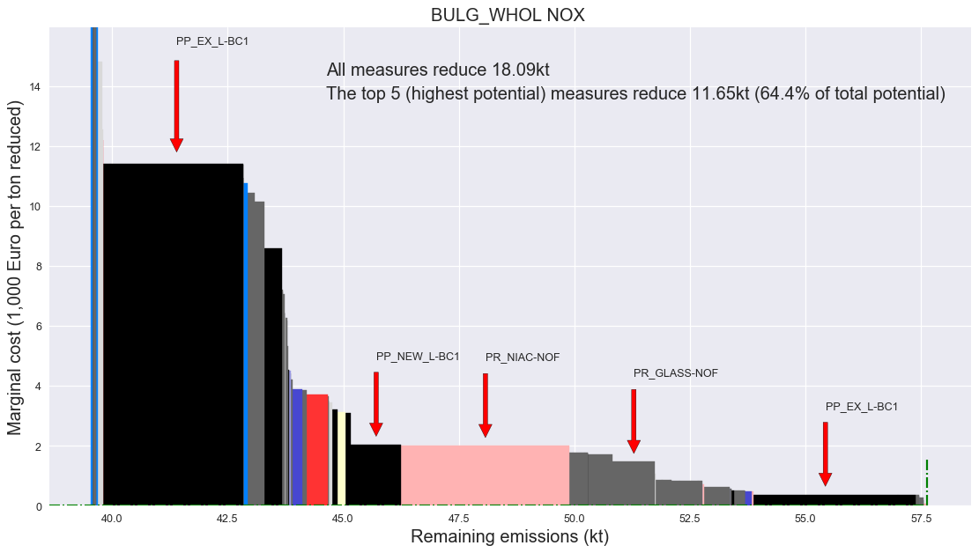
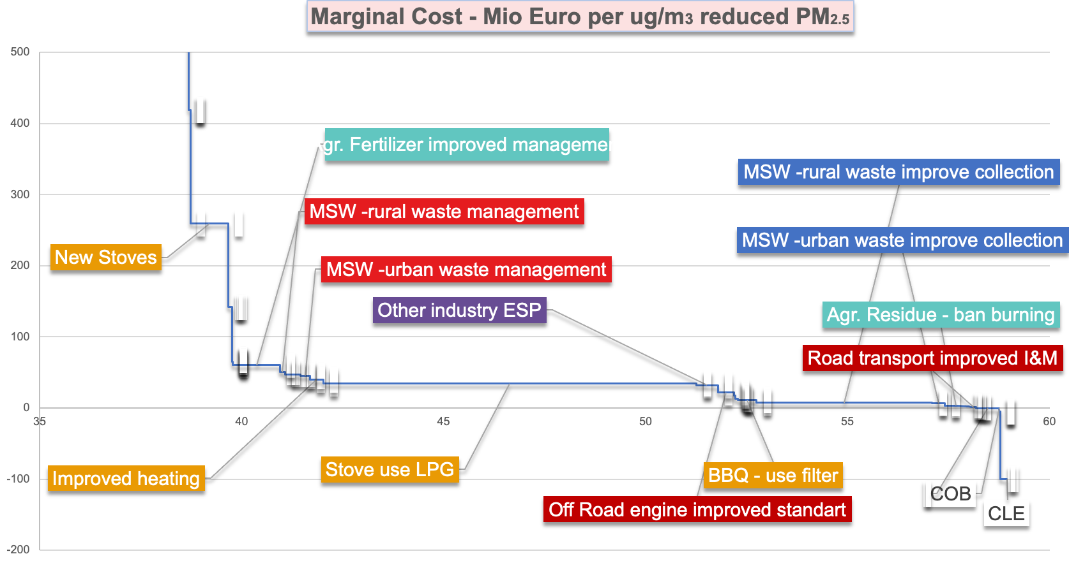
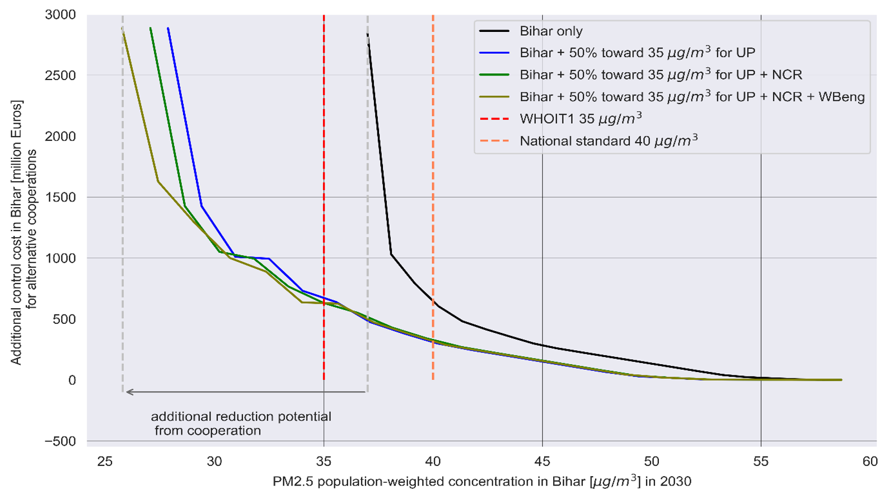
Cost curves: single pollutant / local concentration / full regional cooperation
Notes:
Three types of cost-curves can be calculated.

Slide 30
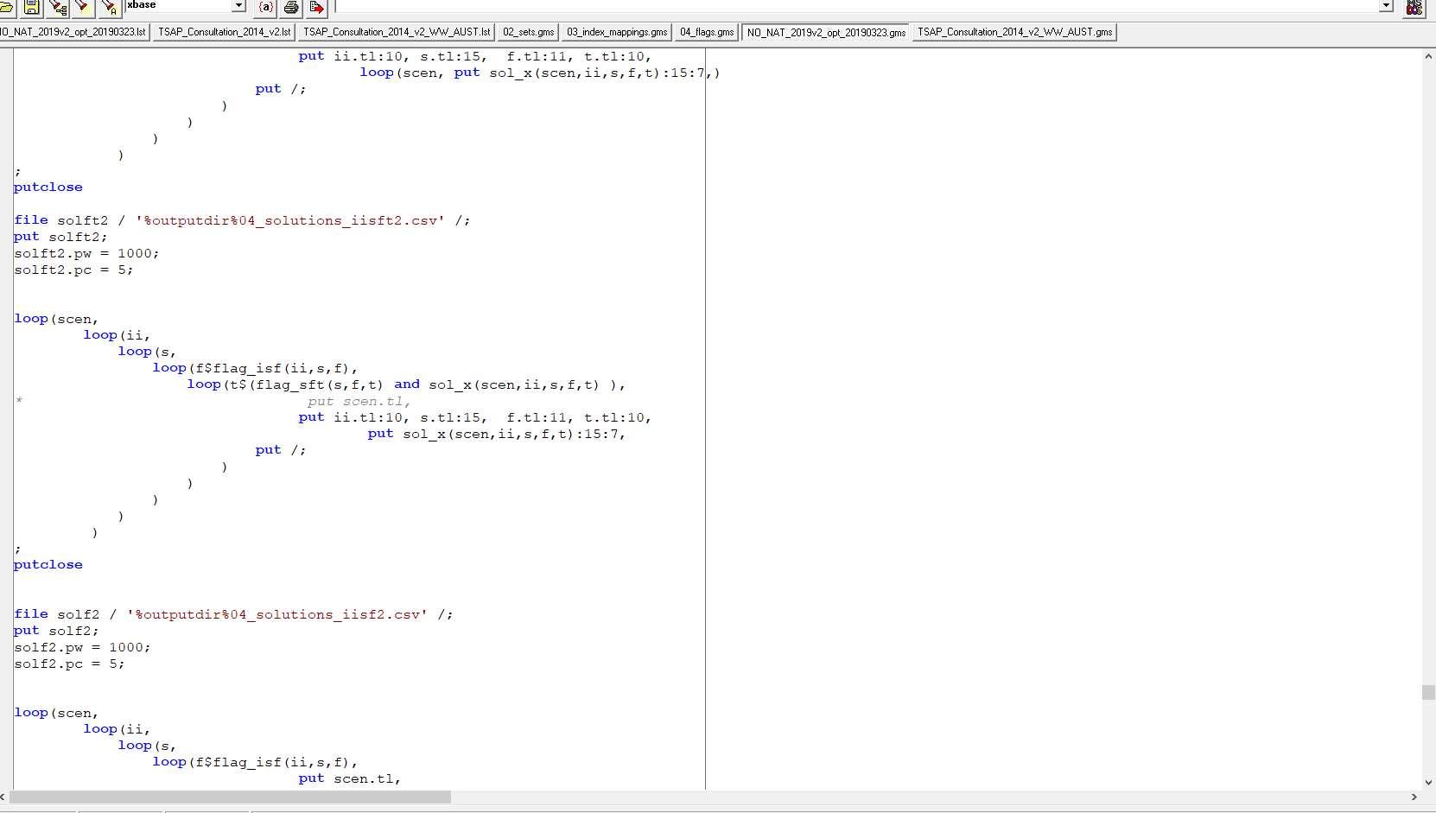
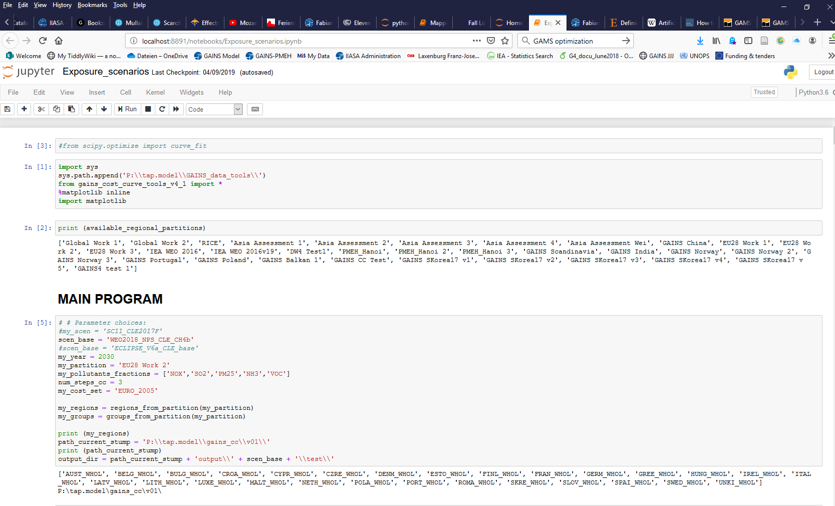
Implementation
Implementation in GAMS
(General Algebraic Modeling System)
www.gams.com
This is a licensed software (approx. 3,000 USD)
Simple iPython Interface – builds on GAMS
Browser-based
Open source

Slide 31


Slide 32
Conclusions
Cost-effectiveness analysis allows to focus on physical targets in the context of economic prudency without implicit valuation of non-marketable goods (e.g. year of life gained, biodiversity)
Targets can be formulated e.g. as AQ standards or public health targets
The gap closure approach to target setting introduces "fairness within capabilities" as a guiding principle for effort and benefit sharing, and a uniform level of ambition across regions
Examples from policy making in Europe illustrate the benefits of coordinated or even integrated transboundary approaches to air quality management
Two questions can be separated: (1) what is the most cost-effective strategy [who does what?] (2) who is going to pay for it? [Side-payments can make the overall cost-effect strategy more palatable for all countries]

