Slide 1
The GAINS model: power generation
EECCA workshop on the GAINS model
Peter Rafaj (rafaj@iiasa.ac.at)
Pollution Management (PM) Group
Energy, Climate and Environment (ECE) Program, IIASA
7 November 2023

Slide 2

Power generation sector in GAINS - topics
Structure of the sector
Activity projections
Emission factors
Control strategies
Data sources
Online interface

Slide 3
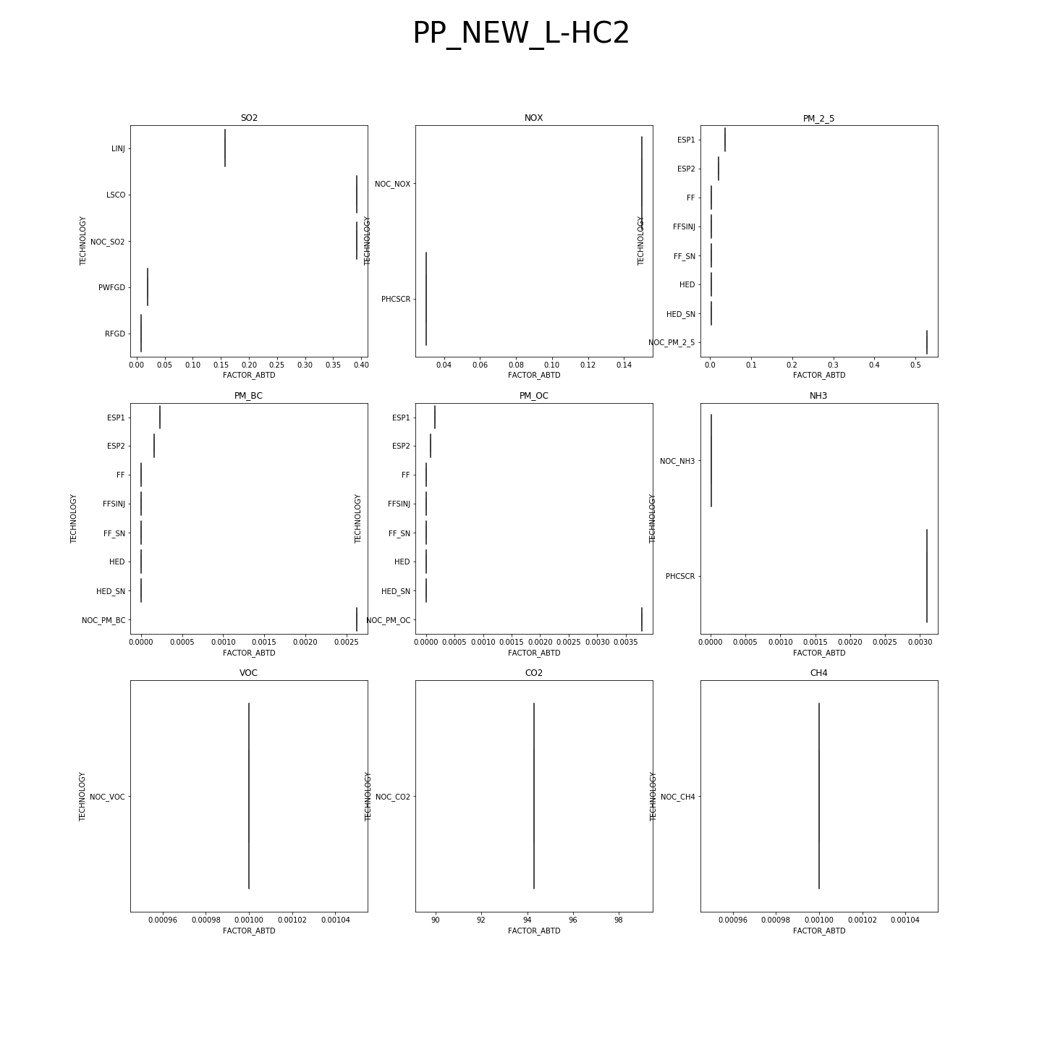
Defining future GAINS scenarios
Pulling together 3 components:
Activity data
Control strategies
Emission factors
+
+

Slide 4
Emission calculation principles
i,j,k,m | Country, sector, fuel, abatement technology
E_{i} | Emissions in country i
A | Activity in a given sector
Ef | “Raw gas” emission factor
eff_{m} | Reduction efficiency of the abatement option m
X_{m} | Implementation rate of the considered abatement measure m

Slide 5
Fuel Categories in GAINS
Combustible
Coal
  -Hard coal (3 grades)
  -Lignite (2 grades)
Oil products
  -Heavy fuel oil
  -Diesel, Gasoline, LPG
Gaseous fuels
  -Natural gas
  -Derived gases
  -Biogas
Biomass
  -Fuelwood
  -Residuals
Waste
  -Renewable
  -Industrial
Non-Combustible
Hydro
Solar
Wind
Geothermal
Nuclear
Electricity
Heat

Slide 6
Structure of the electricity and conversion sectors
Power and heat generation
Power plants
Heating plants
CHPs
Existing
New (after y. 2000)
Modern
Large units (>50MWth)
Small units
No-CCS
CCS
DG sets
Engines
Fuel-specific classification
COAL
Subcritical
(Ultra)supercritical
IGCC
GAS
Steam / boilers
Gas turbine
NGCC
BIOMASS
Same as coal
no co-firing
Fuel conversion
Conversion processes
Own use
Losses
Refineries
Coking plants
Liquefaction
Boilers
Combustion

Slide 7
Activity data sources
International databases:
IEA, EUROSTAT
UN
USGS
Local databases:
National statistics
Provincial statistics
Projections (examples):
PRIMES - Europe
WEO, MESSAGE - Global
Other IAMs

Slide 8
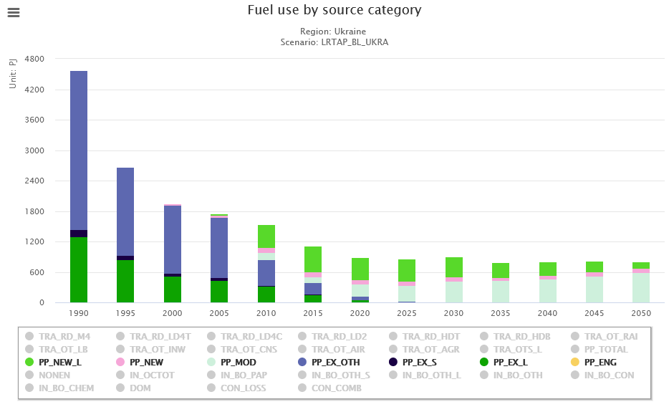
Activity projections - example

Slide 9
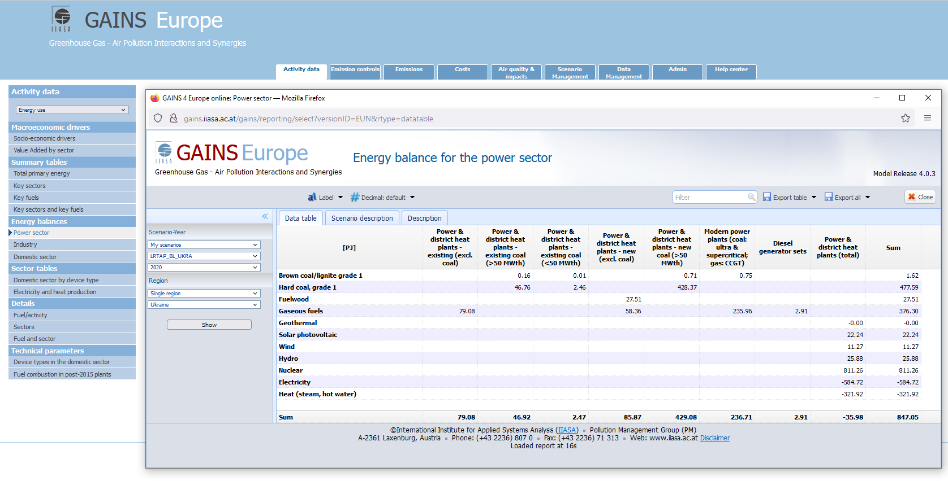
Visualization in GAINS online - example

Slide 10
Emission factors for SO₂, NO_{x}, and PM
Combustion–related emissions:
  Unabated factors depend on combustion installation, fuel type and fuel quality
    Either calculated based on fuel quality parameters
    Or based on measurements for typical installations
  Abated factors depend on controls
    Efficiency of abatement technology
    Application rate of technologies / measures (time depended)

Slide 11
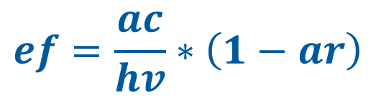
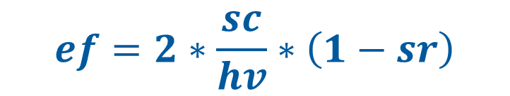
Emission factors calculation
SO₂
PM
$$ef=2∗\frac{sc}{hv}∗\left(1−sr\right)$$
$$ef=\frac{ac}{hv}∗\left(1−ar\right)$$
ef | “Raw gas” emission factor
sc | Sulphur content of a fuel
hv | Lower heating value
sr | Sulphur retention in ash
ef | “Raw gas” emission factor
ac | Ash content of a fuel
hv | Lower heating value
Ar | Ash retention in boilers

Slide 12
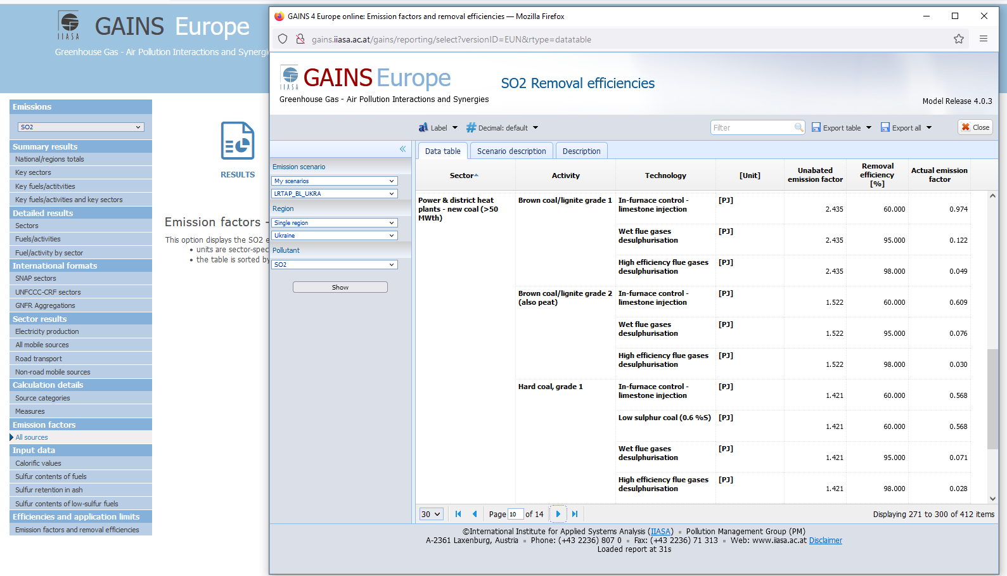
Visualization in GAINS online - example

Slide 13
Emission control options for SO₂
Use of low sulfur coal 0.6% S
Use of low sulfur heavy fuel oil 0.6% S
Use of low sulfur diesel (3 stages) 0.2 - 0.001% S
Use of low sulfur gasoline 0.001% S
In- furnace control (limestone inj.) 60%
Flue gas desulfurization 85 - 95%
Wet FGD 90%
Advanced flue gas desulfurization 98%

Slide 14
Emission control options for NO_{x}
For stationary sources
  Combustion modifications 20 - 65 %
  SNCR 70 %
  SCR 80 %
  CM + SCR combined
For small sources (engines)
  Euro equivalents 30 – 90 %

Slide 15
Emission control options for PM
For stationary sources
  Cyclones 30%
  Wet scrubbers 50 – 93%
  ESPs (1 and 2 fields) 93 – 96%
  ESP3 and fabric filters 99 – 99.5%
  Good practices
For small sources (engines)
  Same as for NOx

Slide 16
Control strategy in emission scenarios
  It is a way of defining legislation in GAINS
  Includes a list of all measures and contains non-zero values for implemented measures in the defined policy
  The values reflect the level of application as a percentage of total activity in the sector
  For each technology the value is between 0% and 100%
  % is always relative to activity
  For power plants activity means fuel input

Slide 17
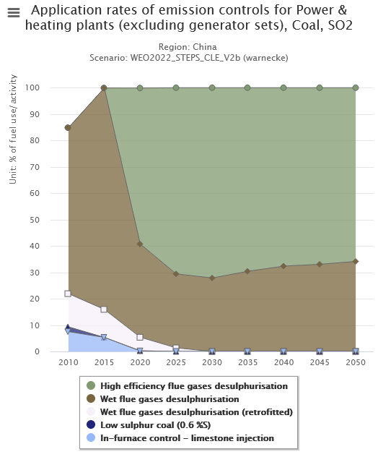
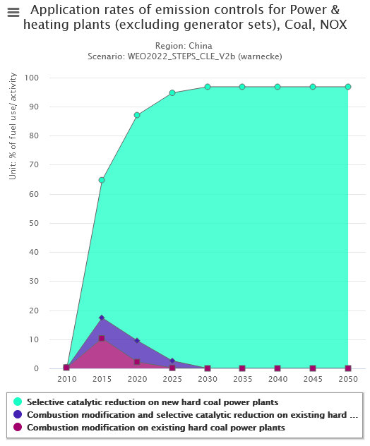
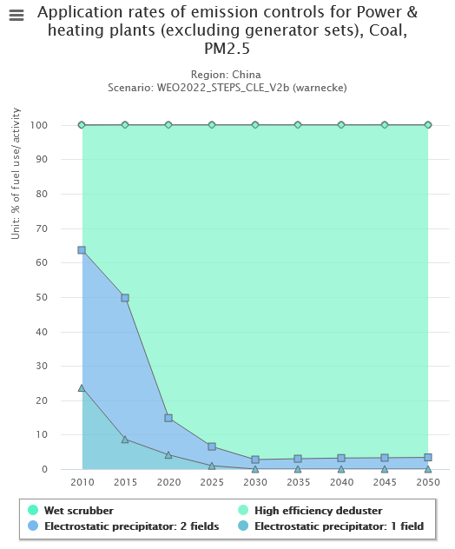
Application rates of abatement measures: % of activity

Slide 18

How do I calculate a control strategy?
Example: Coal-fired power plants
STEP 1: Start with capacities: Total = 800 MW_{el}
250 MW_{el}
500 MW_{el}
50 MW_{el}

Slide 19
How do I calculate a control strategy?
Step 2: Calculate fuel input per year, using
    Operating hours per year
    Conversion efficiency
250 MW_{el}
500 MW_{el}
2,000 hours/yr, 30% efficiency
6.0 PJ/yr = 20%
4,000 hours/yr, 35% efficiency
50 MW_{el}
20.6 PJ/yr = 69%
6,000 hours/yr, 32% efficiency
3.4PJ/yr = 11%

Slide 20
How do I calculate a control strategy?
Step 3: Determine control technology in operation
6.0 PJ/yr = 20%
20.6 PJ/yr = 69%
e.g. lime stone injection
e.g. flue gas desulfurization
3.4PJ/yr = 11%
e.g. no control

Slide 21
How do I calculate a control strategy?
Apply control strategy here

Slide 22
How do I calculate a control strategy?
No control = 11%
Lime stone injection = 20%
Flue gas desulphurization = 69%

Slide 23
What is the origin of GAINS data?
[emission factors and ef parameters, reduction efficiencies and costs of abatement]
Guidebooks (EEA/EMEP, AP-42, BUWAL)
UNECE Expert Groups
National submissions (consultations)
International databases, e.g., CEPMEIP
Industrial associations
Peer-reviewed literature
Grey literature
Own expertise

Slide 24
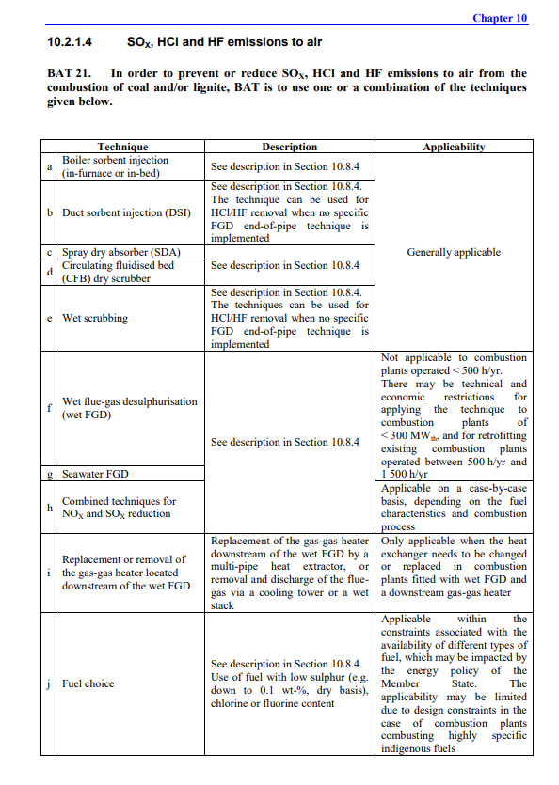
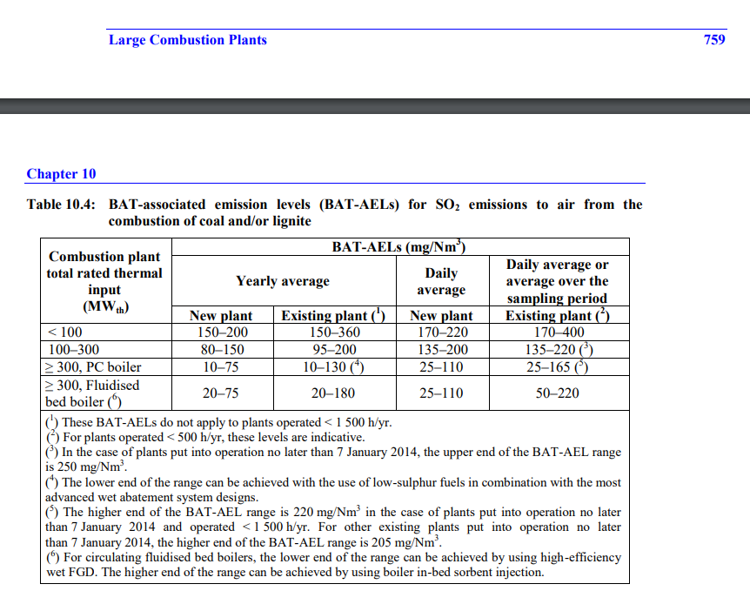
    Comparison to legislation

Slide 25
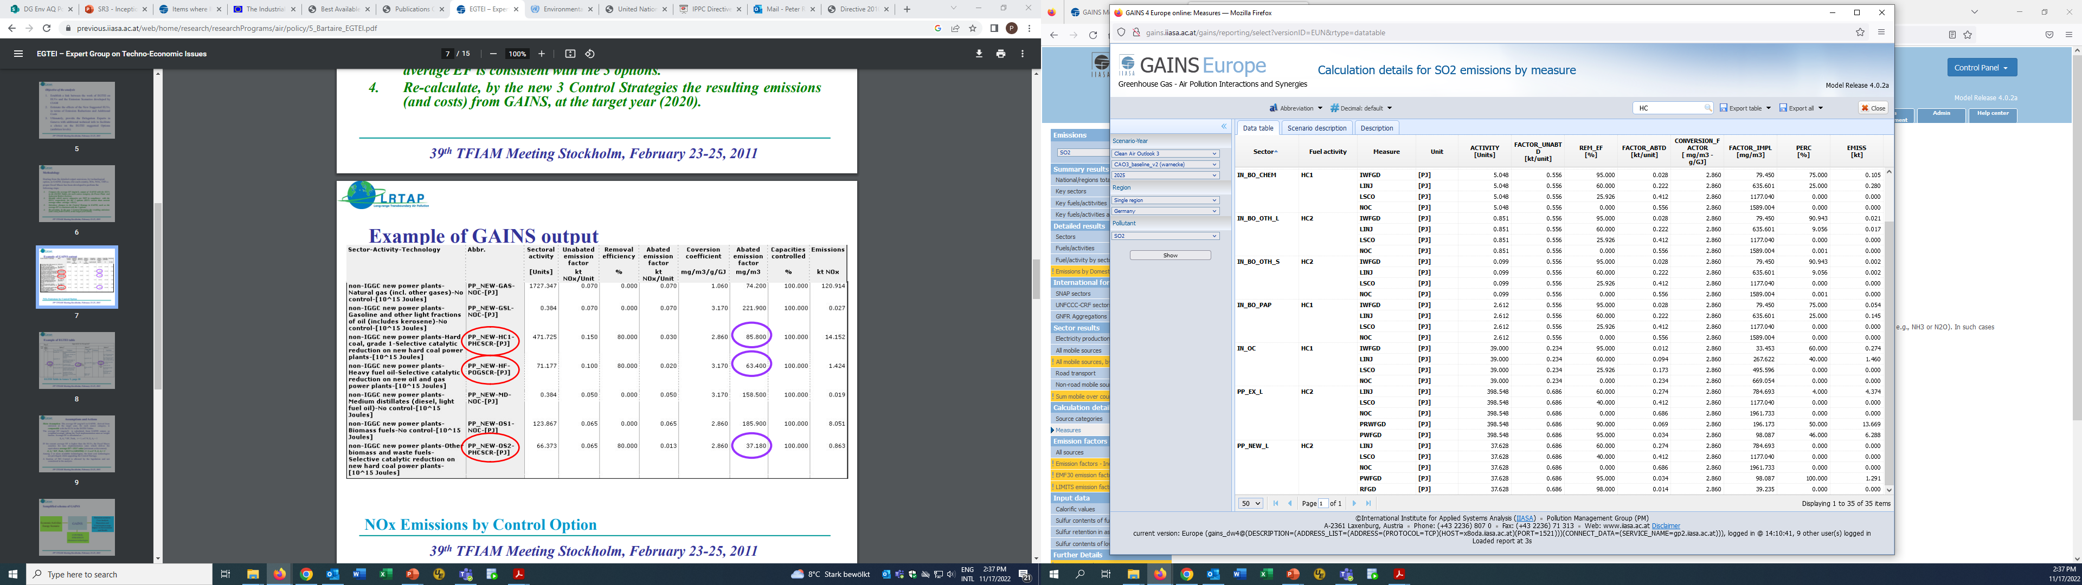
    Mapping and calibration of control strategies
130
127

Slide 26
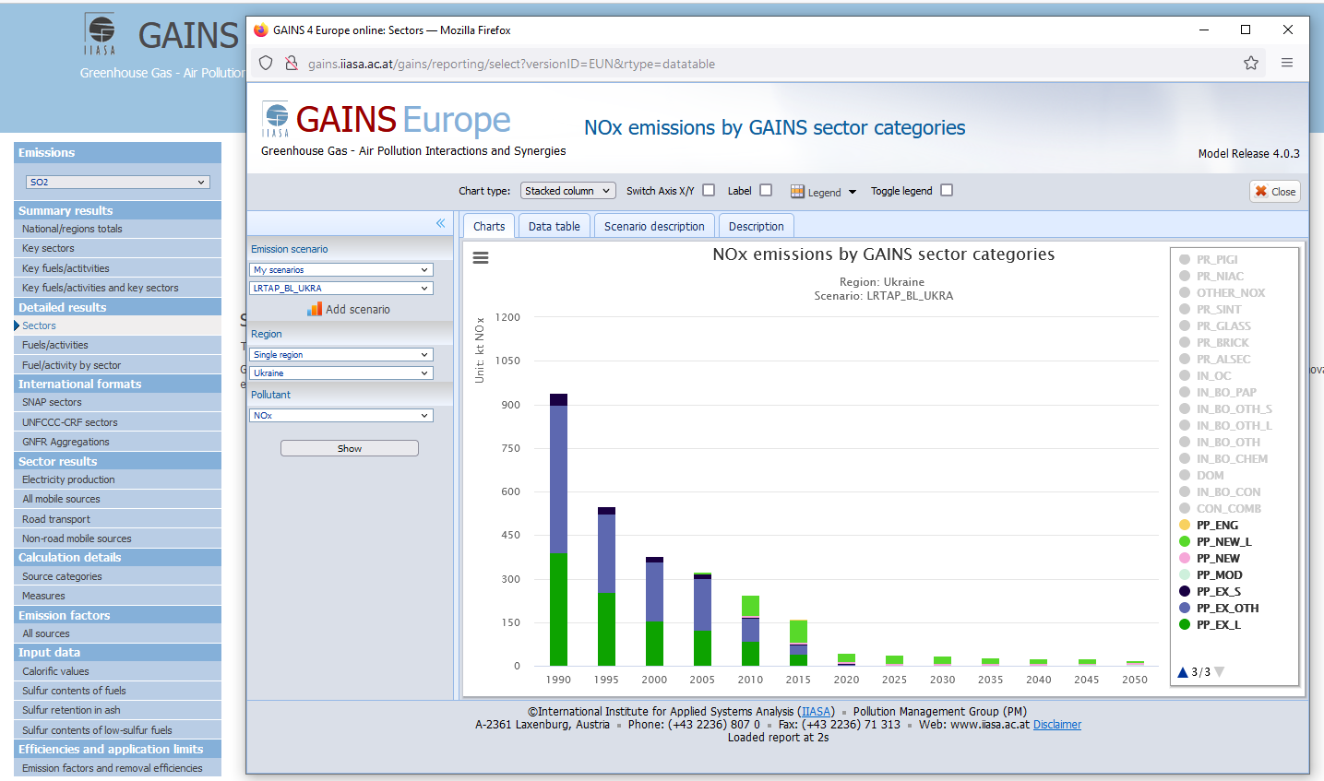
Visualization in GAINS online - example

Slide 27
rafaj@iiasa.ac.at

