Slide 1
The GAINS Model: residential combustion
Pallav PUROHIT (E-mail: purohit@iiasa.at) and Zbigniew Klimont
IIASA - Energy, Climate and Environment (ECE) Program
Pollution Management (PM) Research Group
EECCA workshop on the GAINS model
6-10 November 2023

Slide 2
Contents
Importance of the Domestic Sector in EECCA Countries
An Overview of the Domestic Sector in GAINS
Modelling of the Domestic Sector in GAINS
Hands-on Training

Slide 3
Importance of the Domestic Sector in EECCA Countries

Slide 4
Solid fuel use in EECCA countries
17%
66%

Slide 5
Air pollutant emissions in Armenia: National vs. GAINS (2020)
National – 91%
GAINS – 63%

Slide 6
Air pollutant emissions in Georgia: National vs. GAINS (2020)
National – 77%
GAINS – 40%

Slide 7
Air pollutant emissions in Kazakhstan: National vs. GAINS (2020)
National – 28%
GAINS – 39%

Slide 8
Air pollutant emissions in Moldova: National vs. GAINS (2020)
National – 88%
GAINS – 74%

Slide 9
Air pollutant emissions in Ukraine: National vs. GAINS (2020)
National – 34%
GAINS – 19%

Slide 10
Domestic Sector in GAINS

Slide 11
Domestic sector in GAINS
Domestic sector (DOM)
Residential
DOM_RES
Commercial
DOM_COM
Other
DOM_OTH
Lighting
DOM_LIGHT
Agriculture
forestry, fisheries, etc.
DOM_RUR
DOM_URB

Slide 12
Domestic sector: Fuel and source structure in GAINS

Slide 13
Mapping to the GAINS structure (example)

Slide 14
Mitigation measures in the domestic sector

Slide 15
Emissions
Total emissions are determined by combination of
activity levels
control strategies
emission factors
Emissions = Activity level x % of capacity controlled x abated emission factor
i,j,k,m : Country, sector, fuel, abatement technology
E_{i} : Emissions in country i
A : Activity in a given sector
ef : “Raw gas” emission factor
eff_{m} : Reduction efficiency of the abatement option m
X : Implementation rate of the considered abatement measure

Slide 16
Modelling of the Domestic Sector in GAINS: Case study - India

Slide 17
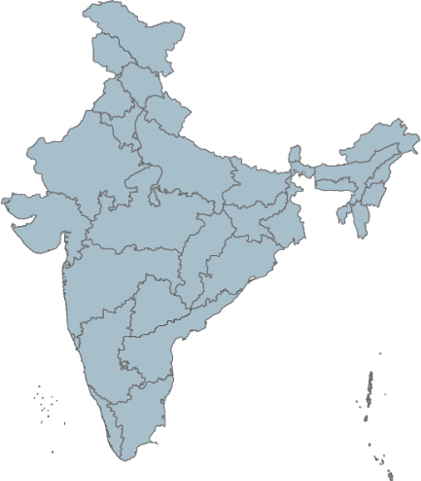
Model linkage

Slide 18
State-wise distribution of households by type of fuel used for cooking in rural and urban areas in India
Source: Census (2011)

Slide 19
Household energy consumption for cooking
Annual primary energy requirement for cooking
PE_{cooking} = 365*A_{fw}*CV_{fw}
Annual useful energy requirement for cooking (annual)
UE_{cooking} = 365*A_{fw}*CV_{fw}*η_{stove,fw}
Calorific value of fuelwood (MJ/kg)
Efficiency of traditional cookstove (%)
Average fuelwood consumption (kg/HH/day)
Daily useful energy requirement for cooking = 12.13 MJ/HH/Day
An average of 138 kg of LPG is required per household per annum to meet household cooking energy needs
≈9–10 LPG cylinders of 14.2 kg each in a year
≈11.3 to 12.5 MJ/HH/Day

Slide 20
Household energy demand for cooking
Annual primary energy demand for cooking (APE_{cooking})
$${APE}_{cooking}=365\sum_{i=j=1}^{m,n}{\frac{N_{i,j}ξ_{i,j}{UE}_{cooking}}{η_{stove,i}}}$$
Where
N_{i,j} = Number of households using i^{th} fuel in j^{th} State/UT
ξ_{i,j} = % of households using i^{th} fuel in j^{th} State/UT
UE_{cooking} = Daily useful energy requirement for cooking
η_{stove,i} = Efficiency of utilization of i^{th} fuel
Data sources
Census;
NSSO;
CSO;
Demographic and Health Survey (DHS)/IIPS

Slide 21
High contribution to ambient PM_{2.5} concentrations
PM_{2.5} concentration from residential and commercial sector
Source apportionment of (population-weighted) PM_{2.5} exposure - Kanpur 2018
30%
Source: IIASA GAINS

Slide 22
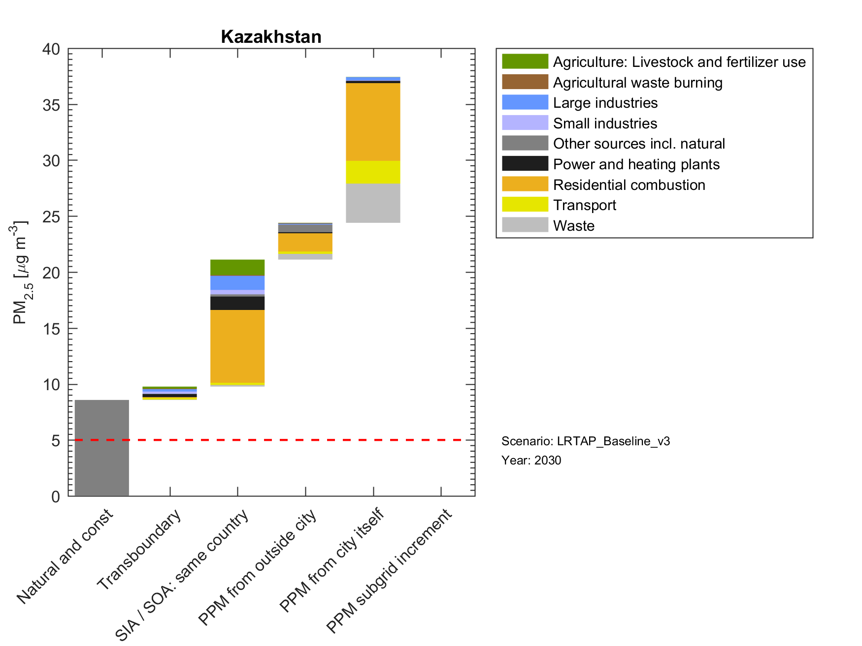
Country averages of cities - Kazakhstan
2015
2030
Cities with >50,000 inhabitants

Slide 23
Kerosene consumption for lighting
Annual kerosene consumption (AKC_{lighting}) for lighting in GAINS region “i” in year “y” is estimated by using the following ex-pression:
$${AKC}_{lighting}=\left(\frac{{POP}_{i.y}}{{HHS}_{i.y}}\right)\left(1−{ELE}_{i.y}\right) 365\sum_{j=1}^{n}{N_{i,j,y}h_{i,j,y}{CV}_{k}{f_{i,j,y} SC}_{j}}$$
where
POP = population,
HHS = household size,
ELE = electrification rate,
f = share of device type “j” (either wick lamps or hurricane lanterns),
N = number of kerosene lamps,
h = daily operating hours,
SC = specific kerosene consumption of a device
CV_{k} = calorific value of kerosene

Slide 24
Diesel generators
Fossil fuel-burning backup generators in developing countries produce as much energy as 700-1,000 coal-fired power stations, consume USD 50 billion in annual spending, and emit dangerous chemicals into homes and businesses.
DG sets in domestic sector
Residential (small back-up generators)
Commercial (small, medium and large BUGS)
Other (small, medium and large DG sets)
Data and Information gaps
Number of diesel generators (residential, commercial, industry, agriculture, etc.) or installed capacity
Capacity factor (???)-
Emission factor - Age (New/Old), Type (Large/small)

Slide 25
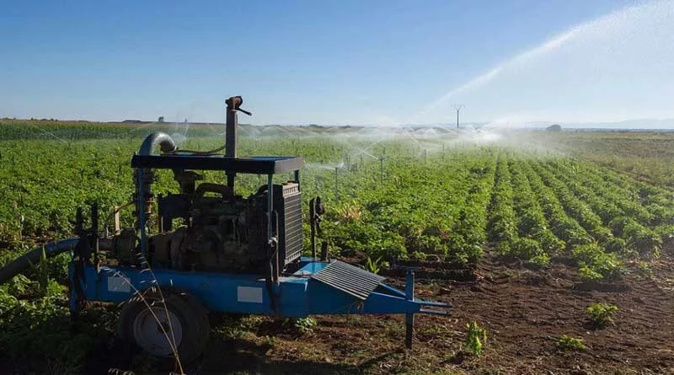
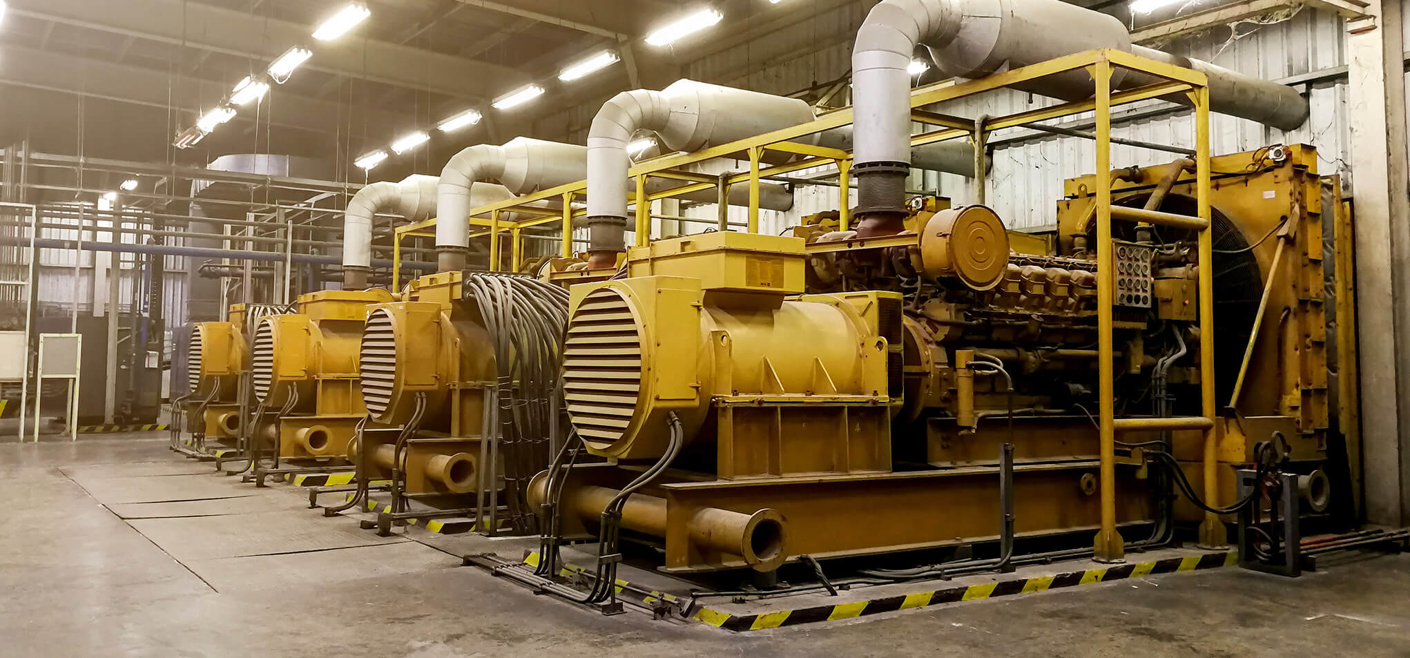
Diesel generators (Contd…)
DG sets
Electricity generation
Water pumping
PP_ENG
TRA_RD_LB

Slide 26
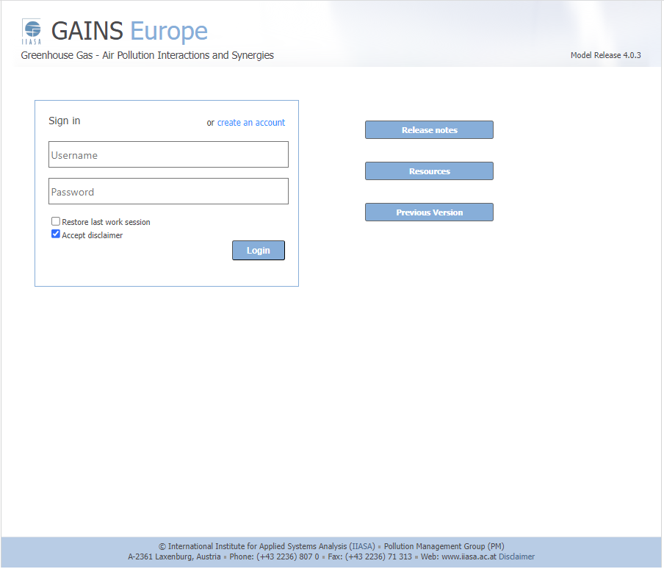

Slide 27
Tutorials
Activity data
What will be the total energy consumption in the domestic sector of Moldova in 2020 and 2030?
By what percentage total biomass consumption in Moldova will decrease in 2050 as compared to the year 2020?
Emissions
Develop an emissions inventory at sectoral level for PM_{2.5} emissions for 2020 in the baseline scenario for Georgia using the GAINS model?
Control strategies
What is the anticipated decrease in PM_{2.5} emissions from domestic sector expected from the full adoption of cyclones (MB_CYC) in in Residential Commercial Medium boilers (<1MW) – manual (DOM_MB_M) fueled by Hard coal, grade 1 (HC1) by the year 2025 in Kazakhstan? What will be the associated impacts?

Slide 28
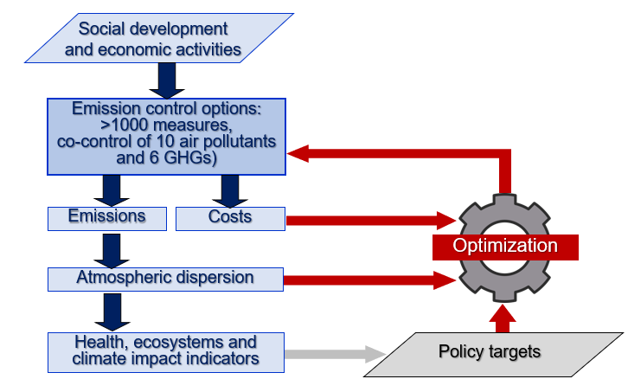
GAINS (Greenhouse gas and Air pollution INteractions and Synergies)
A tool for a systematic assessment of the cost-effectiveness of emission control strategies
GAINS quantifies sectoral emission control potentials and costs,
for exogenous (governmental, international agencies) activity projections,
considering physical and economic interactions between pollutants.
Search for least-cost mix of mitigation measures to meet air quality and/or GHG targets
GAINS is implemented for Europe, Asia, several single countries, and globally.
The model is available online http://gains.iiasa.ac.at/models/gains_models4.html

Slide 29
Dr. Pallav PUROHIT
Senior Research Scholar
Pollution Management Research Group
Energy, Climate, and Environment Program International Institute for Applied Systems Analysis (IIASA)
Schlossplatz 1, A-2361, Laxenburg, Austria
purohit@iiasa.ac.at www.iiasa.ac.at

