Slide 1
Data import and model documentation
Presented by Laura Warnecke
For the EECCA workshop on the GAINS model

Slide 2
Data import

Slide 3
Importing process
Data from external models
Mapping
Energy models:
IEA: World Energy Outlook data, global
PRIMES: Europe
POTEnCIA: Europe
Other IAMs, e.g.: AIM, MESSAGE, TIMES, GCAM
Agricultural models:
CAPRI: Europe
FAO: FAO Agricultural Outlook model results, global
Regional mapping
Sectoral mapping

Slide 4
Mapping table examples
AGGREGATION
GAINS Region | GAINS Fuel | GAINS Sector | Ext. model Region | Ext. model Fuel | Ext. model Sector
CHIL_WHOL | GSL | DOM_COM | CHILE | Oil | COMPUB
CHIL_WHOL | GSL | DOM_COM | CHILE | MODBIOLIQ | COMPUB
DISAGGREGATION
GAINS Region | GAINS Fuel | GAINS Sector | Ext. model Region | Ext. model Fuel | Ext. model Sector
AUTR_WHOL | HF | TRA_OTS_L | AUNZ | Oil | DOMESNAV
AUTR_WHOL | MD | TRA_OTS_L | AUNZ | Oil | DOMESNAV
AUTR_WHOL | GSL | TRA_OT_INW | AUNZ | Oil | DOMESNAV
AUTR_WHOL | MD | TRA_OT_INW | AUNZ | Oil | DOMESNAV
NZEL_WHOL | HF | TRA_OTS_L | AUNZ | Oil | DOMESNAV
NZEL_WHOL | MD | TRA_OTS_L | AUNZ | Oil | DOMESNAV
NZEL_WHOL | GSL | TRA_OT_INW | AUNZ | Oil | DOMESNAV
NZEL_WHOL | MD | TRA_OT_INW | AUNZ | Oil | DOMESNAV

Slide 5
Importing process
Data from external models
Mapping
Import routines, incl. downscaling
Data in the GAINS format
Energy models:
IEA: World Energy Outlook data, global
PRIMES: Europe
POTEnCIA: Europe
Other IAMs, e.g.: AIM, MESSAGE, TIMES, GCAM
Agricultural models:
CAPRI: Europe
FAO: FAO Agricultural Outlook model results, global
Regional mapping
Sectoral mapping
Pattern distribution
Seeding
Default ratios
Trend of drivers
Gap filling
Quality checks
Pre-checks, e.g.:
Are all inputs available?
Are there any new categories or changes in the naming?
Post-checks, e.g.:
Do the sums match?
Are there any negative numbers?

Slide 6
Disaggregation of inputs based on pattern scenario
GAINS Region | GAINS Fuel | GAINS Sector | Pattern scenario number in PJ | Share in % | New input data in PJ, disaggregated to GAINS categories
AUST_WHOL | HF | TRA_OTS_L | 0 | 0 | =0*2=0
AUST_WHOL | MD | TRA_OTS_L | 0 | 0 | =0*2=0
AUST_WHOL | GSL | TRA_OT_INW | 0.1 | 2.17 | =0.0217*2=0.0434
AUST_WHOL | MD | TRA_OT_INW | 1 | 21.74 | =0.2174*2=0.4348
NZEL_WHOL | HF | TRA_OTS_L | 3.5 | 76.09 | =0.7609*2=1.5218
NZEL_WHOL | MD | TRA_OTS_L | 0 | 0 | =0*2=0
NZEL_WHOL | GSL | TRA_OT_INW | 0 | 0 | =0*2=0
NZEL_WHOL | MD | TRA_OT_INW | 0 | 0 | =0*2=0
Sum |  |  | 4.6 PJ | 100% | 2 PJ
Input data
(AUNZ - DOMESNAV - Oil)

Slide 7
Model documentation

Slide 8
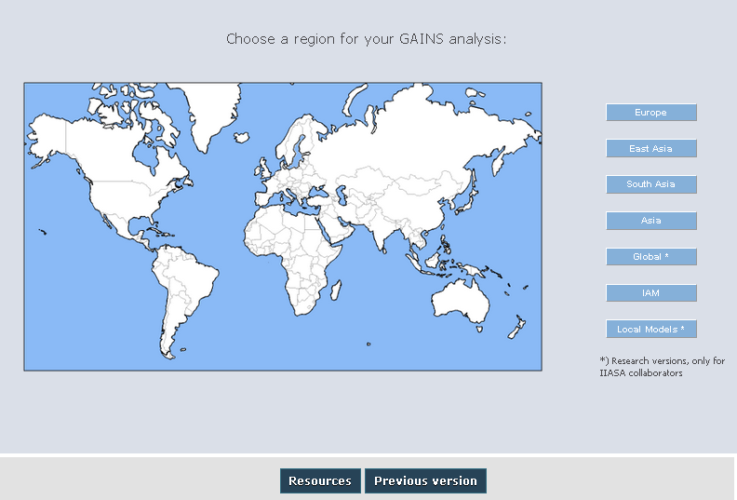
Help and resources in the online model
User guide/technical documentation
Release notes
Other technical reports
Peer-reviewed papers
Notes:
http://gains.iiasa.ac.at/models/gains_models4.html
http://gains.iiasa.ac.at/models/gains_resources.html

Slide 9
New documentation website
Notes:
I:\gueret\GAINS-doc-v1\build\html\start

Slide 10
Thank you for your time. Feel free to ask questions!

