Slide 1
Welcome to GAINS World
Zbigniew Klimont
Pollution Management research group;
Energy, Climate and Environment Program (IIASA)
EECCA Workshop on the GAINS model
6-10 November 2023, IIASA, Laxenburg, Austria

Slide 2
Purpose of the workshop
Improve capacity for scenario development and assessment, including data evaluation, emission projections and reduction targets, using GAINS model
Understanding purpose, strengths and limitations of GAINS
Understand key data sets used in GAINS
Understand key methods of GAINS
Hands-on (interactive) training supported by GAINS model team
…last but not least…
Get to know each other enabling future interactions and collaboration

Slide 3
Towards successful regional collaboration
Important ingredients in the EU/LRTAP* work
Science
Policy
Joint recognition of problems
Common agreed objectives and goals
Establishing and institutionalizing expert networks
Accepting science tools to support discussion and negotiations
Building trust and common language
*LRTAP - UNECE Convention on Long-Range Transboundary Air Pollution

Slide 4
Why integrated assessment models?
Uniform or effect-based scenarios?
Example from discussion leading to Gothenburg Protocol (1999)
There are large differences in the contribution
of different sources to ambient PM_{2.5}
Netherlands
Poland
2005 WHO guideline
Source: GAINS model (IIASA) – from the analysis for the UNECE Gothenburg Protocol (left) and EU Thematic Strategy for Air Pollution (right)

Slide 5
Why integrated assessment models?
Cost-effectiveness approach
Models help to separate policy and technical issues
Decision makers
Models
Decide about:
Ambition level (environmental targets)
Level of acceptable risk
Willingness to pay
Identify cost-effective and robust measures:
Balance controls over different countries, sectors and pollutants
Regional differences
Side-effects of present policies
Maximize synergies with other air quality (and climate) problems
Search for robust strategies

Slide 6
Purpose of Integrated Assessment Models (IAMs) in air quality and climate policy development/revision/assessment
Assess future situations based on current trends and policy interventions
Identify cost-effective and win-win packages of policy interventions
Reveal multiple benefits of policy interventions for diverse stakeholders

Slide 7
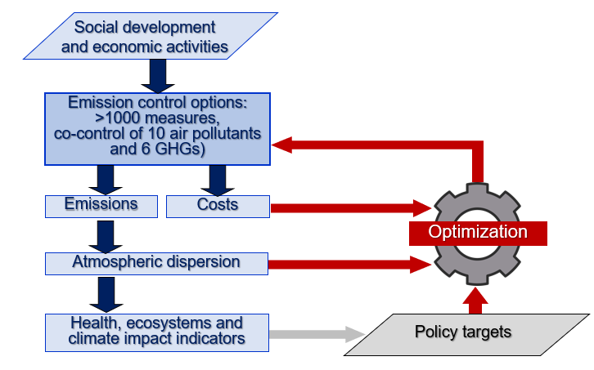
GAINS (Greenhouse gas and Air pollution INteractions and Synergies)
A tool for a systematic assessment of the cost-effectiveness of emission control strategies
GAINS quantifies sectoral emission control potentials and costs,
  for exogenous (governmental, international agencies) activity projections,
  considering physical and economic interactions between pollutants.
Search for least-cost mix of mitigation measures to meet air quality and/or GHG targets
GAINS is implemented for Europe, Asia, several single countries, and globally.
The model is available online http://gains.iiasa.ac.at/models/gains_models4.html

Slide 8
National data vs GAINS…
GAINS has been developed independently at IIASA involving experts (many!) from all over the World
The model aims to consider all relevant sources of pollution, independent if they are reported or not
GAINS databases build on international data and peer reviewed work and benefits from high quality detailed national information and assessments – GAINS would not exist without collaboration with national expert networks
Comparison and validation of GAINS data and assumptions is performed regularly

Slide 9
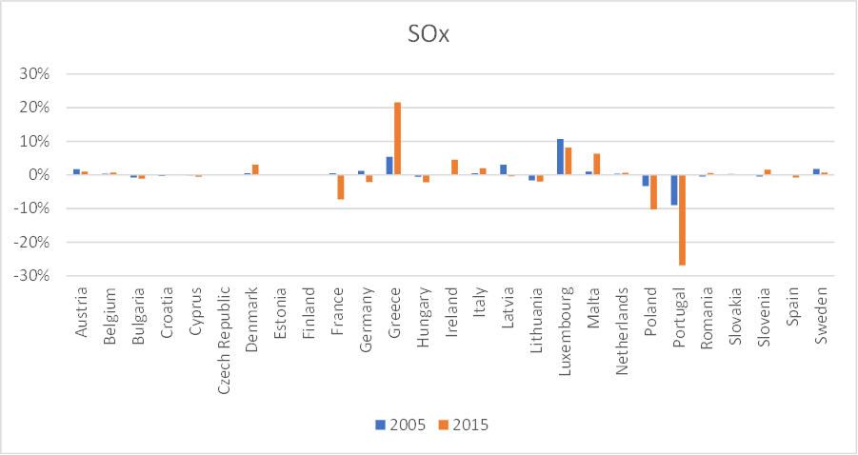
There is always ‘better’ data
Change in national reporting of SO2 emissions for 2005 and 2015 in 2021 vs 2019 national submissions

Slide 10
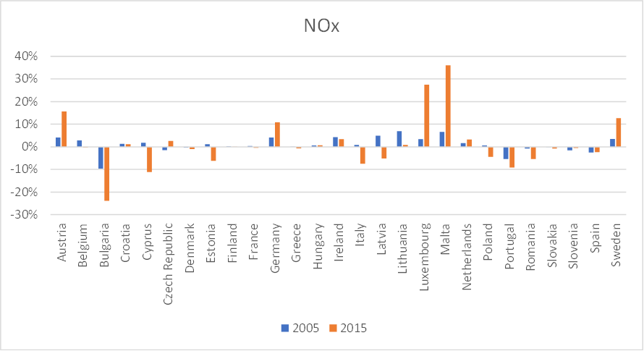
There is always ‘better’ data
Change in national reporting of NOx emissions for 2005 and 2015 in 2021 vs 2019 national submissions

Slide 11
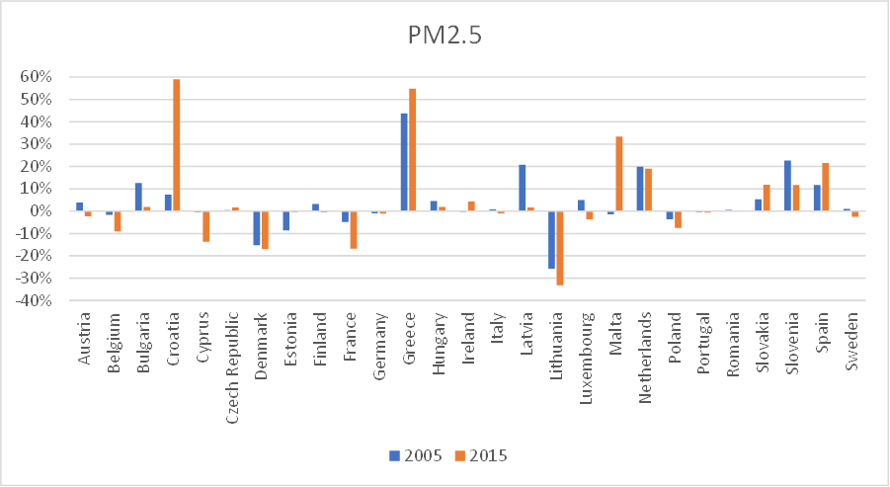
There is always ‘better’ data
Change in national reporting of PM2.5 emissions for 2005 and 2015 in 2021 vs 2019 national submissions

Slide 12
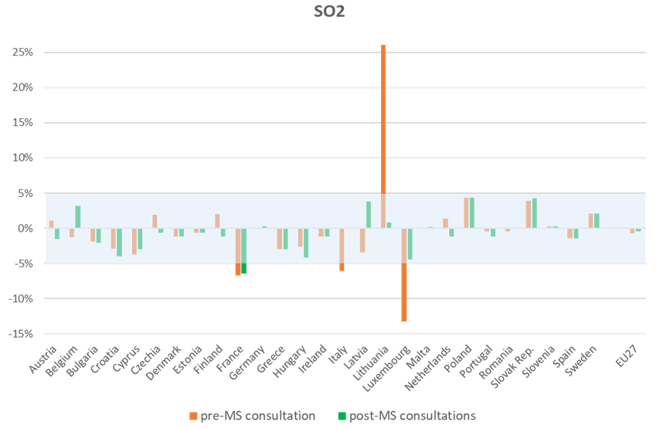
There is always ways to ‘improve’
Comparison of national SO2 emission totals in GAINS vs national data for 2005

Slide 13
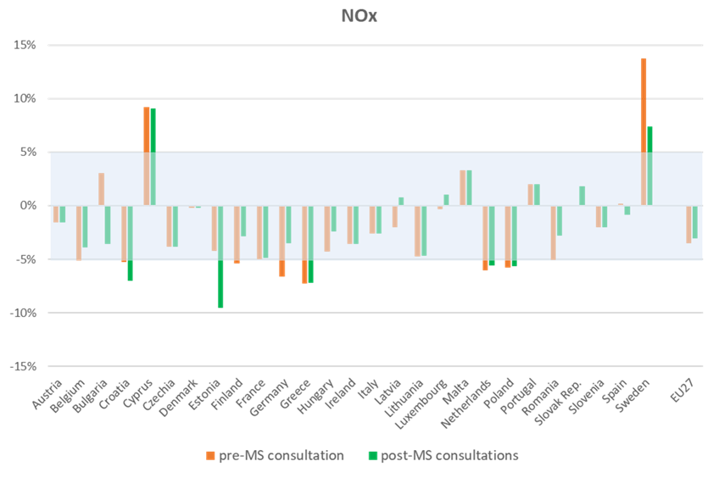
There is always ways to ‘improve’
Comparison of national NOx emission totals in GAINS vs national data for 2005

Slide 14
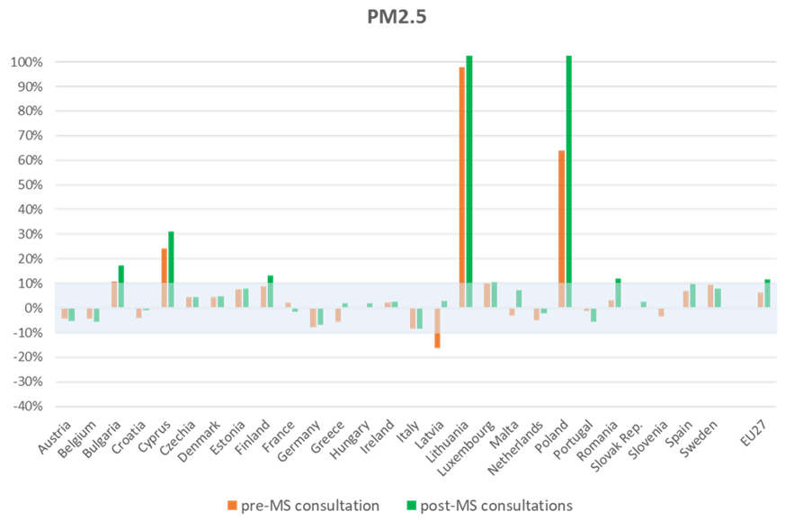
There is always ways to ‘improve’
Comparison of national PM2.5 emission totals in GAINS vs national data for 2005

Slide 15
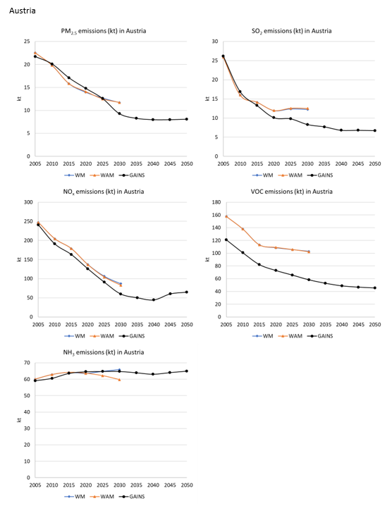
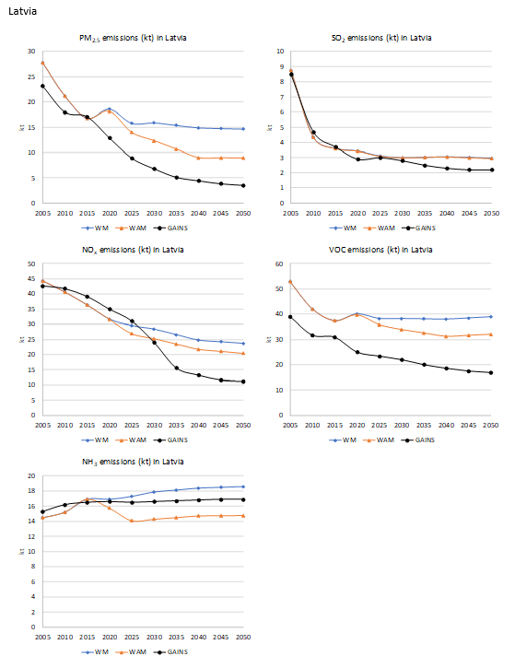

Analysis of projections an important part of discussion

Slide 16
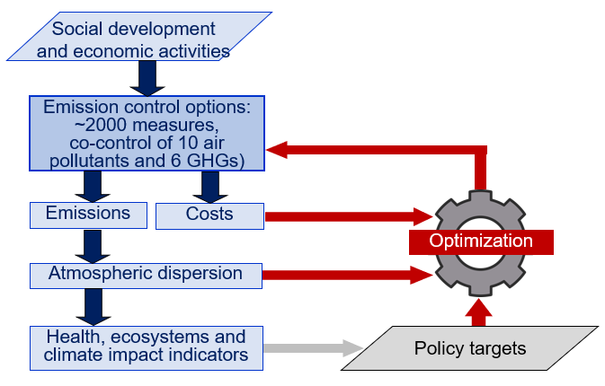

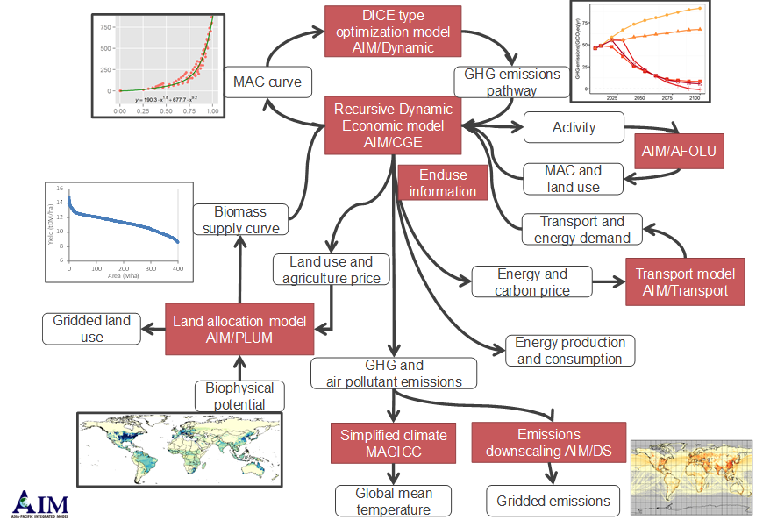
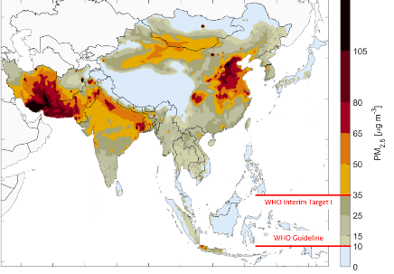
GAINS ‘universe’ or ‘mind map’
CH4,
F-gases, Hg
pyGAINS
Optimization
GAINS PMEH/City
GAINS online
Regional/Global IAM
GAINS ‘AR6’
Public access: Europe, Asia, IAM
Restricted access:
Global, IGP, Vietnam, Korea, South Africa, etc.
https://gains.iiasa.ac.at/models/gains_models4.html

Slide 17
Thank you!
Wish you a great week and please use the time to ask us any questions you might have…feel free to interrupt any of us at any time

