Slide 1
Calculating ambient PM_{2.5} and health impacts in GAINS
Gregor Kiesewetter
Pollution Management Group
Energy, Climate and Environment Program
EECCA Workshop, Laxenburg, November 2023

Slide 2
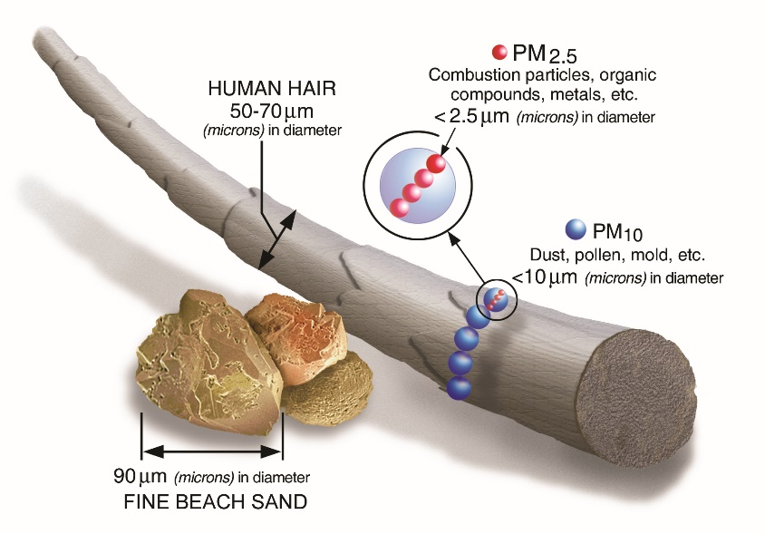
Principles: PM_{2.5}
PM_{2.5} is composed of primary PM (PPM) and secondary aerosols
PPM dispersion
SO₂
NOx SIA formation: (NH₄⁺)₂SO₄²⁻ , (NH₄⁺)NO₃⁻
NH₃
VOC SOA formation
Natural dust, sea salt
→ Pure dispersion models (e.g. Aermod) are not enough, but can be useful at local scale
State of the art atmospheric chemistry-transport models (CTMs) can describe ambient PM_{2.5} concentrations well, but are time consuming:
Emission gridding needed every time
Execution time of the CTM – typically days per 1 year simulation with good resolution
Needed: fast approximation of the full atmospheric model with similar performance
GAINS approach: linearized response model (“atmospheric transfer coefficients”) derived from sensitivity simulations of a full CTM.
Total PM_{2.5}
© US EPA

Slide 3
How GAINS calculates ambient PM: Transfer coefficients
We use sensitivity simulations of EMEP CTM on 0.3°x0.2° (~22km) to derive transfer coefficients from region $r$ → grid $i$. Each sensitivity run changes emissions of pollutant $p$ from region $r$ by 15%:
$$T_{p,r,i}^{}=\frac{{\left[{PM}_{2.5}\right]}_{i,base}^{}−{\left[{PM}_{2.5}\right]}_{i,red}^{}}{0.15 E_{p,r,base}^{}}$$
For each source region and 5 source pollutants: PPM_{2.5}, SO₂, NOx, NH₃, VOC
Source region r
Pollutant p
Receptor grid i

Slide 4
Transfer coefficients
Linear approximation of the full CTM
$${\left[PM\right]}_{i}={const}_{i}+\sum_{p}{\sum_{r}{T_{p,r,i}^{}⋅E_{p,r}}}$$
$i$… 0.3° x 0.2° grid cell
$p$… source pollutant (PPM_{2.5}, NOx, SO₂, NH₃, VOC)
$r$… source region
$T_{p,r,i}^{}$ … transfer coefficient from emissions of pollutant $p$ in region $r$ to grid cell $i$
$E_{p,r}^{}$… emissions of pollutant $p$ in region $r$
$const_{i}$… grid specific constant: natural sources, boundary conditions, non-linearities

Slide 5
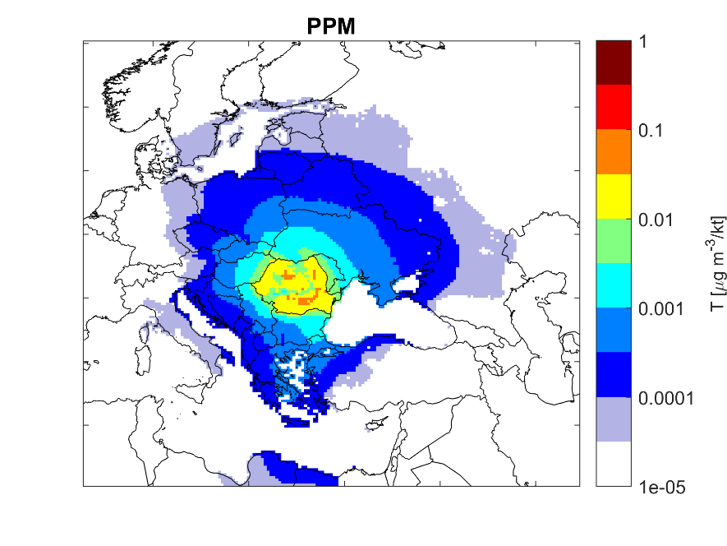
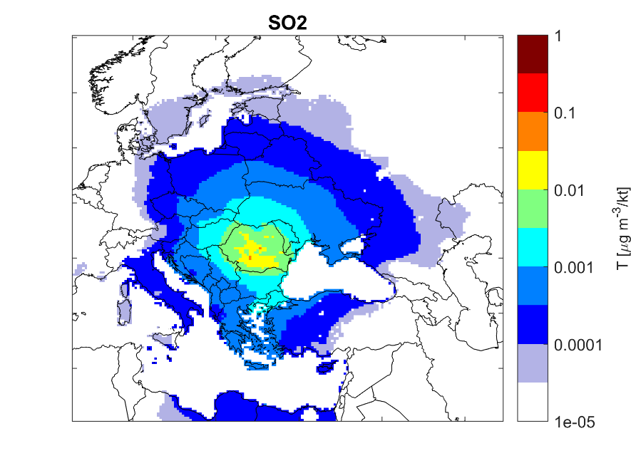
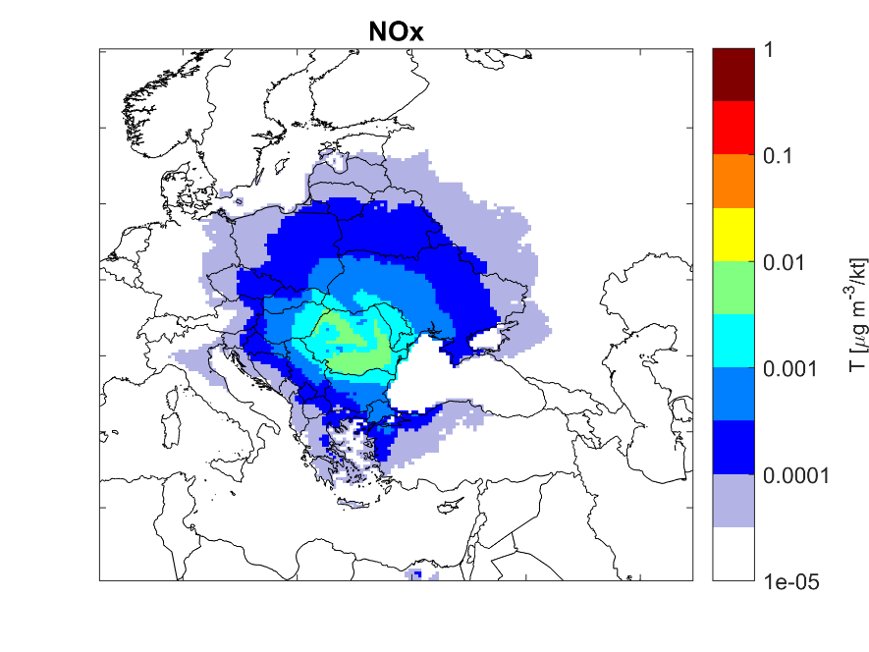
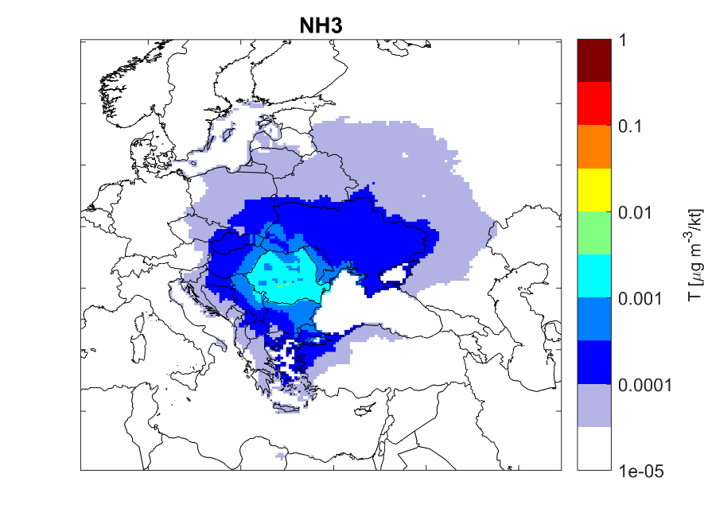
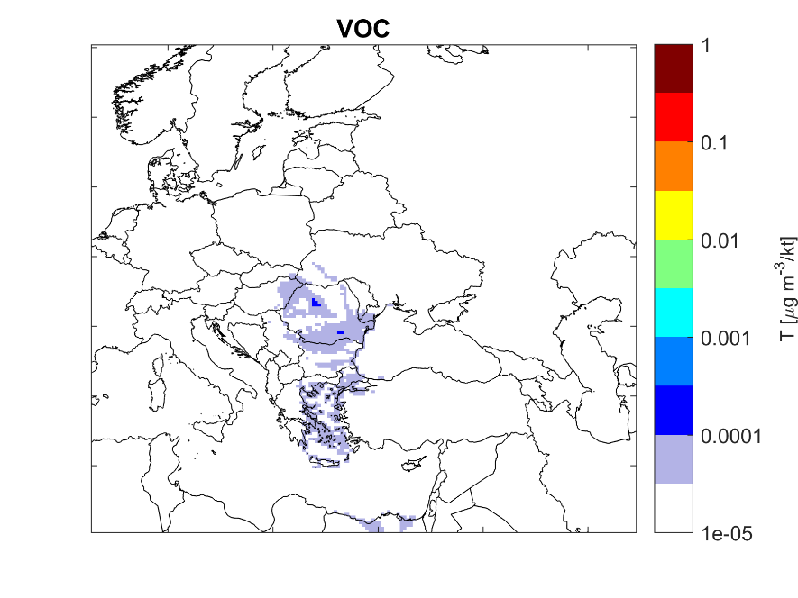
Examples of transfer coefficients
Transfer coefficients have been developed for 60 source regions in GAINS-Europe (50 countries, 10 sea regions)
Example for emissions from Romania in GAINS (0.3⁰x0.2⁰ resolution):
0.3⁰x0.2⁰ or ~22km resolution is good enough for secondary PM but not for primary PM!

Slide 6
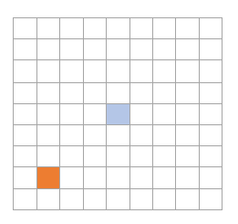
Extension with grid-to-grid tracking of PPM
EMEP CTM can track PPM contributions grid-to-grid (0.1°)
4 different vertical emission “layers” (low-level 1&2, industry, power)
monthly results allow for sector-specific time patterns
Sector specific transfer coefficients
Receptor grid $i$
Source grid $j$

Slide 7
Extension with grid-to-grid tracking of PPM
EMEP CTM can track PPM contributions grid-to-grid (0.1°)
4 different vertical emission “layers” (low-level 1&2, industry, power)
monthly results allow for sector-specific time patterns
five nested resolutions for source grids: 0.1° / 0.2° / 0.5° / 1° (/ 2°)
Sector specific transfer coefficients (0.1°)
20 grid cells in each direction => Complete domain coverage
Receptor grid $i$
Source grid $j$

Slide 8
Combination: Sector specific transfer coefficients
GAINS transfer coefficients for secondary aerosols: linear approximation of EMEP CTM
From source regions $r$, source pollutant $p$, to PM_{2.5} in receptor grid cell $i$:
$$T_{r,p,i}=\frac{{\left[PM_{2.5}\right]}_{i,base}−{\left[PM_{2.5}\right]}_{i,red}}{0.15⋅Emis_{r,p}}$$
Grid to grid tracking (“local fraction”) of PPM with EMEP CTM at 0.1⁰, monthly results
=> sectoral transfer coefficients for PPM:
$$T_{r,s,i}=\frac{1}{12}⋅\sum_{t=1}^{12}{\sum_{j}{D\left(r,s,l(s),j\right)⋅τ\left(s,j,t\right)⋅G(j,i,l,t)}}$$
$r$… source region, $s$… source sector, i… receptor grid cell (0.1⁰), $j$… emission grid cell (0.1⁰), $l$…vertical emission layer, $t$…month
$D(r,s,l,j)$ … spatial emission distribution pattern
$τ(s,j,t)$ … temporal (monthly) emission share
$G(j,i,l,t)$… grid-to-grid transfer coefficient from $j$ to $i$ in month $t$ for emission layer $l$
So that ${\left[PM2.5\right]}_{i,scen}=δ_{i}+\sum_{s}{\sum_{r}{\sum_{p}{Emis_{r,s,p,scen}⋅T_{r,p,s,i}}}}$
(applying relative sectoral contributions also to SO₂ and NOx transfer coefficients)

Slide 9
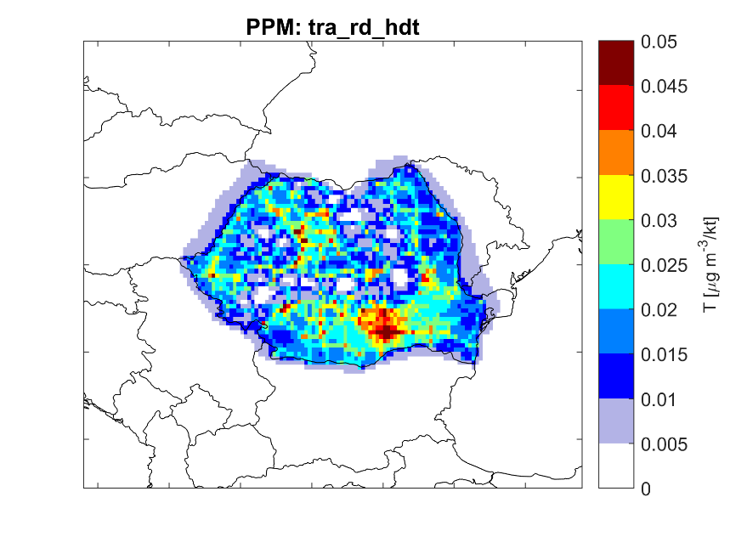
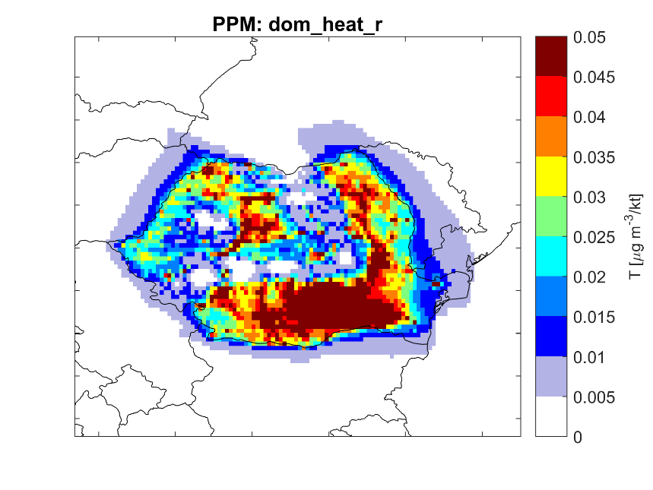
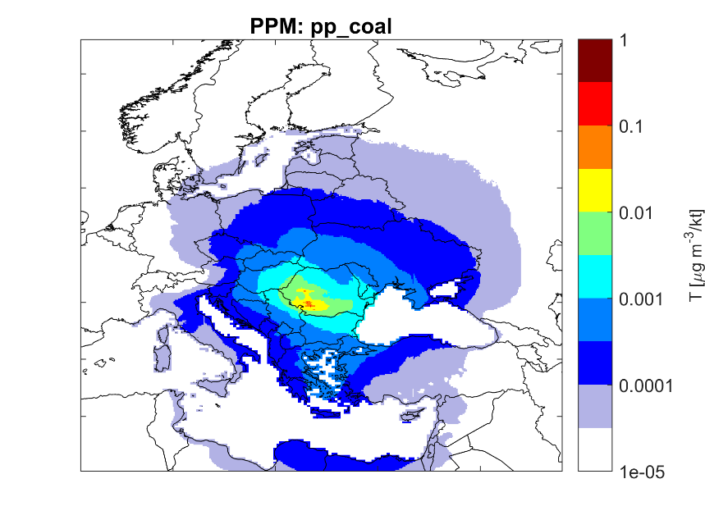
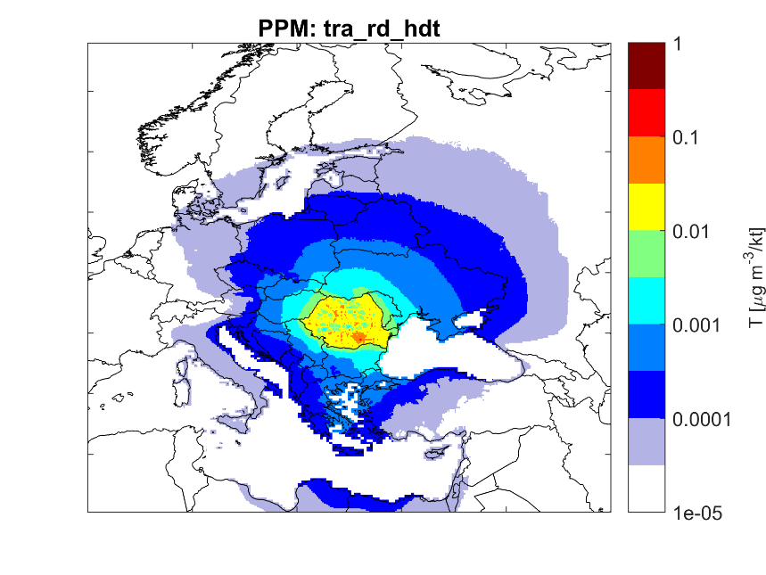
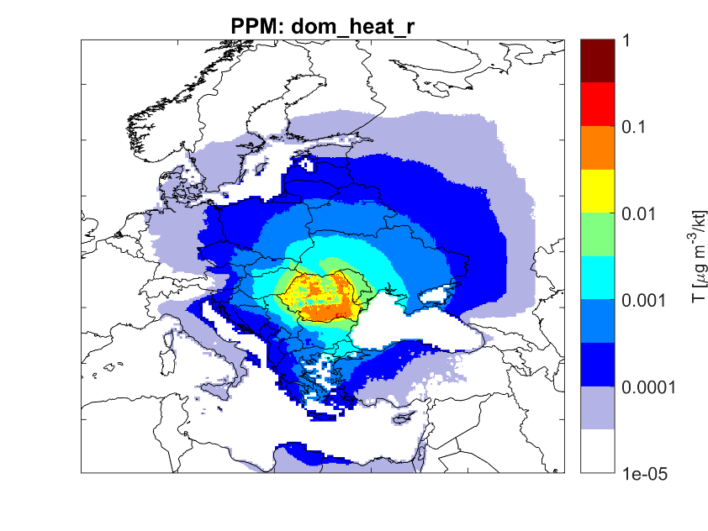
Sector specific transfer coefficients: PPM
A few examples from Romania (~45 sectors in total…)
(Coal) power plants
Heavy duty trucks
Heating: rural
Linear scale
Logarithmic scale

Slide 10
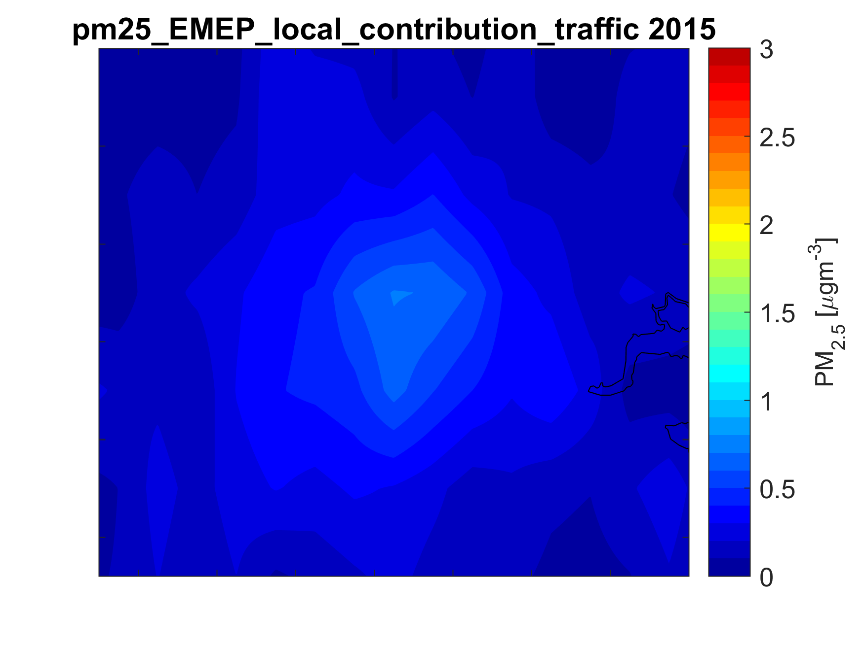
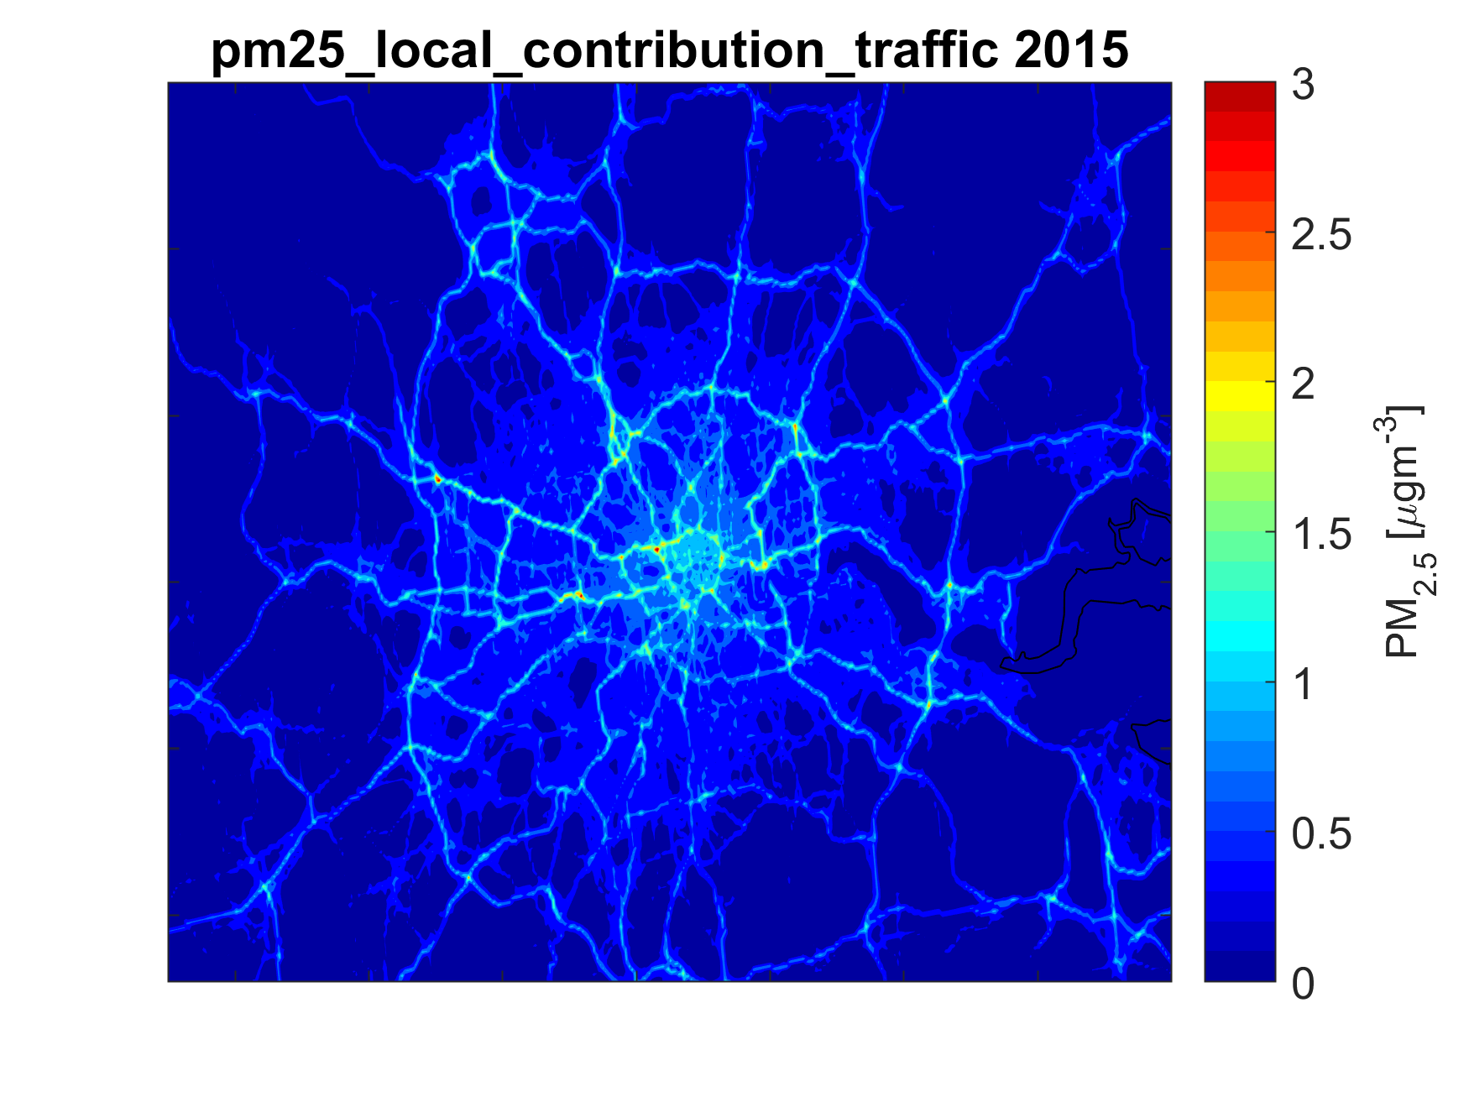
Downscaling based on uEMEP
Near-ground emission sources of PPM require higher resolution than 0.1° (10km)
High resolution (100x100m) simulations with the uEMEP model were used to derive PM_{2.5} exposure increments that allow GAINS to calculate the same population-weighted PM2.5 concentration as if the 100m resolution was used.
This is done for traffic and residential sectors.
Local contribution from traffic, EMEP model (0.1°)
Local contribution from traffic, uEMEP model (100m)

Slide 11
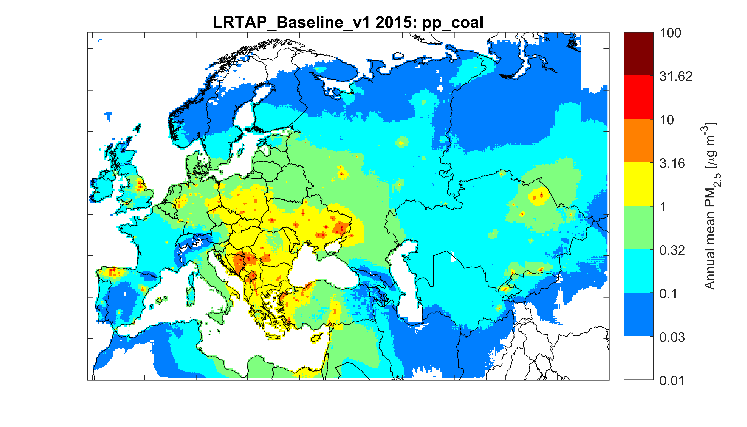
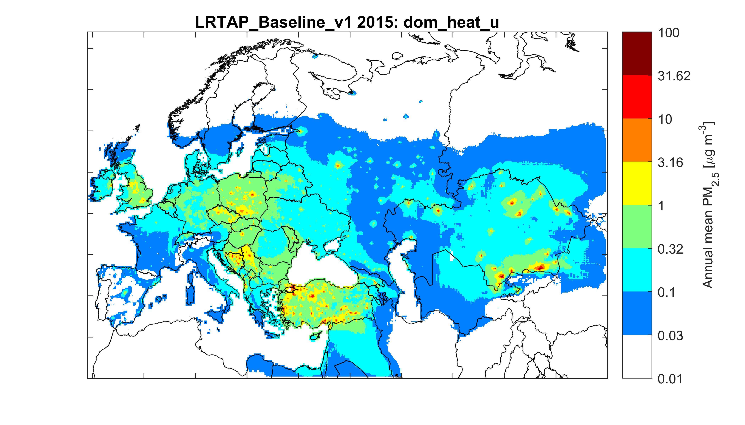
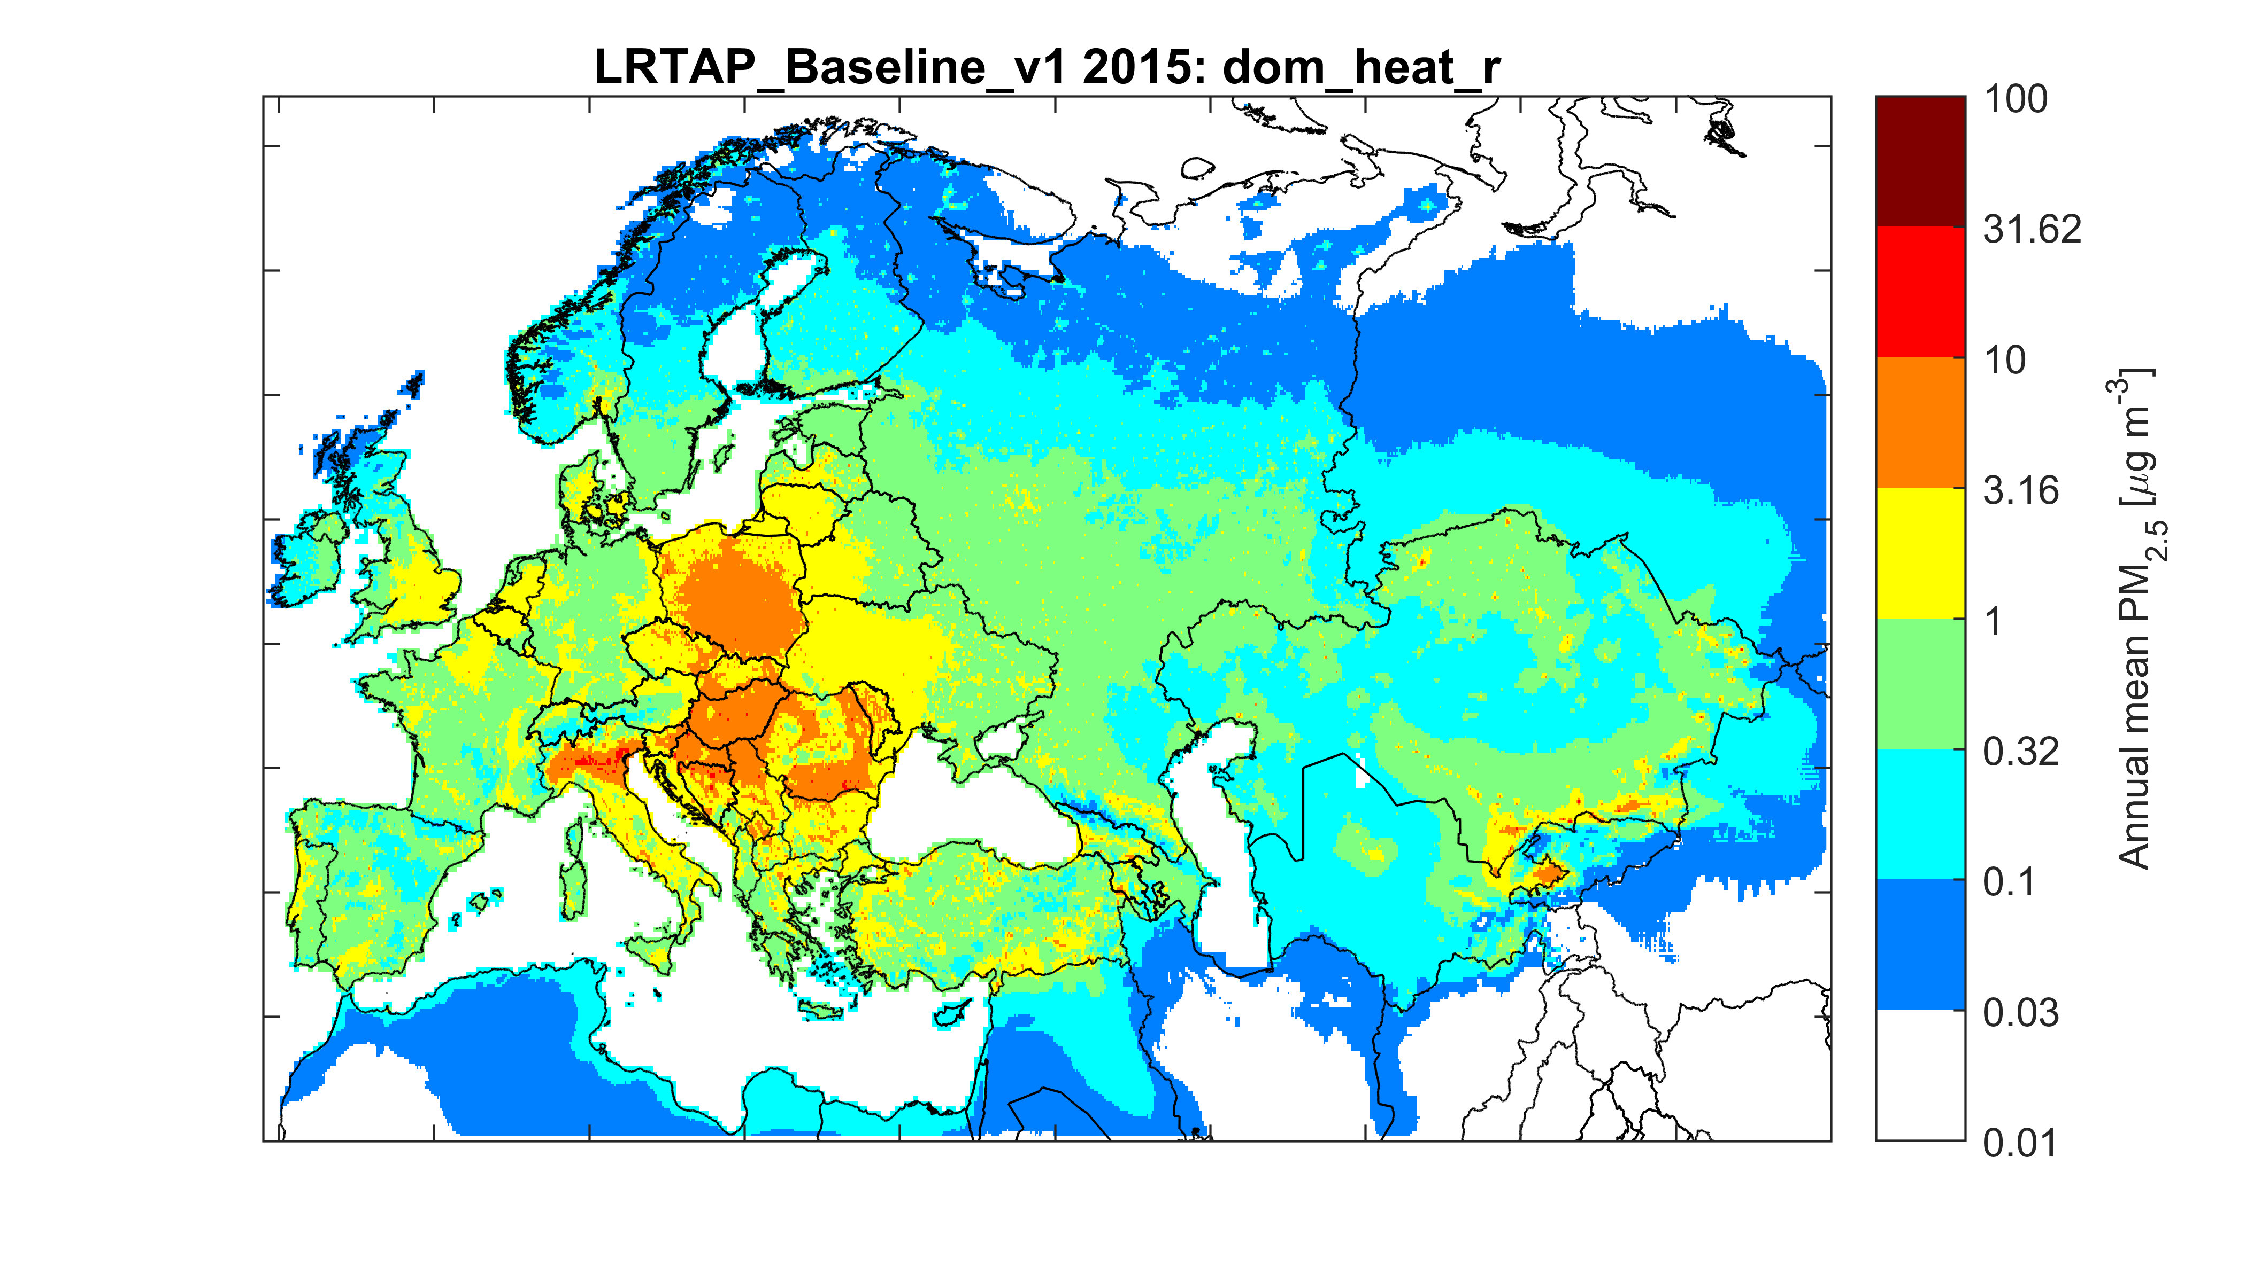
Ambient PM_{2.5}: Contributions from sectors (2015)
Iron & steel industry
Coal power plants
Heating: urban
Heating: rural
Done for ~40 sectors.

Slide 12
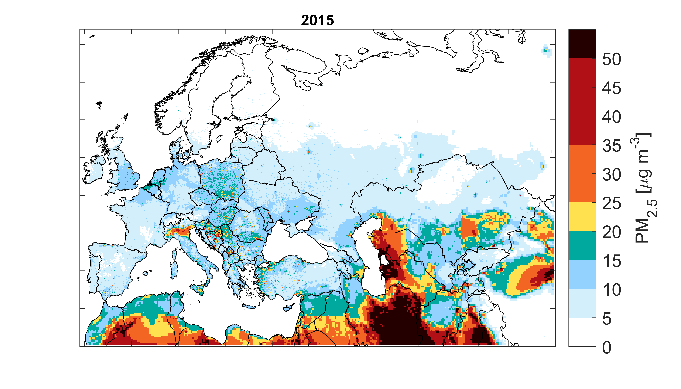
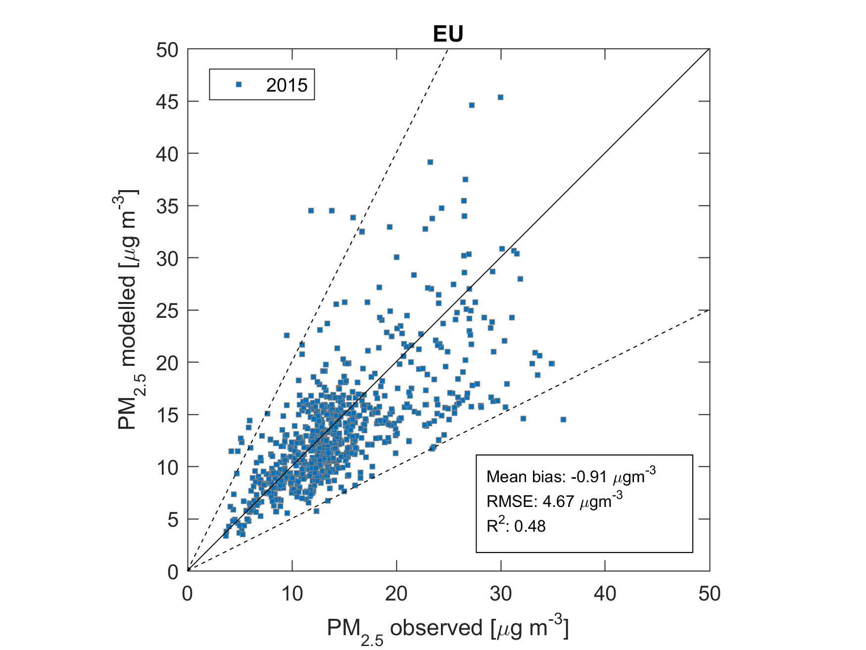
Ambient PM_{2.5} concentrations

Slide 13
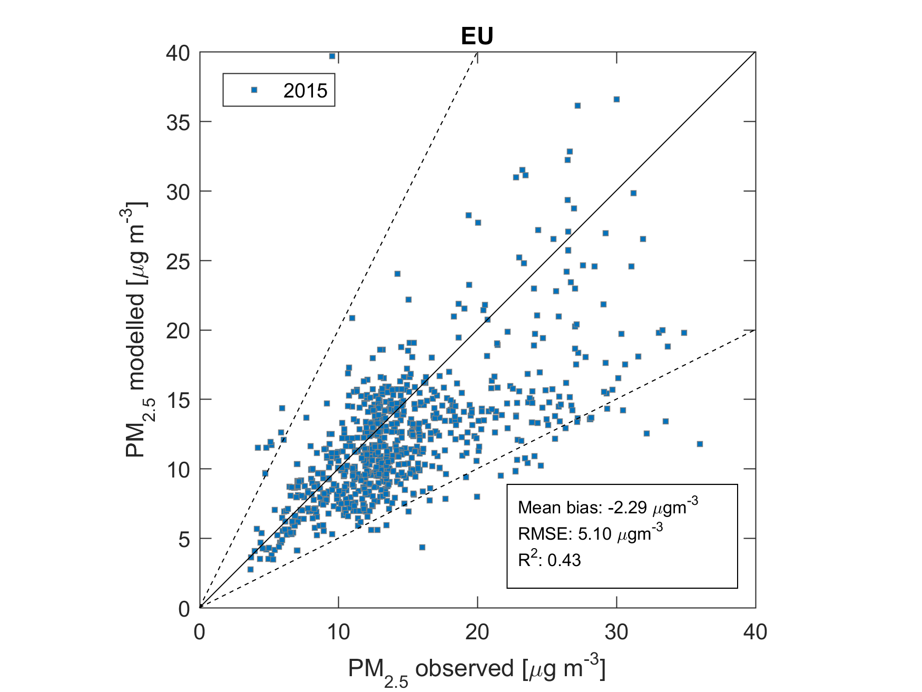
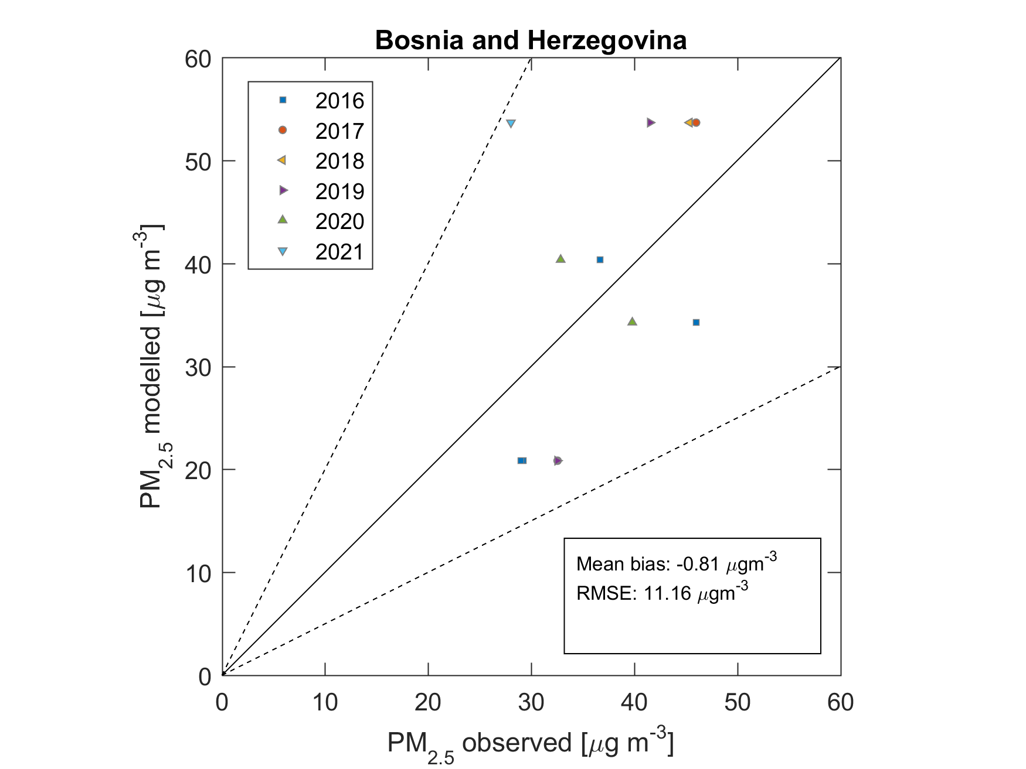
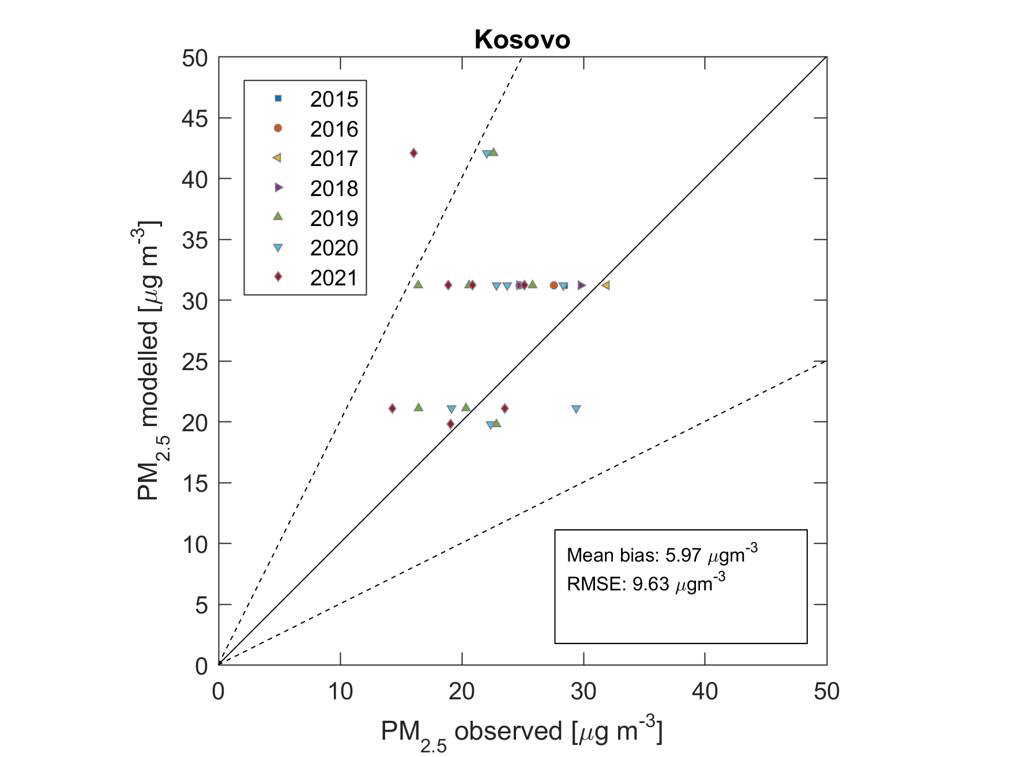
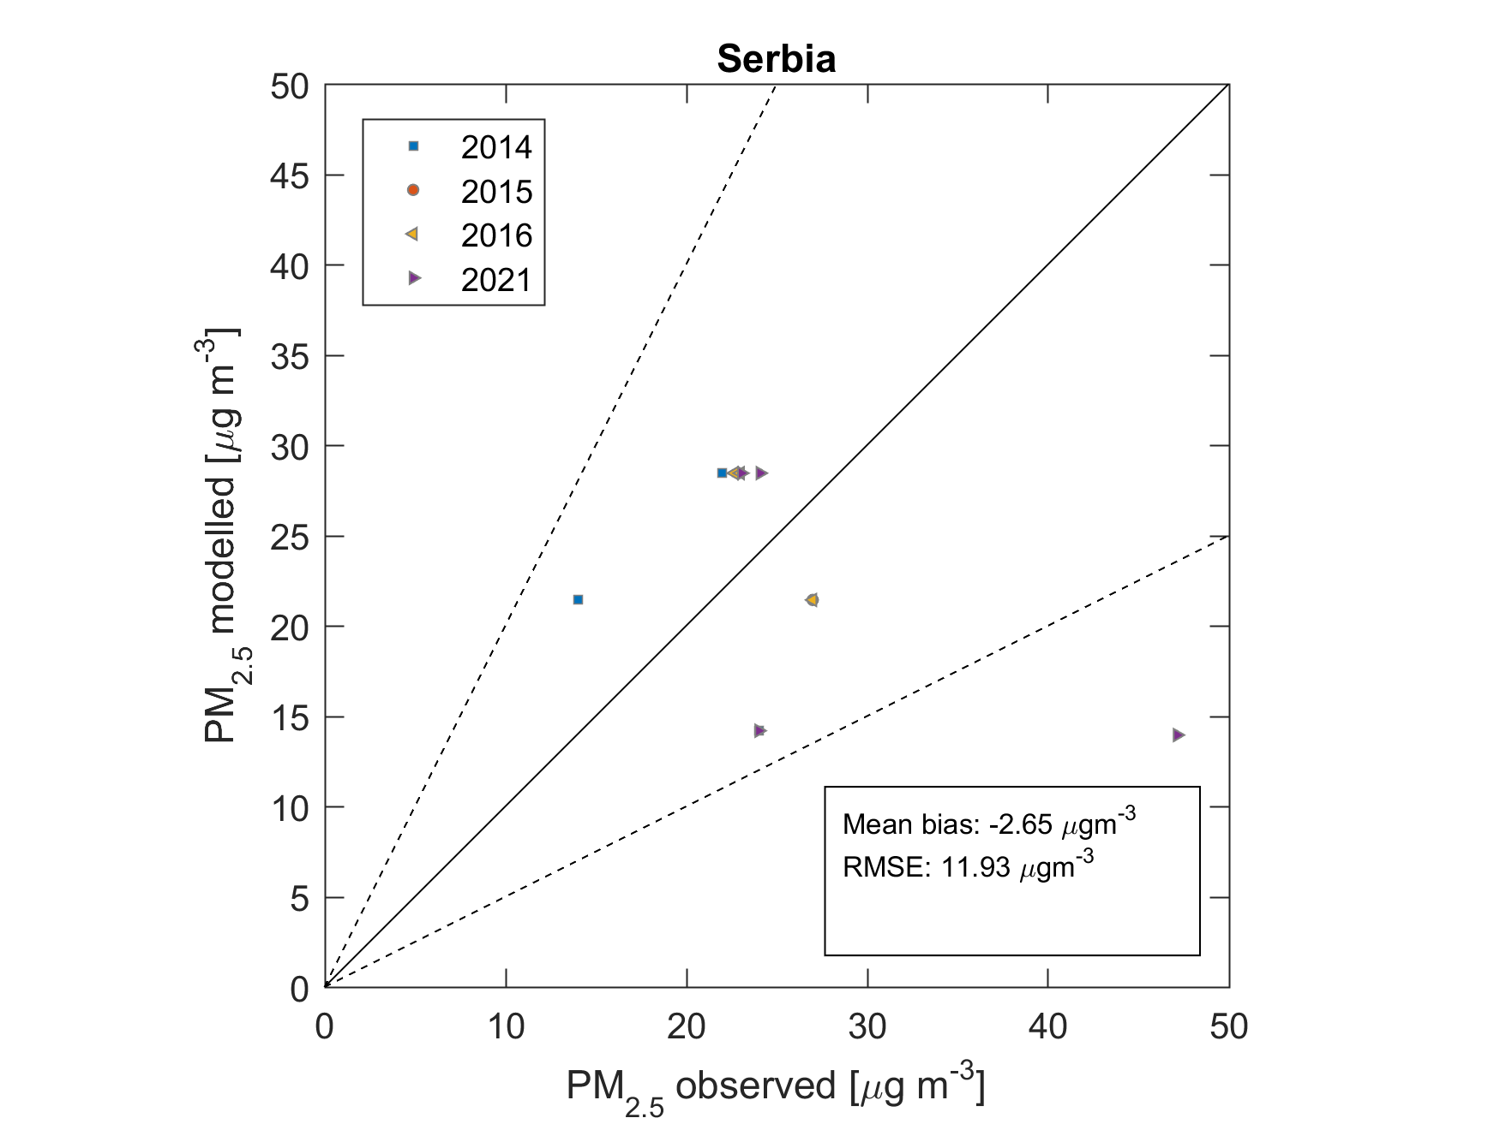
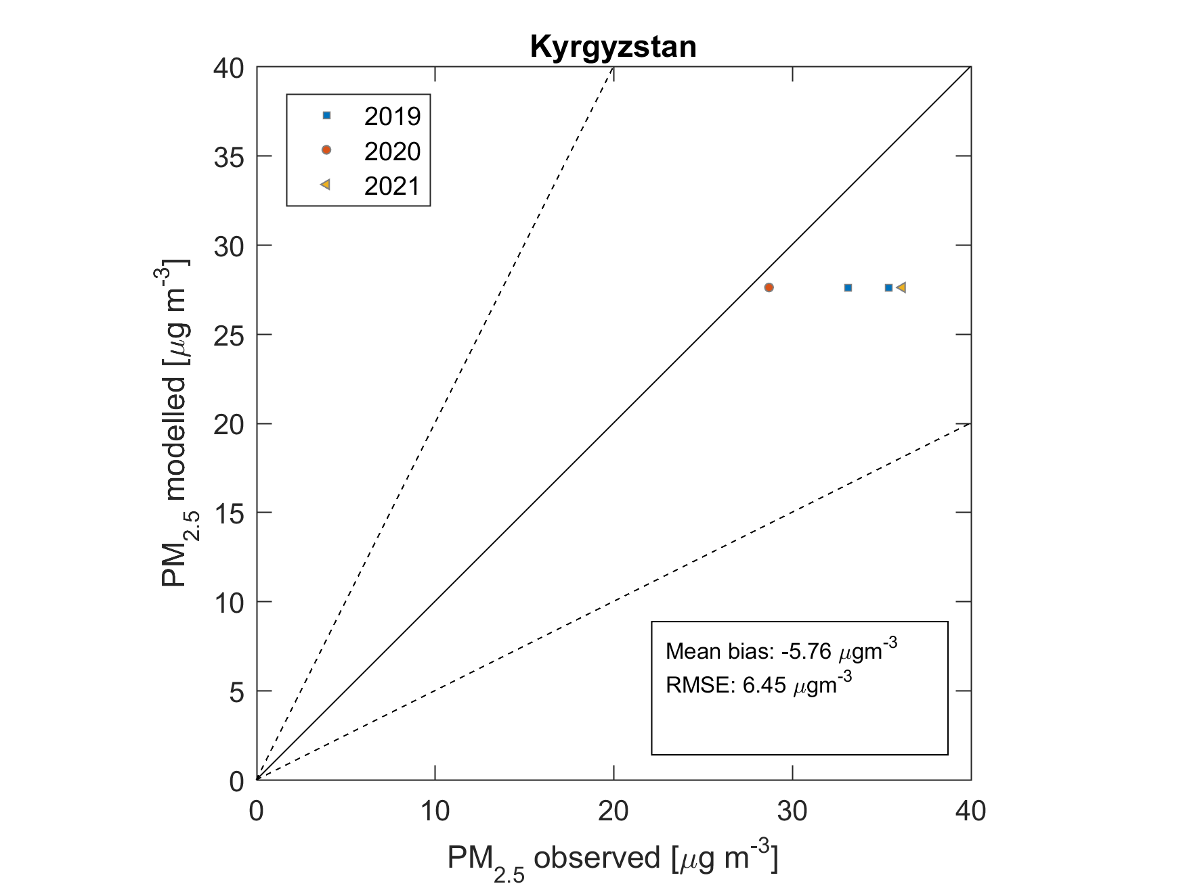
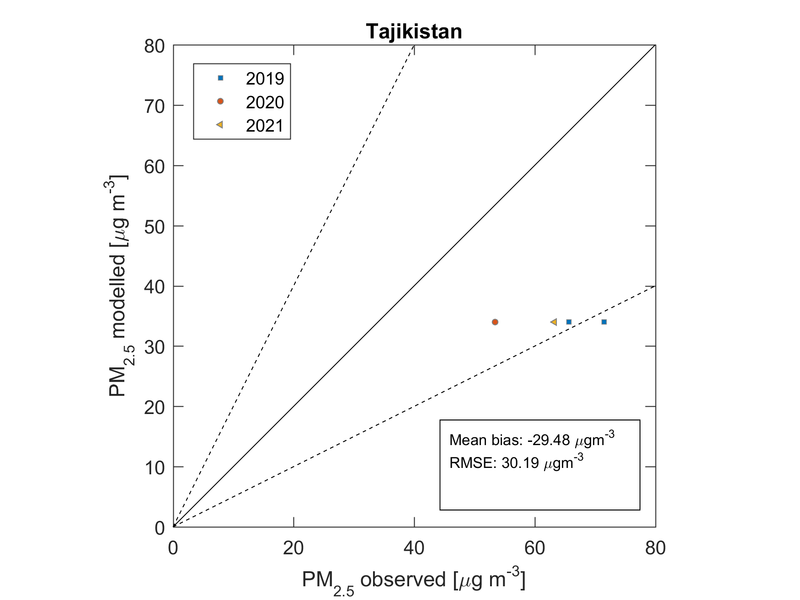
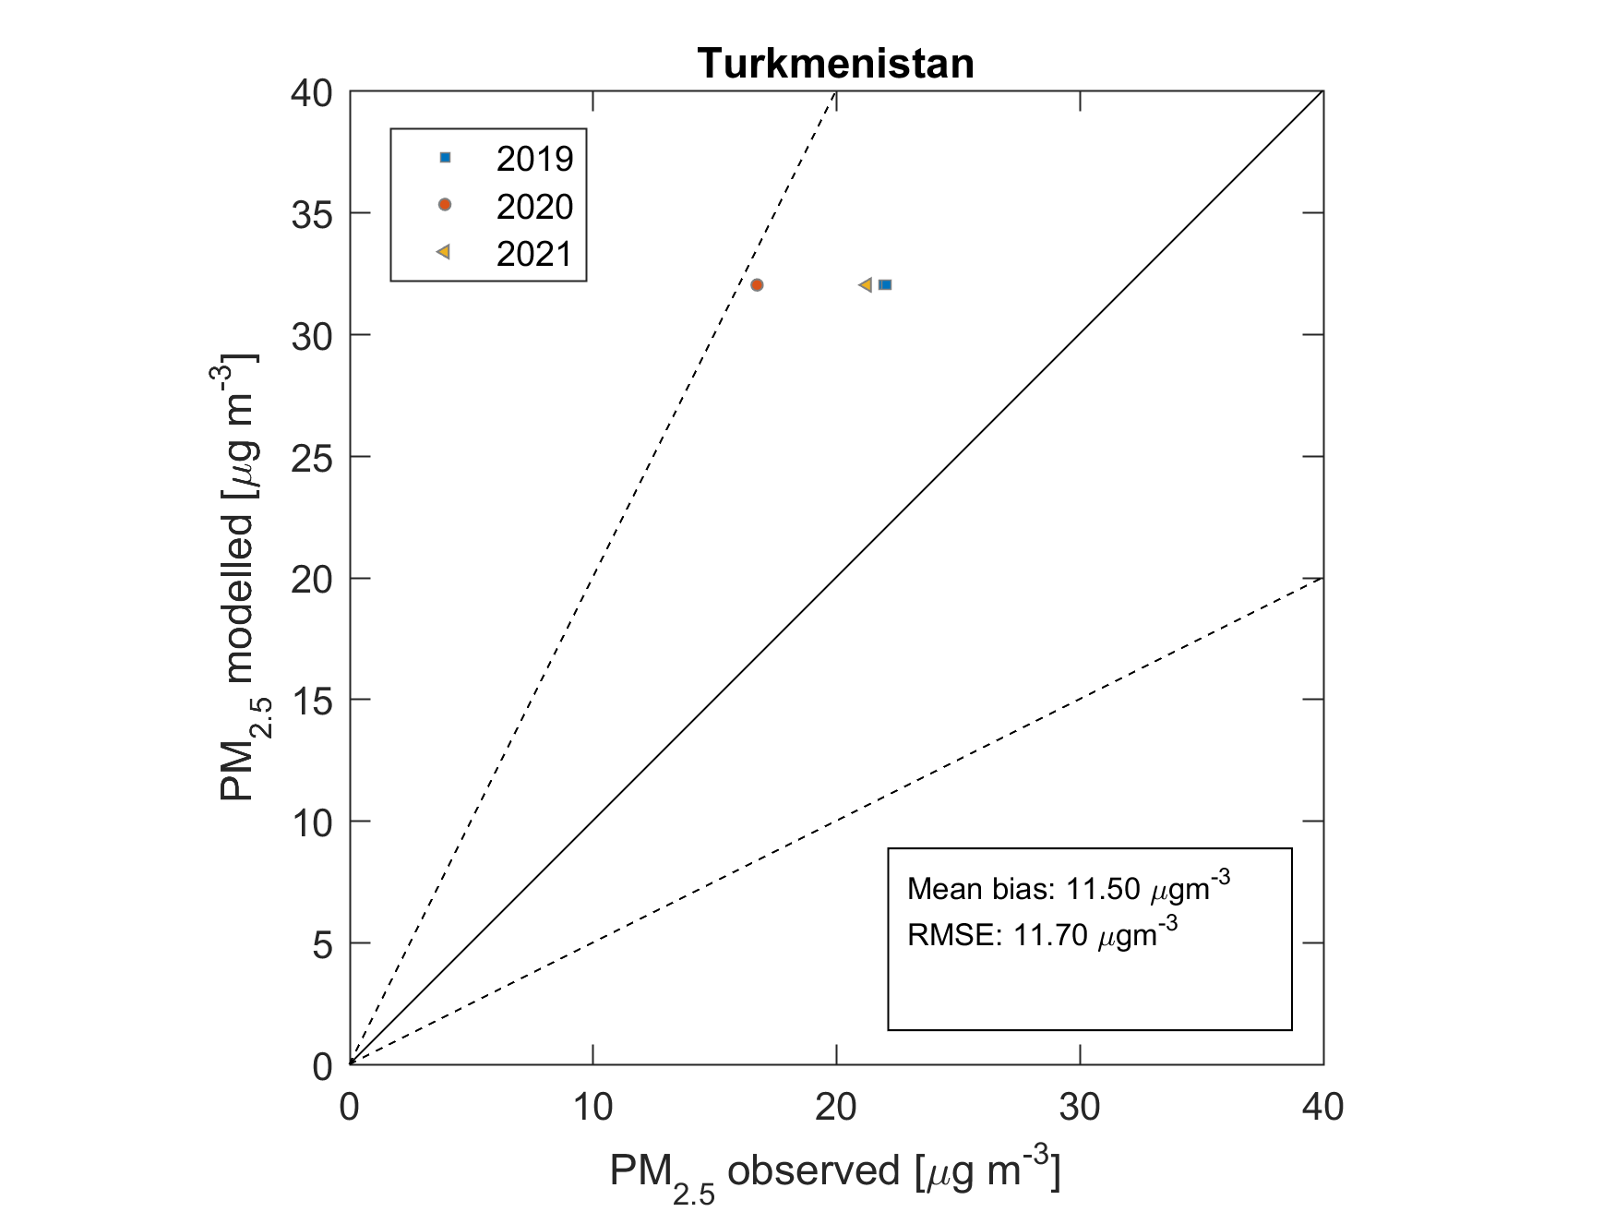
Ambient PM_{2.5} concentrations – validation
Non-EU: Not many stations available…
(WHO DB 2022, AirBase, US Embassies)
Preliminary results!

Slide 14
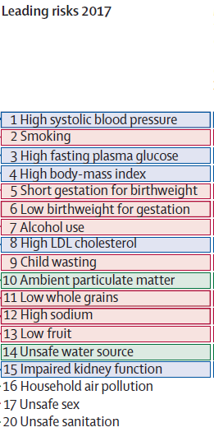
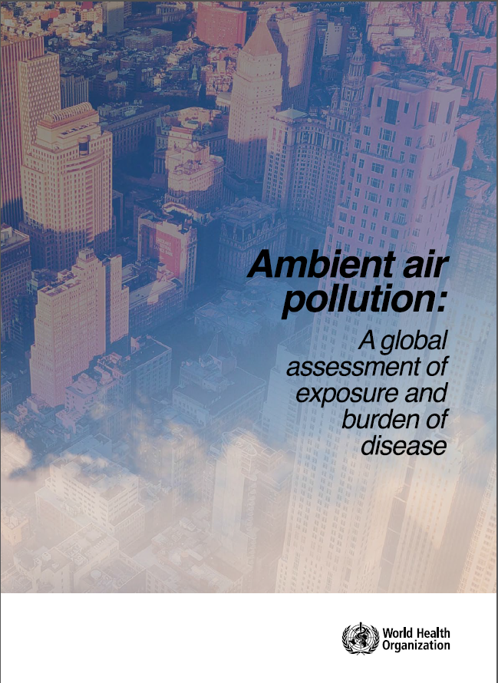
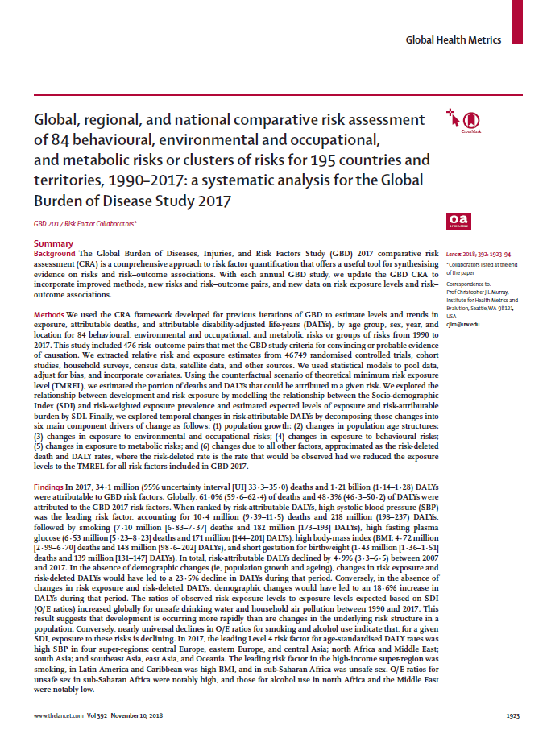
PM_{2.5} and human health
Long-time exposure to PM_{2.5} increases the risk of cardiovascular and respiratory diseases, and lung cancer
3-5 million cases of premature deaths annually are attributed to it,
making it the most important environmental risk factor for human health.

Slide 15
Health impact calculations in GAINS
Long-term exposure increases the risk for death from a few diseases: COPD, stroke, IHD, lung cancer, ALRI, diabetes. The relevant factor is called relative risk ($RR$) and is a function of PM_{2.5}
In Europe, GAINS follows the WHO Europe approach, quantifying all-cause mortality:
Per 10µgm⁻³, the risk for death increases by 8% (Chen & Hoek, 2020)
(recently updated, previously HRAPIE 2013: 6%/10µgm⁻³. HRAPIE2 update expected soon)
Needed for the calculations:
Ambient PM_{2.5} concentration on relevant resolution (urban background)
Population data on the same spatial distribution
Concentration-response relationships
Baseline mortality data
GAINS
JRC (250m grid)
International literature: WHO,…
UN World Population Prospects

Slide 16
Basic principle of the calculation
Exposure to PM_{2.5} increases the risk to die from certain diseases:
$$D({PM}_{2.5})=D_{0}⋅RR({PM}_{2.5})$$
$D$… Deaths occurring in a given year under elevated PM_{2.5} concentrations (“baseline deaths”)
$D_{0}$… hypothetical number of deaths under ‘clean’ conditions
$RR({PM}_{2.5})$…relative risk for this level of PM_{2.5}, derived from epidemiological studies. $RR≈1+β {PM}_{2.5}$
GAINS considers all anthropogenic PM_{2.5} without any lower cut-off (but no natural dust).
To get the additional number of deaths (“premature” or attributable deaths $PD$) caused by PM_{2.5}, we take
$$PD=D−D_{0}=D_{0}⋅RR−D_{0}$$
$$=D_{0}⋅(RR−1)$$
$$=\frac{D}{RR}⋅(RR−1)$$
$$=D⋅\frac{RR−1}{RR}$$
$$≈D⋅β {[PM}_{2.5}]$$
Observed (or projected) natural-cause deaths
Population-weighted mean PM_{2.5}

Slide 17
Years of life lost, Loss of life expectancy
People dying prematurely lose a part of their life expectancy
Years of life lost in a country:
$$YLL=\sum_{a}{PD\left(a\right)⋅ex(a)}$$
Alternatively to the number of premature deaths in a given year, we can also calculate the loss of life expectancy under constant exposure, using a life table approach. For details see Kiesewetter et al., Environ. Modell. Softw. 2015
Premature deaths
Remaining life expectancy

Slide 18
Ground-level ozone
Ozone is formed from emissions of NOx and VOC (also CO, CH₄ but longer time scales)
Chemistry is non-linear, but the linear approximation is good enough
GAINS calculates SOMO35 as a function of NOx and VOC emissions:
$$SOMO{35}_{i}=δ_{i}+\sum_{r}{\sum_{p∈\{NOx,VOC\}}{E_{r,p}⋅S_{r,p,i}}}$$
Transfer coefficients $S$ are calculated from perturbation simulations of the EMEP CTM at 0.3°×0.2°
grid cell $i$
source region $r$
pollutant $p$

Slide 19
Ground-level ozone
Ground-level ozone is associated with premature mortality (respiratory diseases)
Mostly a short-term effect during episodes
Exposure indicator: SOMO35 = sum of daily max 8-hour mean O₃ >35ppb
Highest 8-hour mean within each day
O₃
Contributions to SOMO35
35 ppb
Day 1 Day 2 Day 3
time
Premature deaths: $PD=SOMO35⋅β⋅D/365$, $β=\frac{0.0043}{10μgm^{−3}}$

Slide 20
What GAINS-Europe online currently offers
PM_{2.5} :
concentration maps
Population-weighted mean PM_{2.5} in each GAINS region
Blame matrix: How much of the pollution is local, how much is transboundary?
Exposure distribution: how many people are exposed to different levels of PM_{2.5}?
Health impacts:
Annual premature deaths from ambient PM_{2.5}
Years of life lost
Loss of life expectancy
Ozone:
Maps of SOMO35
Premature deaths

