Slide 1
Industry in GAINS
GAINS-EECA Workshop
Shaohui Zhang
IIASA - Energy, Climate and Environment (ECE) Program,
Pollution Management (PM) Research Group
7 November 2023

Slide 2
Industry role in energy and environment
Structural measures – Energy savings, efficiency improvements: bans all pollutants
– Biomass: CO2 ↓ NOx , PM, SO2 , HC↑
– Nuclear power generation : CO2 , SO2 , NOx , PM, HC ↓
– Wind power generation : CO2 , SO2 , NOx , PM, HC ↓
– Solar power generation : CO2 , SO2 , NOx , PM, HC ↓
Stationary sources – Advanced residential combustion: CO2 , NOx , HC ↓
– Large co-generation (CHP): CO2 , SO2, NOx , PM ↓ NMVOC ↑
– Small co-generation (CHP): CO2 , SO2 , PM ↓ NOx , CH4 , NMVOC ↑
– SCR, SNCR: NOx ↓, NH3 ↑
– FGD: SO2 , PM ↓, CO2 ↑
– Biomass co-firing in gas: CO2 ↓ NOx , PM, SO2 ↑
– Biomass co-firing in coal: CO2 , SO2 , PM ↓ NOx , NMVOC↑
– CCS (post combustion, coal) : CO2 , SO2 ↓ NOx , PM, NH3 ↑
– CCS industry : CO2 ↓ NOx , PM, SO2 ↑
– Heat pumps : CO2 , NOx ↓ PM, SO2 ↑
Mobile sources – Euro-standards: NOx , PM, HC↓ NH3 ↑
– Road pricing : CO2 , NOx , PM ↓
– Road fuel taxes : CO2 , NOx , SO2 , PM ↓
– CO2 standards cars/trucks: CO2 , SO2↓
– Biofuels road vehicles: CO2 ↓
– Electric vehicles2: CO2 ↓ NOx , SO2 ↑
Agricultural sources – Low nitrogen cattle feed: NH3 , CH4 ↓
– Improved injection of manure: NH3 ↓ N2O ↑
– Anaerobic digestion-biogas: CO2 , CH4↓ NOx , SO2 , NMVOC, PM ↑
– Anaerobic digestion (CHP): CO2 , CH4 , SO2 ↓ NOx , NMVOC, PM ↑
– Air scrubbers animal housings: NH3 , PM ↓ CO2 ↑
Other sources – Green gas landfill/sewage treatment: CO2 , CH4 ↓ NOx , SO2 , PM, NMVOC ↑
Industrial processes and activities consumed a large amount of energy that is dominated by fossil fuels (e.g., and coal). These activities generate emissions of hazardous substances, like GHGs and air pollutants and cause damage to human health.
The future demand of key materials will continue increase for supporting the sustainable manufacture and energy transition to zero emission system.
Note: HC = Hydrocarbons, CH4 = methane, PM = particulate matter

Slide 3
GAINS emissions calculation
i,j,k,m | Country, sector, fuel, abatement technology
E_{i} | Emissions in country i
A | Activity in a given sector
ef | “Raw gas” emission factor
eff_{m} | Reduction efficiency of the abatement option m
X | Implementation rate of the considered abatement measure

Slide 4
Manufacturing Industries: sectorial combustion
IN | Industrial combustion
IN_BO | Industry: combustion in boilers (heat only boilers, all sectors)
IN_OCTOT | Industry: other combustion (all sectors)
IN_BO_CON | Industry, transformation sector, combustion in boilers
IN_OC_ISTE | Industry: iron and steel (other combustion)
IN_BO_CHEM | Industry: chemical industry (combustion in boilers)
IN_OC_CHEM | Industry: chemical industry (other combustion)
IN_OC_NFME | Industry: non-ferrous metals (other combustion)
IN_OC_NMMI | Industry: non-metallic minerals (other combustion)
IN_BO_PAP | Industry: paper and pulp production (combustion in boilers)
IN_OC_PAP | Industry: paper and pulp production (other combustion)
IN_BO_OTH_L | Industry: other sectors; combustion of brown coal/lignite and hard coal in large boilers ( >50 MWth)
IN_BO_OTH_S | Industry: other sectors; combustion of brown coal/lignite and hard coal in small boilers ( < 50 MWth)
IN_BO_OTH | Industry: other sectors; combustion of fossil fuels other than brown coal/lignite and hard coal
IN_OC_OTH | Industry: other sectors (other combustion)
IN_OC | Industry: other combustion (all sectors) except fuel consumption in mineral products industry (used only for emissions calculations)
NONEN | Nonenergy use of fuels

Slide 5
Industrial process in GAINS
Abbreviation | Description
PROD | Production of natural gas or crude oil
PR_REF | Ind. Process: Crude oil & other products - input to petroleum refineries
PR_BRIQ | Ind. Process: Briquettes production
PR_ALPRIM | Ind. Process: Aluminum production - primary
PR_ALSEC | Ind. Process: Aluminum production - secondary
PR_OT_NFME | Ind. Process: Other non-ferrous metals prod. - primary and secondary
PR_GLASS | Ind. Process: Glass production (flat, blown, container glass)
PR_BRICK | Ind. Process: Bricks production
PR_CEM | Ind. Process: Cement production
PR_LIME | Ind. Process: Lime production
PR_COKE | Ind. Process: Coke oven
PR_SINT | Ind. Process: Agglomeration plant - sinter
PR_SINT_F | Ind. Process: Agglomeration plant - sinter (fugitive)
PR_PELL | Ind. Process: Agglomeration plant - pellets
PR_BAOX | Ind. Process: Basic oxygen furnace
PR_EARC | Ind. Process: Electric arc furnace
PR_HEARTH | Ind. Process: Open hearth furnace
PR_PIGI | Ind. Process: Pig iron, blast furnace
PR_PIGI_F | Ind. Process: Pig iron, blast furnace (fugitive)
PR_CAST | Ind. Process: Cast iron (grey iron foundries)
PR_CAST_F | Ind. Process: Cast iron (grey iron foundries) (fugitive)
PR_PULP | Ind. Process: Paper pulp mills
PR_FERT | Ind. Process: Fertilizer production
PR_NIAC | Ind. Process: Nitric acid
PR_OTHER | Ind. Process: Production of glass fiber, gypsum, PVC, other
PR_CBLACK | Ind. Process: Carbon black production
PR_ADIP | Ind. Process: Adipic acid production
Energy
Mining and storage for energy and material
non-ferrous metals
Abbreviation | Description
CONSTRUCT | Construction activities
MINE_BC | Mining: Brown coal
MINE_HC | Mining: Hard coal
MINE_OTH | Mining: Bauxite, copper, iron ore, zinc ore, manganese ore, other
STH_AGR | Storage and handling: Agricultural products (crops)
STH_COAL | Storage and handling: Coal
STH_FEORE | Storage and handling: Iron ore
STH_NPK | Storage and handling: N,P,K fertilizers
STH_OTH_IN | Storage and handling: Other industrial products (cement, bauxite, coke)
non-metallic minerals
Iron and Steel
Paper
Fertilizer

Slide 6
Fuel Categories in GAINS
Abbreviation | Description
BC1 | Brown coal/lignite, grade 1
BC2 | Brown coal/lignite, grade 2 (includes peat)
DC | Derived coal (coke, briquettes)
HC1 | Hard coal, grade 1
HC2 | Hard coal, grade 2
HC3 | Hard coal, grade 3
MD | Medium distillates (diesel, light fuel oil; includes biofuels)
GSL | Gasoline and other light fractions of oil; includes biofuels
HF | Heavy fuel oil
LPG | Liquefied petroleum gas
GAS | Natural gas (incl. CNG and derived gases)
OS1 | Biomass fuels
ARD | Agricultural residuals - direct use
BGS | Bagasse
BIO | Biogas
BMG | Biomass gasification
CHCOA | Charcoal
DNG | Dung
FWD | Fuelwood direct
OS2 | Other biomass and waste fuels
BLIQ | Black liquor
WSFR | Waste fuel, renewable
WSFNR | Waste fuels, non-renewable
REN | Renewable energy other than biomass
GTH | Geothermal
SHP | Small hydro power
SPV | Solar photovoltaic
STH | Solar thermal
WND | Wind
HYD | Hydro
NUC | Nuclear
HT | Heat (steam, hot water)
ELE | Electricity
Coal
Fossil fuels
Oil
Gas
Combustible
Renewable
Non-Combustible

Slide 7
Main emission control options for NO_{x} in Industry
Abbreviation | Description
FLR_GP | Good practice in oil and gas industry - flaring
IOGCM | Combustion modification on oil and gas industrial boilers and furnaces
IOGCSC | Combustion modification and selective catalytic reduction on oil and gas industrial boilers and furnaces
IOGCSN | Combustion modification and selective non-catalytic reduction on oil and gas industrial boilers and furnaces
ISFCM | Combustion modification on solid fuels fired industrial boilers and furnaces
ISFCSC | Combustion modification and selective catalytic reduction on solid fuels fired industrial boilers and furnaces
ISFCSN | Combustion modification and selective non-catalytic reduction on solid fuels fired industrial boilers and furnaces
NOC | No control
NSC_NOX | Stock not suitable for NOx control
PRNOX1 | Process emissions - stage 1 NOx control
PRNOX2 | Process emissions - stage 2 NOx control
PRNOX3 | Process emissions - stage 3 NOx control

Slide 8
Main emission control options for PM_{2.5} in Industry
Abbreviation | Description
FLR_GP | Good practice in oil and gas industry - flaring
IN_CYC | Cyclone - industrial combustion
IN_ESP1 | Electrostatic precipitator: 1 field - industrial combustion
IN_ESP2 | Electrostatic precipitator: 2 fields - industrial combustion
IN_HED | High efficiency deduster - industrial combustion
MINE_GP | Good practice in mining industry
NOC | No control
NSC_PM | Stock not suitable for control
PRF_GP1 | Good practice: ind.process - stage 1 (fugitive)
PRF_GP2 | Good practice: ind.process - stage 2 (fugitive)
PR_CYC | Cyclone - - industrial process
PR_ESP1 | Electrostatic precipitator: 1 field - industrial processes
PR_ESP2 | Electrostatic precipitator: 2 fields - industrial processes
PR_HED | High efficiency deduster - industrial processes
STH_GP | Good practice: storage and handling
VSBK | Vertical Shaft Brick Kiln with basic dust control
TK_EOF | Tunnel Kiln with end of pipe abatement

Slide 9
Main emission control options for SO₂ in Industry
Abbreviation | Description
FLR_GP | Good practice in oil and gas industry - flaring
IWFGD | Industry - wet flue gases desulphurisation
LINJ | In-furnace control - limestone injection
LSCK | Low sulphur coke (0.6 %S)
LSCO | Low sulphur coal (0.6 %S)
LSGSL | Low sulphur gasoline (0.001 %S)
LSHF | Low sulphur fuel oil (0.6 %S)
LSMD1 | Low sulphur diesel oil - stage 1 (0.2 % S)
LSMD2 | Low sulphur diesel oil - stage 2 (0.045 % S)
LSMD3 | Low sulphur diesel oil - stage 3 (0.001 % S)
NOC | No control
NSC_SO2 | Stock not suitable for SO2 control
RFGD | High efficiency flue gases desulphurisation
SO2PR1 | Process emissions - stage 1 SO2 control
SO2PR2 | Process emissions - stage 2 SO2 control
SO2PR3 | Process emissions - stage 3 SO2 control

Slide 10
Rules for Energy Activity: Energy and material Balance
Process
If energy (e.g., ELE) changed in Industry

Slide 11
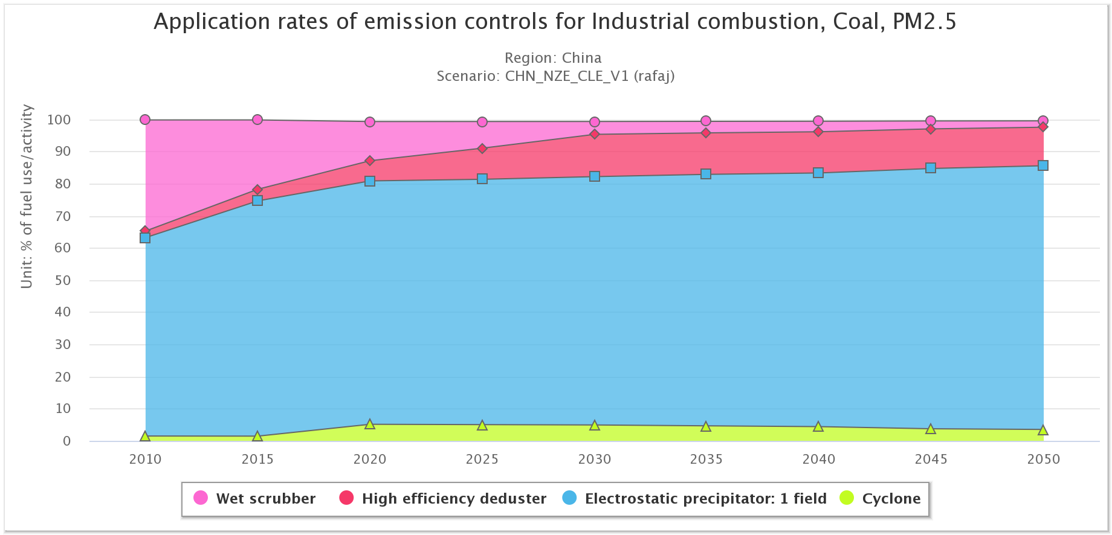
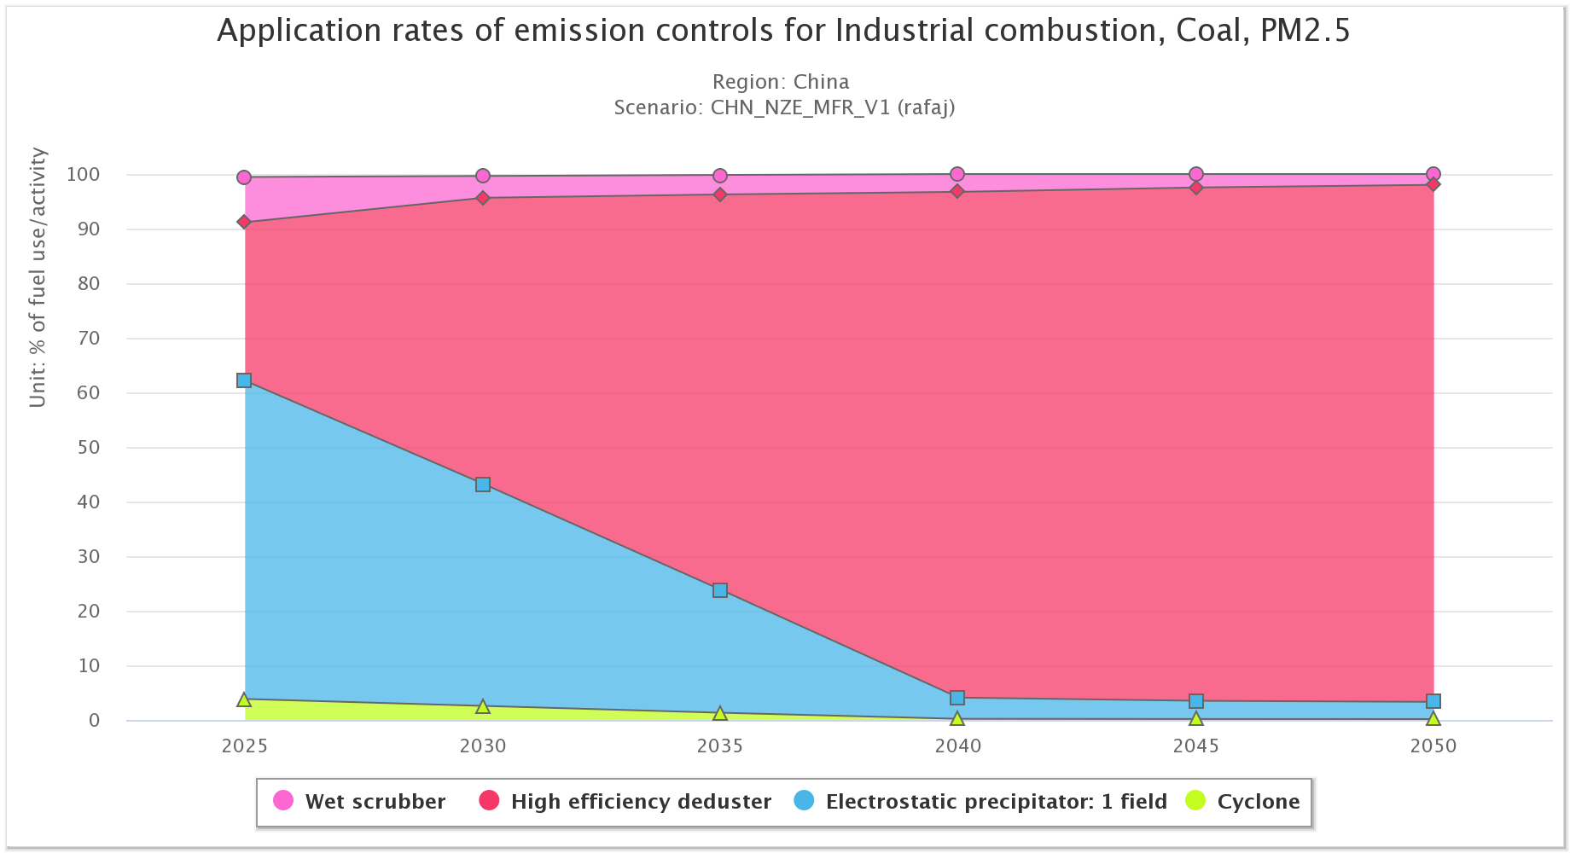
Rules for emission control options

Slide 12
Data requirements for GAINS
Data needs | Initial IIASA version (international data) | Improved with input from national experts
Base year & projections of economic activities | Data already implemented in GAINS (IEA, FAO, UN, China Yearbook, etc.) | National data and projections
Emission factors | Current GAINS database, including region-specific parameterization | Refinements based on local measurements
Emission controls; efficiencies, costs | Current GAINS database, including region-specific parameterization | Refinement based on national information
Current/maximum application of emission controls | Current GAINS databases, including published info about legislation | Local information
Atmospheric dispersion | GAINS modelling based on global & regional atmospheric dispersion model | Regional/local fine scale model utilizing local monitoring campaigns
Health impacts | Global WHO methodology | Local health statistics

Slide 13
Dr. Shaohui Zhang
Research Scholar
Energy, Climate, and Environment Program (ECE)
International Institute for Applied Systems Analysis (IIASA)
Laxenburg, Austria
shaohui.zhang@iiasa.ac.at
www.iiasa.ac.at

