Slide 1
Calculating ambient PM_{2.5} and health impacts in GAINS
Gregor Kiesewetter
Pollution Management Group
Energy, Climate and Environment Program
IIASA
Laxenburg, Austria
GAINS training workshop, April 2021

Slide 2
Overview
Introduction: Principles of source-receptor calculations
Health impact calculations
GAINS-South Asia – current implementation, plans

Slide 3

The GAINS model
Today
PM_{2.5} exposure
Dose-response
Dispersion,
atmospheric chemistry
Health impacts
emissions
Emission factors
Mitigation strategies
Cost optimization
targets
Control technologies
costs
activities
unit costs

Slide 4
Principles: PM_{2.5}
PM_{2.5} is composed of primary PM and secondary aerosols
  PPM dispersion
  SO₂
  NOx SIA formation: (NH₄)₂SO₄ , (NH₄)NO₃
  NH₃
  VOC SOA formation
  Natural dust, sea salt
  → Pure dispersion models (e.g. Aermod) are not enough, but can be useful at local scale
State of the art atmospheric chemistry-transport models (CTMs) can describe ambient PM_{2.5} concentrations well, but are time consuming:
  Emission gridding needed every time
  Execution time of the CTM – typically days per 1 year simulation with good resolution
Needed: fast approximation of the full atmospheric model with similar performance
GAINS approach: linearized response model (“atmospheric transfer coefficients”) derived from sensitivity simulations of a full CTM.
Total PM_{2.5}

Slide 5
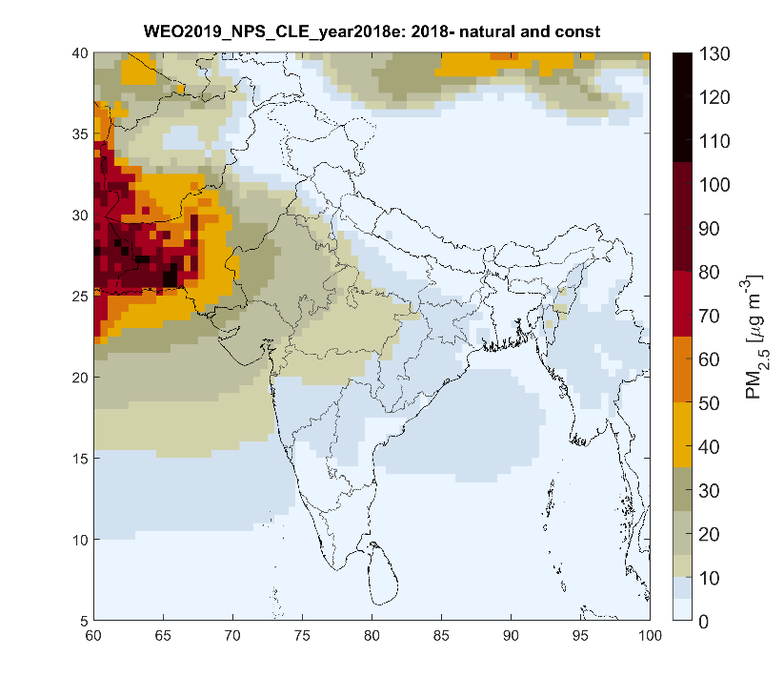
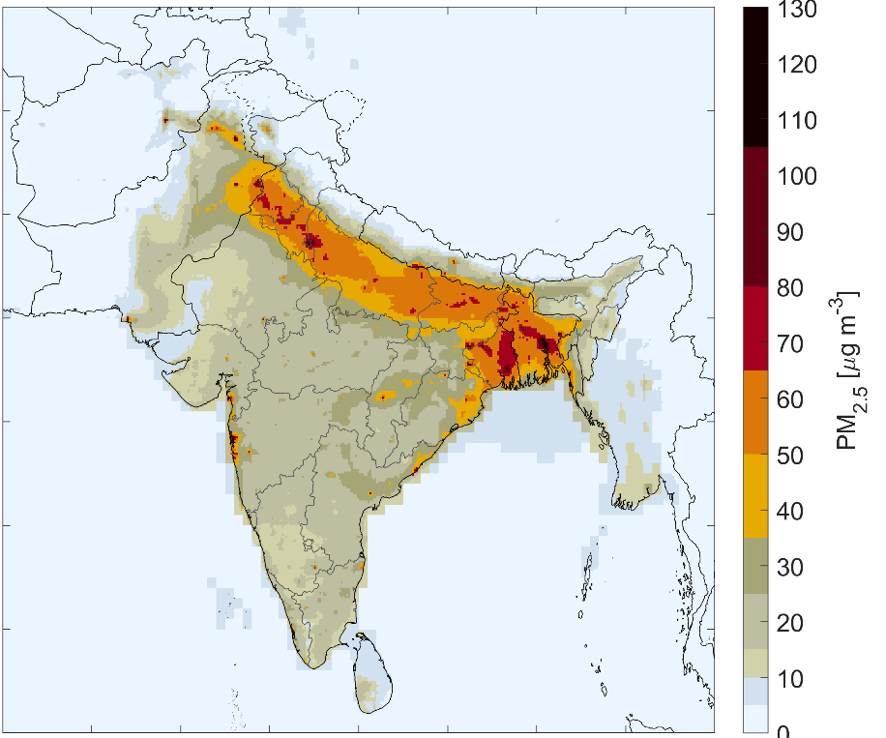
Natural and anthropogenic contributions to PM_{2.5} in ambient air - 2018
Total PM2.5 concentrations
From natural sources (soil dust, sea salt)
From anthropogenic sources
Source: IIASA GAINS

Slide 6
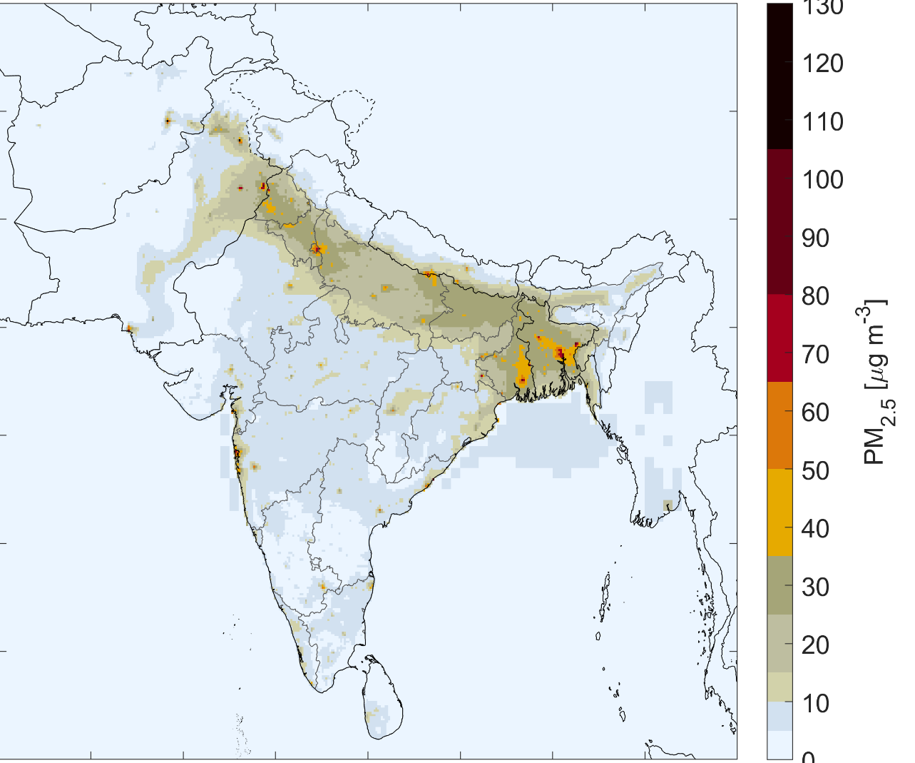
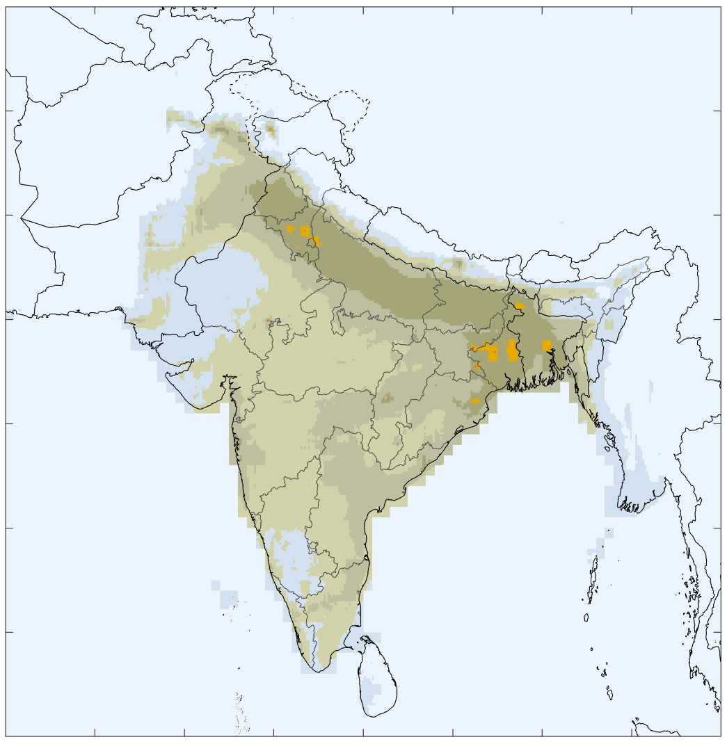
Composition of ambient PM_{2.5}: Primary and secondary PM_{2.5}
Secondary PM_{2.5} formed from
SO₂, NO_{x}, NH₃ and VOC emissions
PM_{2.5} from primary PM emissions from anthropogenic sources
Source: IIASA GAINS

Slide 7
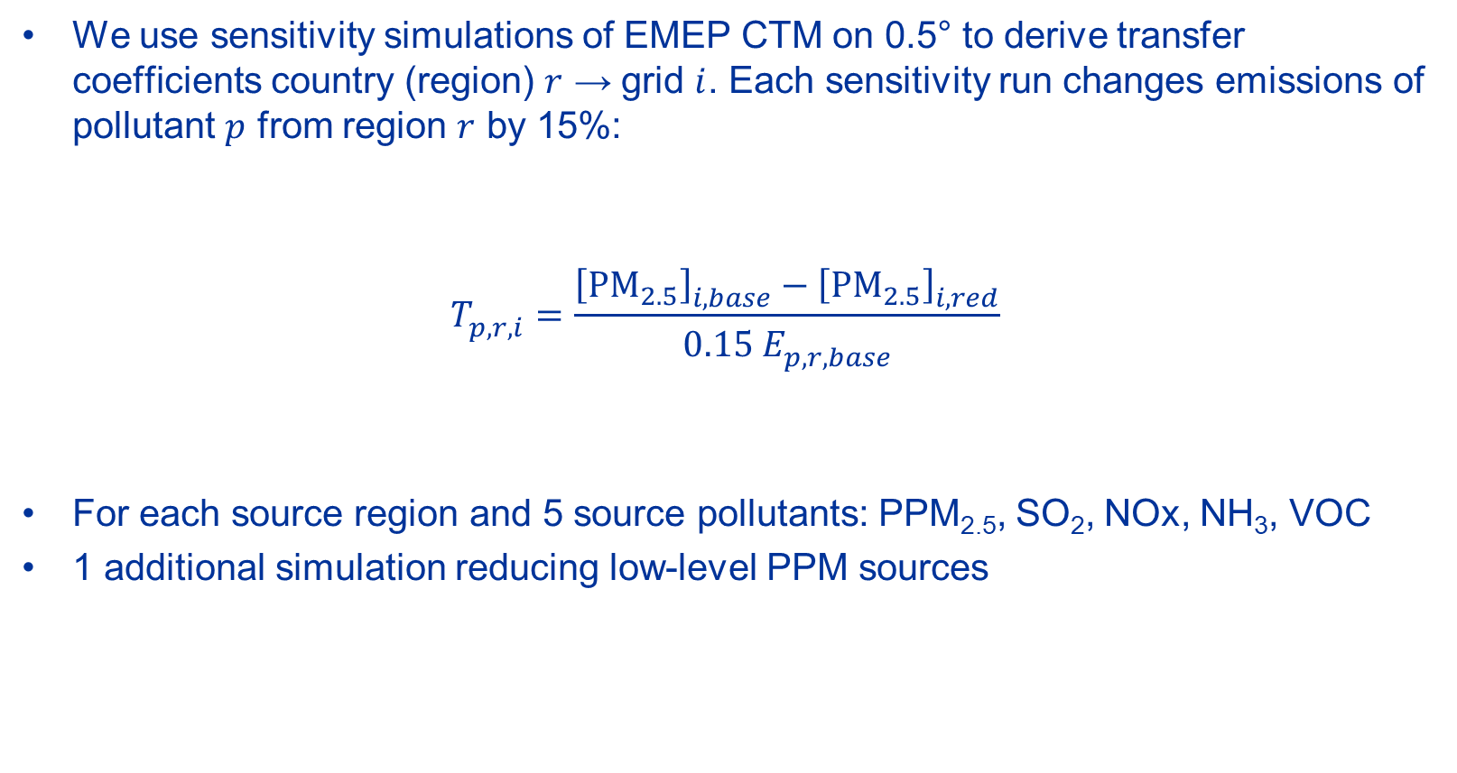
0.5° transfer coefficients
We use sensitivity simulations of EMEP CTM on 0.5° to derive transfer coefficients country (region) $r$ → grid $i$. Each sensitivity run changes emissions of pollutant $p$ from region $r$ by 15%:
$$T_{p,r,i}^{}=\frac{{\left[{PM}_{2.5}\right]}_{i,base}^{}−{\left[{PM}_{2.5}\right]}_{i,red}^{}}{0.15 E_{p,r,base}^{}}$$
For each source region and 5 source pollutants: PPM_{2.5}, SO₂, NOx, NH₃, VOC
1 additional simulation reducing low-level PPM sources
Source region r
Pollutant p
Receptor grid i

Slide 8
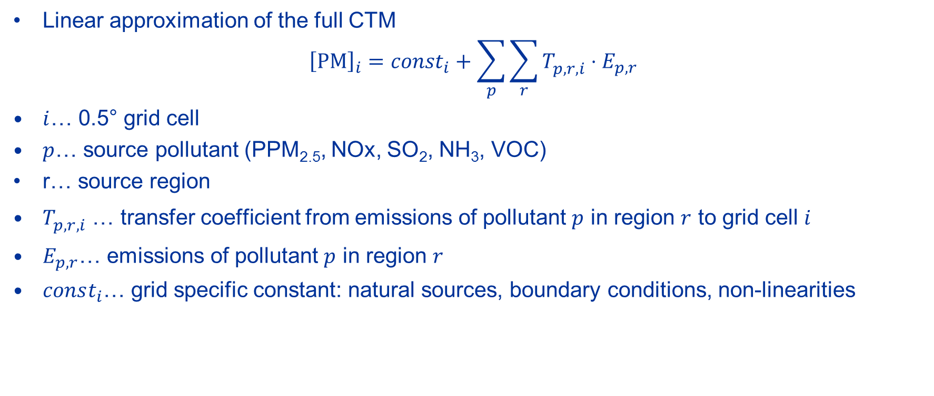
Transfer coefficients
Linear approximation of the full CTM
$${\left[PM\right]}_{i}={const}_{i}+\sum_{p}{\sum_{r}{T_{p,r,i}^{}⋅E_{p,r}}}$$
$i$… 0.5° grid cell
$p$… source pollutant (PPM_{2.5}, NOx, SO₂, NH₃, VOC)
r… source region
$T_{p,r,i}^{}$ … transfer coefficient from emissions of pollutant $p$ in region $r$ to grid cell $i$
$E_{p,r}^{}$… emissions of pollutant $p$ in region $r$
$const_{i}$… grid specific constant: natural sources, boundary conditions, non-linearities
(PPM is actually split into high stack and low-level to take into account the different dispersion characteristics!)

Slide 9
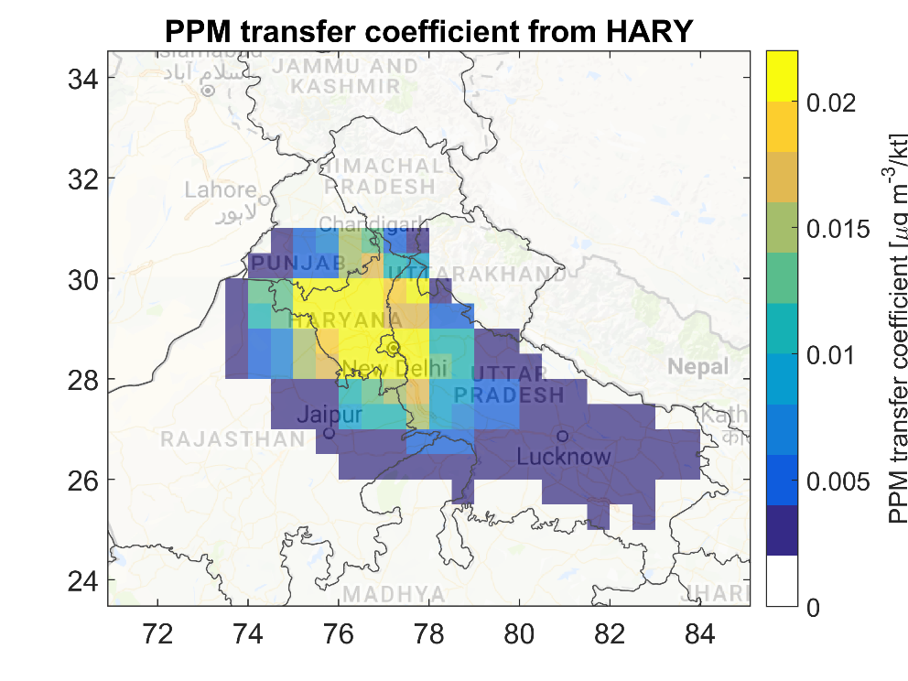
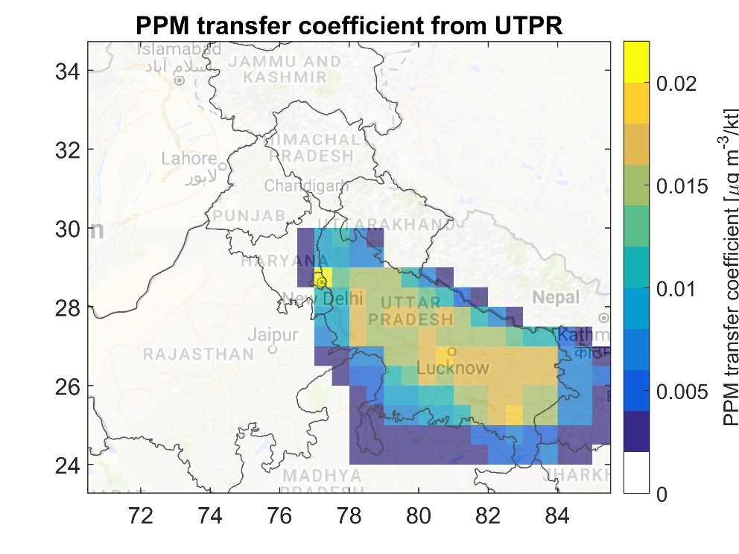
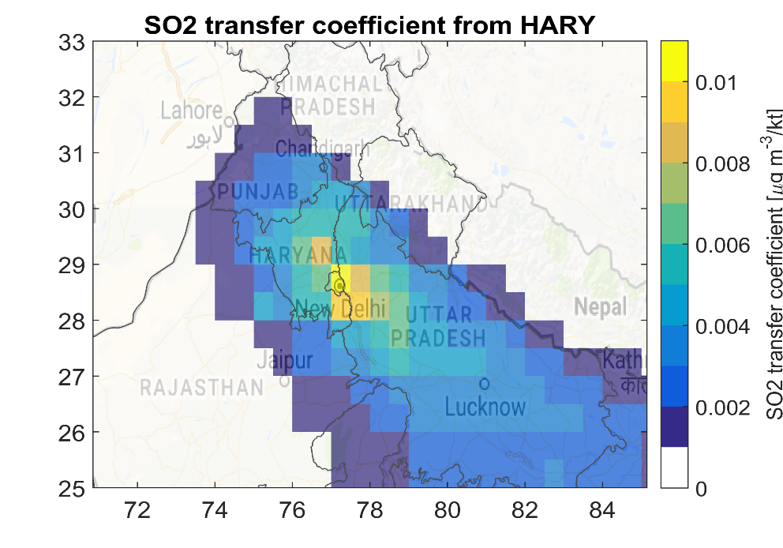
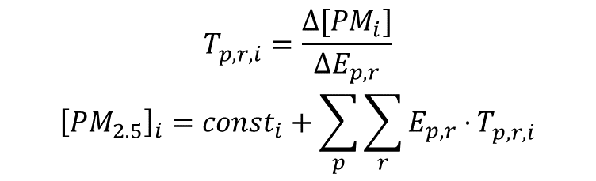
Example: 0.5° atmospheric transfer coefficients
Transfer coefficients represent the change in ambient PM_{2.5} if 1 kiloton more is emitted!
$$T_{p,r,i}^{}=\frac{Δ[PM_{i}]}{ΔE_{p,r}}$$
$${\left[PM_{2.5}\right]}_{i}=const_{i}+\sum_{p}{\sum_{r}{E_{p,r}⋅}T_{p,r,i}^{}}$$

Slide 10
Downscaling for urban areas
0.5° resolution ~ 50km. Not sufficient for urban concentration variation!
Mostly primary PM emissions from low-level sources are responsible for small scale variations (urban increments) in ambient PM concentrations!
  Relevant sectors:
    Residential combustion
    Road traffic
    Municipal waste burning
GAINS splits these sectors into urban and rural (traffic only internally)
Special sensitivity simulations were done with higher resolution (0.1° / 10km) changing only low-level urban emissions
  Split of the PPM low-level transfer coefficient into urban and rural

Slide 11
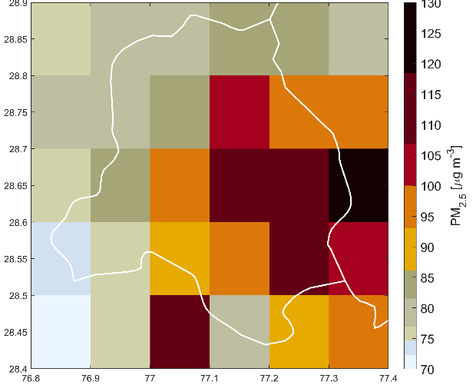
Comparison of monitoring data with model estimates
Modelled grid-average vs. observed PM2.5 in Delhi - 2018
Modelled grid-average
PM2.5 in Delhi - 2018
Observed PM2.5 in Delhi - 2018
GAINS calculates ~10 km*10 km
grid average concentrations
Population-
weighted
mean
exposure
in Delhi
Alternative metrics for different purposes:
Peak concentrations: for compliance with ambient air quality standards | Grid-average concentrations: a spatially more representative measure
Concentrations at specific monitoring sites: for validation of model results | Population-weighted mean exposure: to maximize economic efficiency of AQM strategies
Alternative metrics for different purposes:
Peak concentrations: for compliance with ambient air quality standards | Grid-average concentrations: a spatially more representative measure
Concentrations at specific monitoring sites: for validation of model results

Slide 12
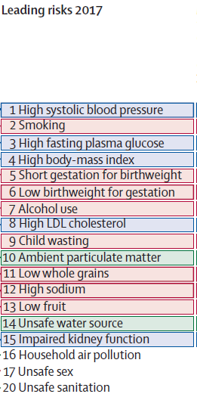
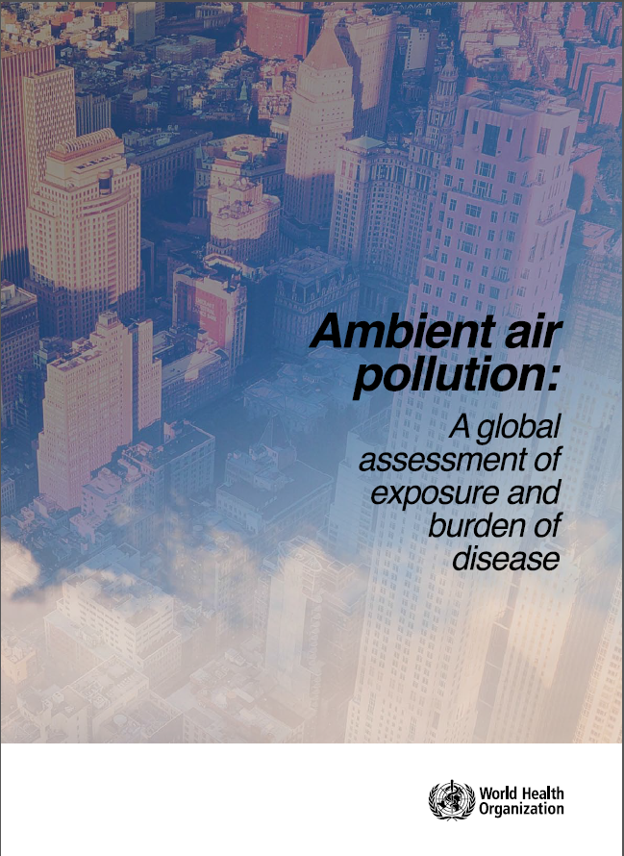
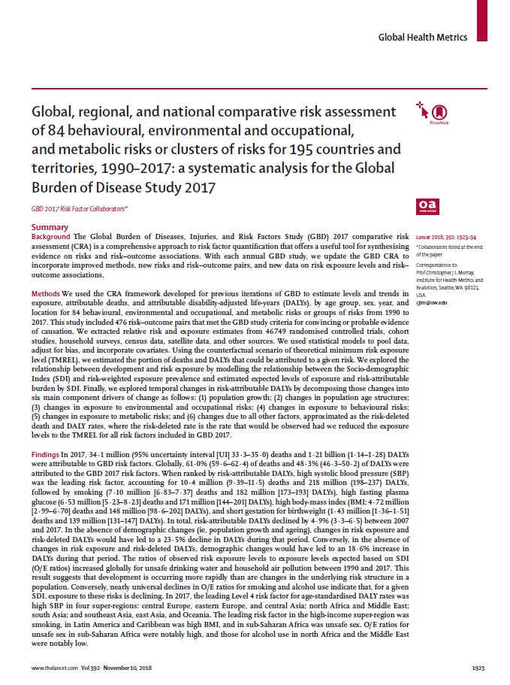
PM_{2.5} and human health
Long-time exposure to PM_{2.5} increases the risk of cardiovascular and respiratory diseases, and lung cancer
3-5 million cases of premature deaths annually are attributed to it,
making it the most important environmental risk factor for human health.

Slide 13
Health impact calculations in GAINS
Outside Europe, GAINS follows the approach of the Global Burden of Disease studies
We calculate disease and age specific mortality
Long-term exposure increases the risk for death from a few diseases: COPD, stroke, IHD, lung cancer, ALRI.
Needed:
  Ambient PM_{2.5} concentration on relevant resolution (urban background)
  Population data on the same spatial distribution
  Exposure-response relationships
  Baseline mortality data (by disease and age)
GAINS
worldpop.org.uk (100m grid)
International literature: GBD, WHO,…
UN World Population Prospects (total mortality)
GBD (disease contributions)

Slide 14
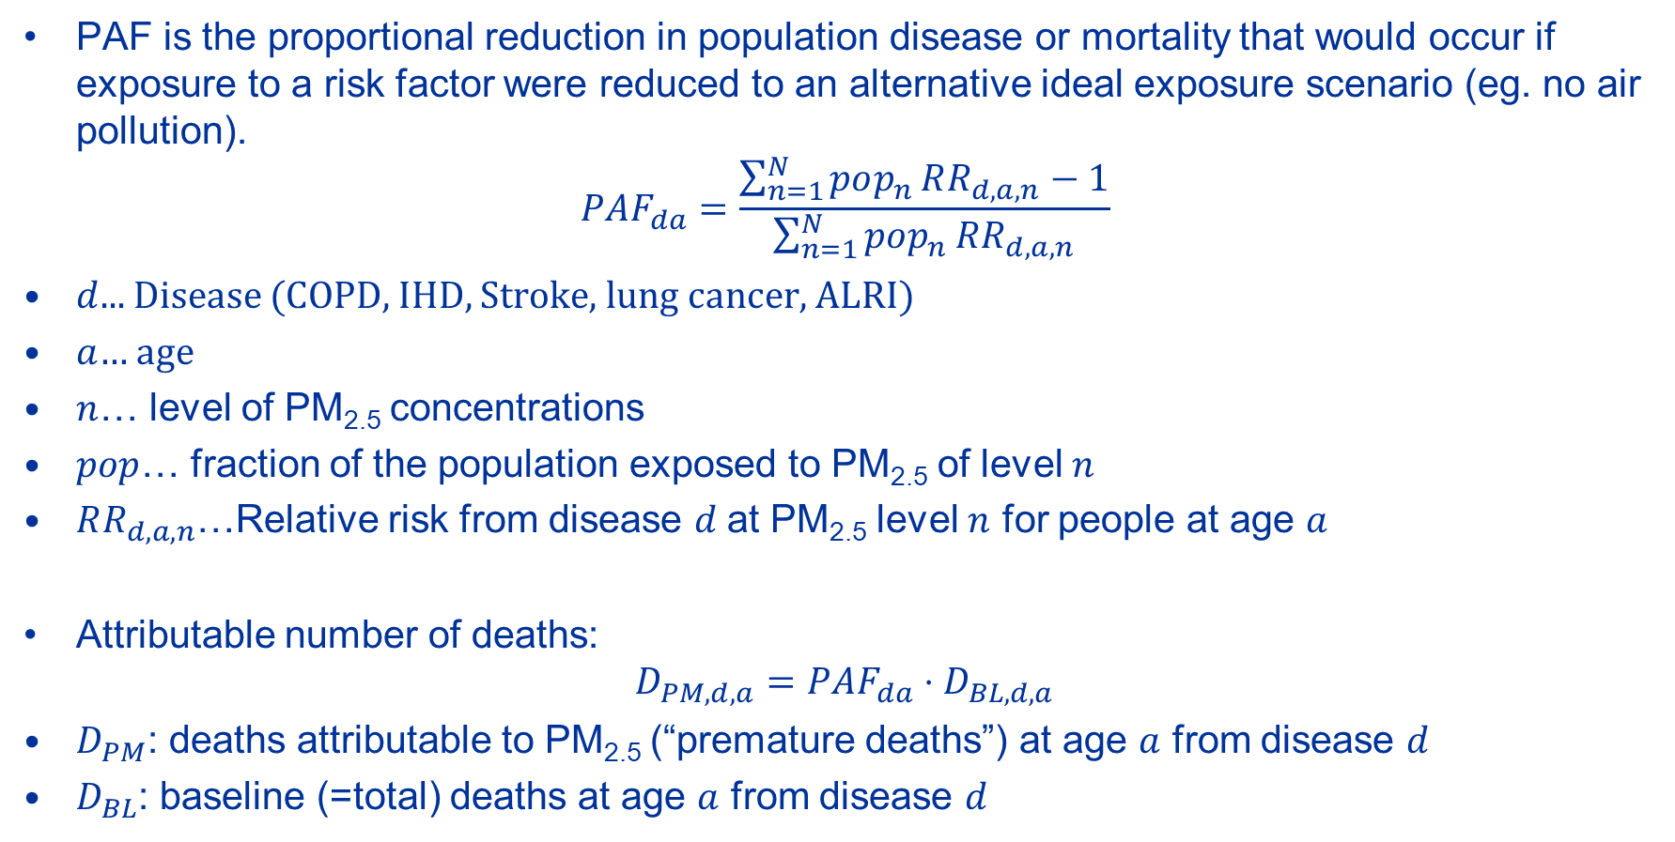
Population attributable fraction
PAF is the proportional reduction in population disease or mortality that would occur if exposure to a risk factor were reduced to an alternative ideal exposure scenario (eg. no air pollution).
$$PAF_{da}=\frac{\sum_{n=1}^{N}{pop_{n}}RR_{d,a,n}−1}{\sum_{n=1}^{N}{pop_{n}}RR_{d,a,n}}$$
$d$... Disease (COPD, IHD, Stroke, lung cancer, ALRI)
$a$… age
$n$… level of PM_{2.5} concentrations
$pop$… fraction of the population exposed to PM_{2.5} of level $n$
$RR_{d,a,n}$…Relative risk from disease $d$at PM_{2.5} level $n$ for people at age $a$
Attributable number of deaths:
$$D_{PM,d,a}=PAF_{da}⋅D_{BL,d,a}$$
$D_{PM}$: deaths attributable to PM_{2.5} (“premature deaths”) at age $a$ from disease $d$
$D_{BL}$: baseline (=total) deaths at age $a$ from disease $d$

Slide 15
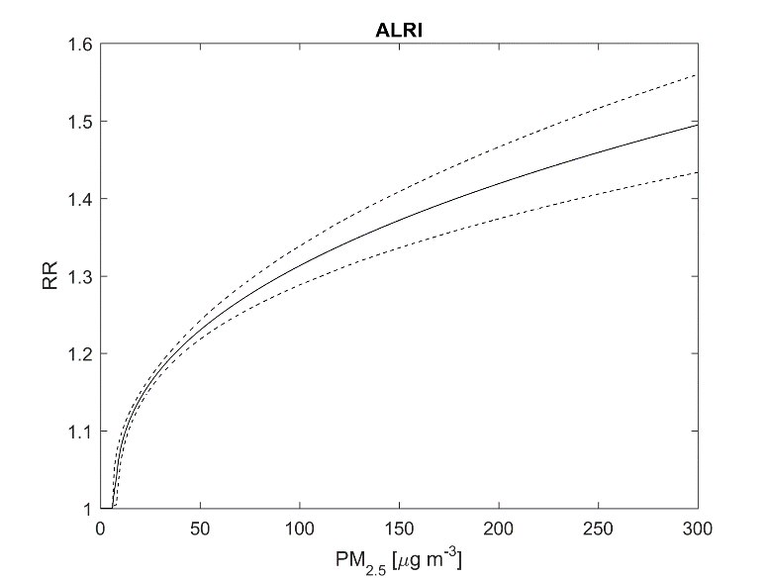
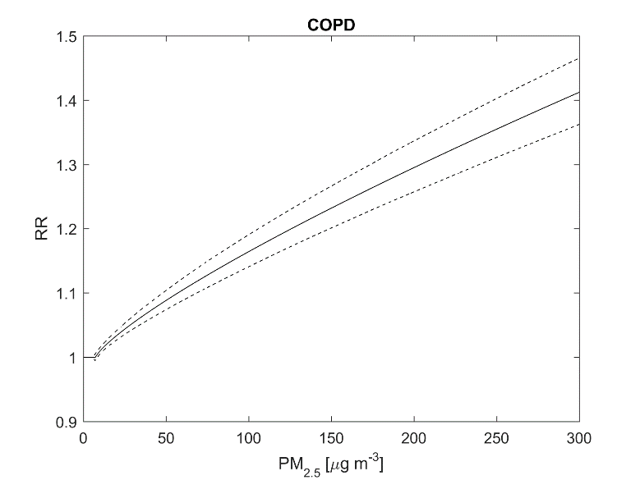
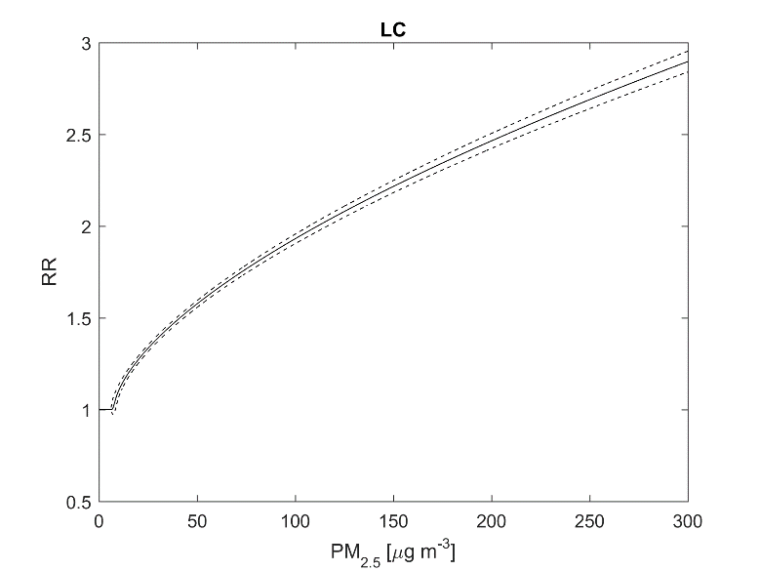
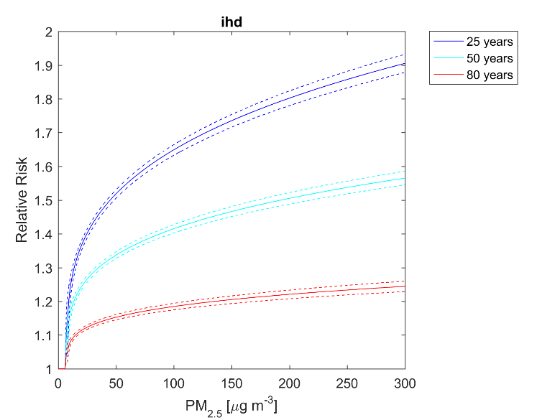
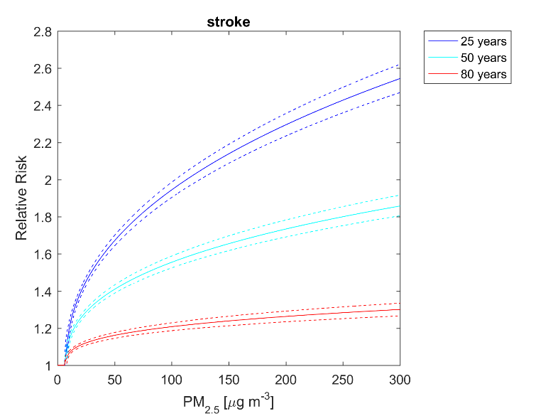
Integrated exposure-response functions
Many versions have been developed. Currently GAINS uses those from WHO 2016 / GBD 2013.
ALRI
COPD
Lung cancer
IHD
Stroke

Slide 16
What GAINS currently calculates
Ambient PM_{2.5} concentration maps
Population-weighted mean PM_{2.5} in each GAINS region
Health impacts: annual premature deaths from ambient PM_{2.5}
Exposure distribution: how many people are exposed to different levels of PM_{2.5}?
Source attribution:
  Where does ambient PM in each GAINS region originate from?
  Which sectors are responsible?

Slide 17
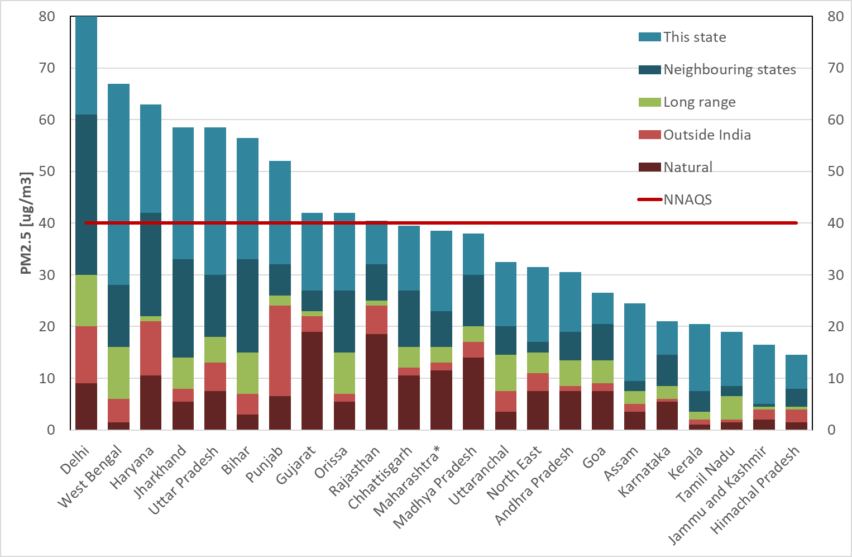
Contributions to state-wise PM_{2.5} in India

Slide 18
Contributions to state-wise PM2.5 in India: sectors

Slide 19
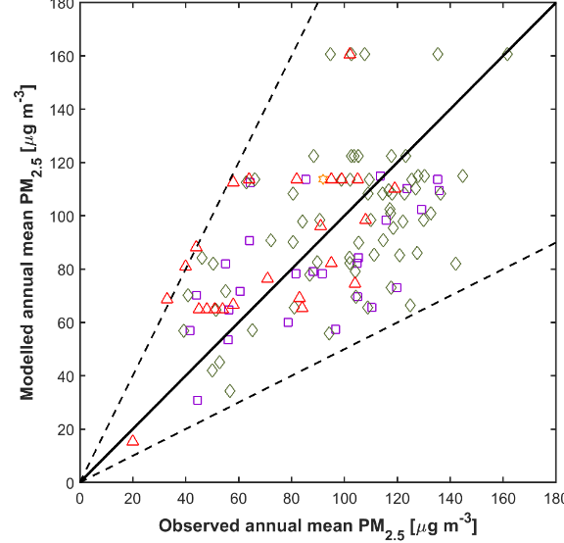
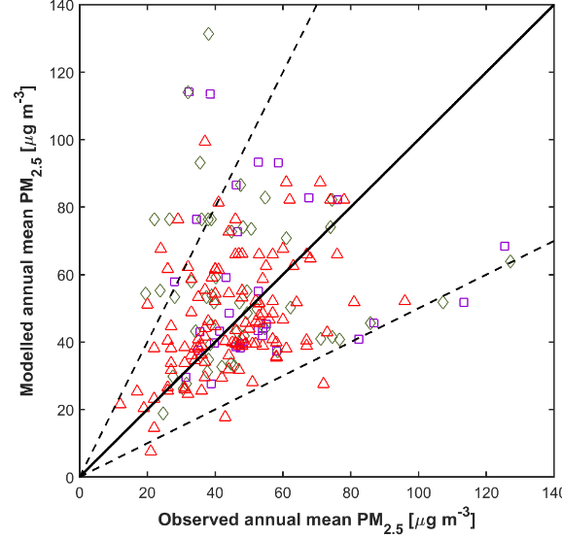
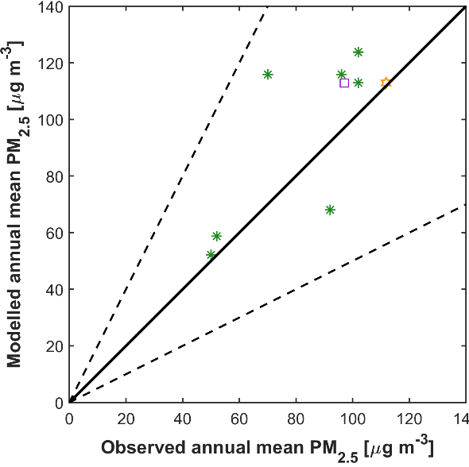
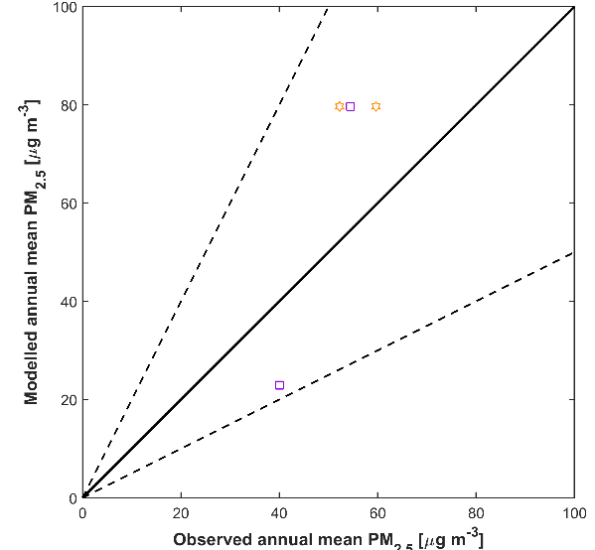
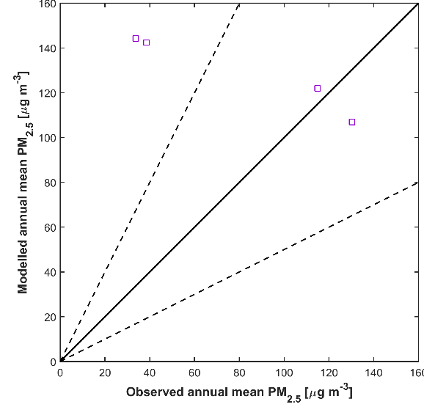
Validation of model results against observations – 2018
Only stations with more than 75% data coverage are considered
India IGP | India – non-IGP States | Bangladesh
Nepal | Pakistan | Sri Lanka

