Slide 1

GAINS cost-effectiveness analysis
Fabian Wagner
fabian@iiasa.ac.at
SPIPA GAINS Training, 12-16 April 2021

Slide 2
Uses of the GAINS model
Activity-based emissions inventory (AP/GHG)
Simulation of future scenarios/incl. What if policies were implemented? (AP/GHG)
Comparison of alternative scenarios (AP/GHG)
Co-benefit analysis (GHG+AP)
Cost-effectiveness analysis (AP/GHG)
  Incl. cost curves

Slide 3
Agenda
Why cost-effectiveness analysis
Optimization/GAINS cost concept/marginal costs
Target setting: recent examples from South Asia
The cycle of policy support and analysis
Conclusion

Slide 4
Why cost-effectiveness analysis

Slide 5
Integrated Assessment Model
A tool that provides useful information and facilitates decisions
Here: Provide answers to the
Central question for policy makers:
To what level should the emissions of air pollutants be reduced in some future year 20XX?
Where will emissions and effects be in year 20XX just with current policies in place?
What further reductions are technically feasible?
How much do they cost? – optimal/non-optimal
Who should take action?
Who (which countries/regions/sectors) pays?
How much are they willing to pay?
Who benefits?
Is it enough?
Is it fair?
Notes:
Need the ability to analyze alternative futures (scenarios)

Slide 6
Separate two questions?
Cost-effective solution?
Who is going to pay for it?

Slide 7


Greenhouse gas–Air pollution Interactions and Synergies:
The GAINS tool
Social development
and economic activities
National
Emission
Ceilings
National emission ceilings
Emission control options: ~2000 measures,
co-control of 10 air pollutants and 6 GHGs)
Emissions
Costs
Optimization
Atmospheric dispersion
Health, ecosystems and climate impact indicators
Policy targets

Slide 8
Optimization: a primer
Linear optimization of air pollution control strategies in GAINS:
Objective: minimize (Costs)
s.t. EnvEffect_{k} < Limit_{k}
Minimize costs, such that environmental effects do not exceed pre-defined limits
(there are additional technology constraints, e.g.
  maximum application rates
  vintage structure
  etc)

Slide 9
Cost concept used
All costs are in (economic) real terms (2015)
Societal costs:
  Standard discount rate: 4 percent p.a.
  Taxes not included
  Transaction & training costs not included
Feedback on economy not included (small)
Technology costs
  Non-technical measures not included
  Investment, Operating and Maintenance costs, Labour cost, Energy costs, etc.
  Are constant over time

Slide 10
Cost information in the literature
Example: Flue gas desulphurization (FGD)
Cost components
Scrubber type | Unit size MW | Capital Cost $/kW | O&M cost - fix $/kW | O&M cost - var $/MWh
Wet | >400 | 100-250 | 2-8 | 0.5-2
Wet | <400 | 250-1500 | 8-20 | 0.5-2
Spray dry | >400 | 40-150 | 4-10 | 0.5-2
Spray dry | <400 | 150-1500 | 10-300 | 0.5-2

Slide 11
Annualizing investment costs
q = discount (interest) rate , n = lifetime of installation

Slide 12
Units used
Costs per unit of activity
  E.g. MEuro per PJ
Costs per ton of pollutant removed
  E.g. Euro per ton of SO2
“per year” is always implicit

Slide 13
Costs are country- and technology-specific
Technology-specific factors:
Investments, fixed O+M
Demand for labour, energy, by-products
Lifetime of equipment
Removal efficiency
Country-specific factors:
Installation size, plant factors
Prices for labour, energy, by-products, etc.
Applicability

Slide 14
Cost calculation methodology
Costs per activity unit:
I^{an} | Annualised investments
OM^{fix} | Fixed operating & maintenance costs
OM^{var} | Variable operating & maintenance costs
pf | Capacity utilisation
Costs per emission removed:
ef | Uncontrolled emission factor
η | Removal efficiency

Slide 15
Unit costs: per fuel vs per tSO2 reduced
 | Emission factor ktSO2 /PJ | Unit cost/ PJ | unit cost/ tSO2
no Control | 2.000
LINJ | 0.750 | 0.6 | 0.48
PWFGD | 0.100 | 0.4 | 0.21
RFGD | 0.050 | 0.7 | 0.36

Slide 16
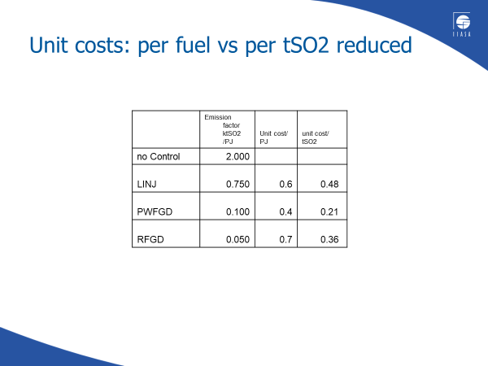
Unit costs vs marginal costs graphically
RFGD
RFGD
PWFGD
PWFGD
No control

Slide 17
Unit costs vs marginal costs
Marginal cost for using technology 2 when technology 1 is in place:
MC₁₂= -(UC₂ – UC₁)/(∆E₂ - ∆E₁)
UC_{i} : unit cost technology i [EUR/PJ]
∆E_{i}: emissions reduced relative to no-control, e.g. [t/PJ]
_{Example:}

Slide 18
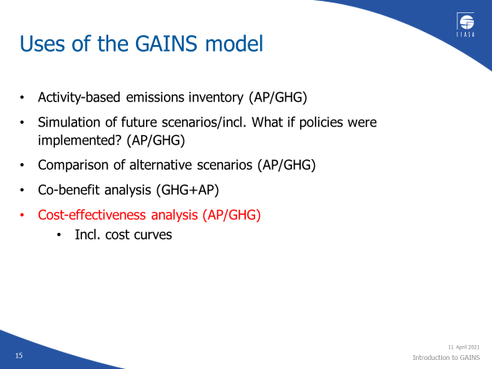
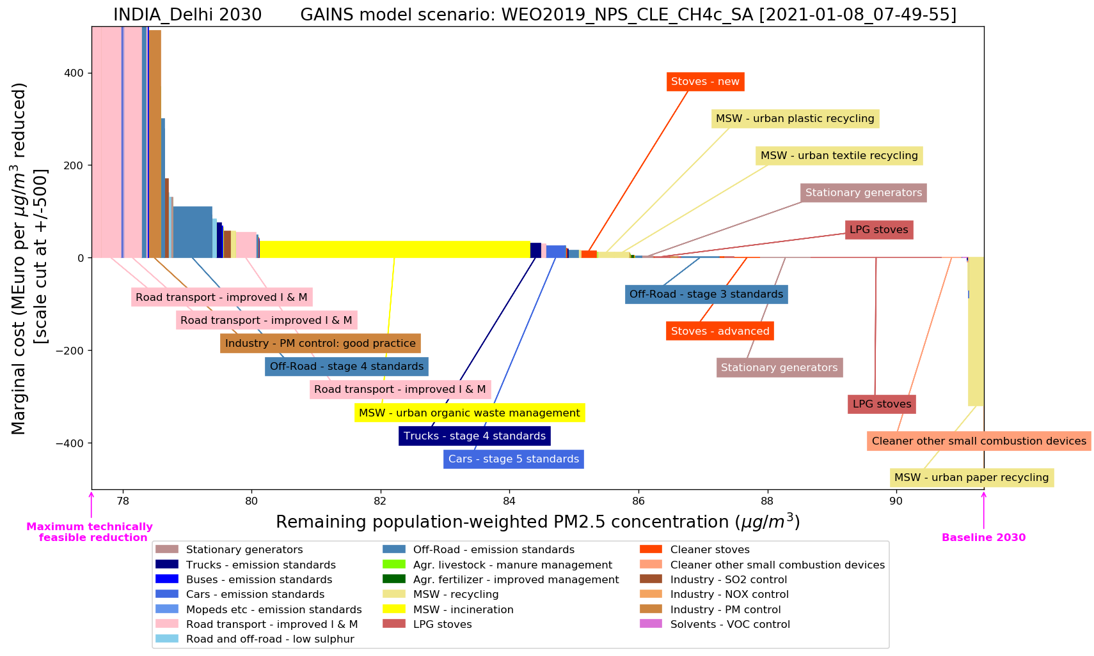
Cost-effectiveness analysis:
How do we reduce pollution in the most cost-effective way?
Marginal abatement cost curves are part of the answer, but not all of it!

Slide 19
The GAINS optimization is formulated as a linear programming (LP) problem
What are the decision variables?
What choices does the GAINS have in the optimization?

Slide 20
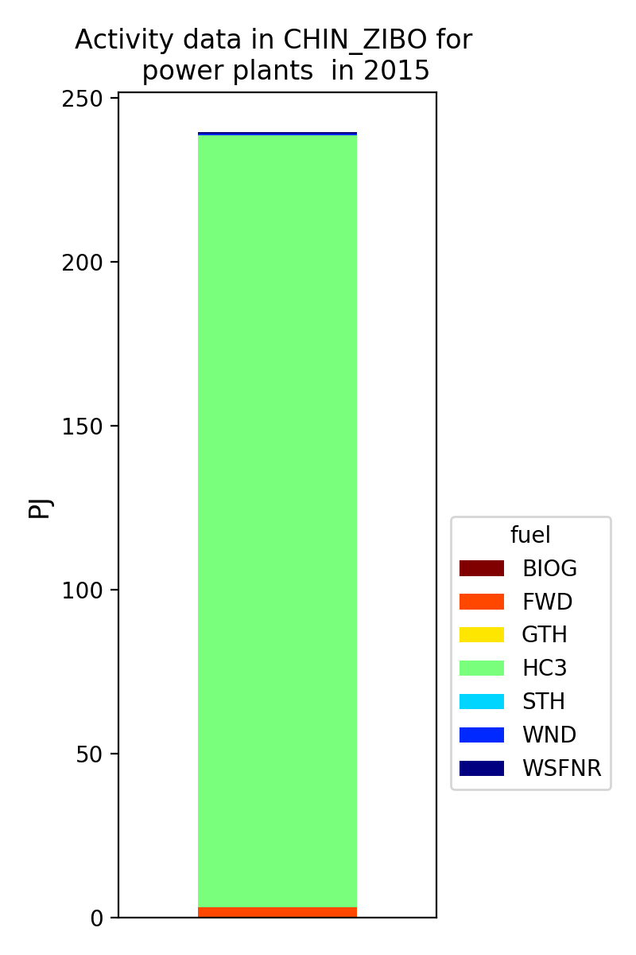
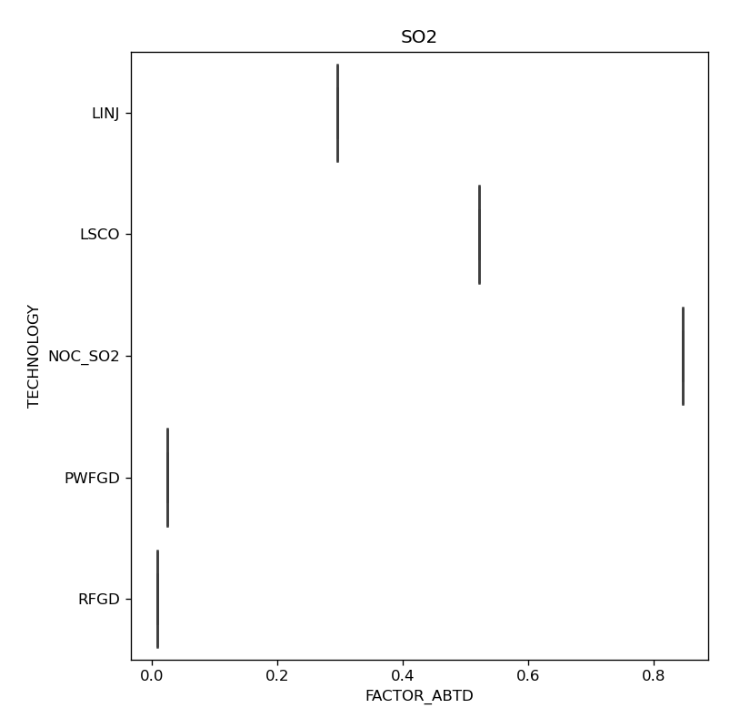
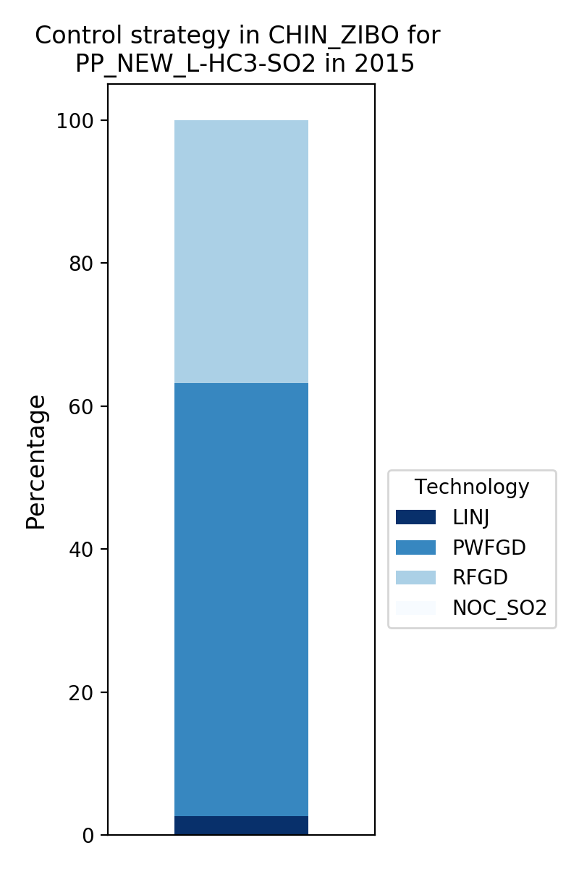


Revisiting the emissions calculation
E.g. power plants
Emissions = (activity data) x (emission factor)
$$×\sum_{t}{}$$
Coal (HC3) use
$$×$$
We can do this for every sector-activity-pollutant combination!

Slide 21
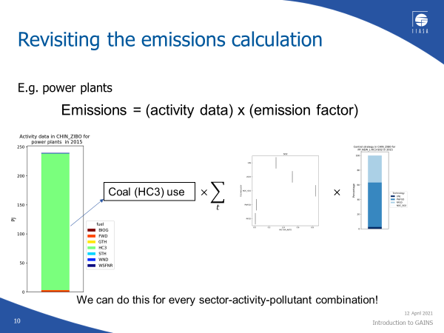
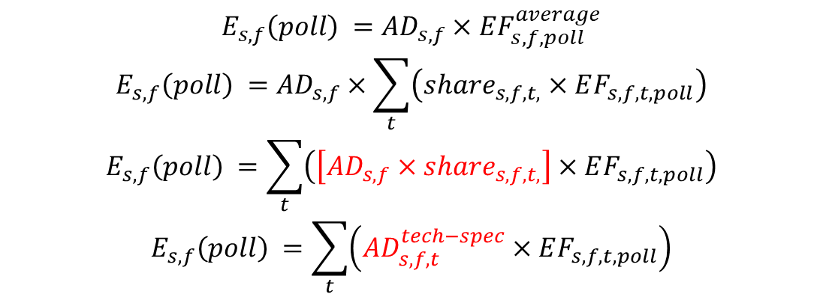
Technology specific activity data
Emissions = (activity data) x (emission factor)
$$E_{s,f}\left(poll\right) ={AD}_{s,f}×EF_{s,f,poll}^{average}$$
$$E_{s,f}\left(poll\right) ={AD}_{s,f}×\sum_{t}{\left(share_{s,f,t,}×EF_{s,f,t,poll}\right)}$$
$$E_{s,f}\left(poll\right) =\sum_{t}{\left(\left[{AD}_{s,f}×share_{s,f,t,}\right]×EF_{s,f,t,poll}\right)}$$
$$E_{s,f}\left(poll\right) =\sum_{t}{\left({AD}_{s,f,t}^{tech−spec}×EF_{s,f,t,poll}\right)}$$

Slide 22
Technology-specific activity data
Variables in the optimization = (activity data) x (control strategy)

Slide 23
The GAINS optimization is formulated as a linear programming (LP) problem
i emission region
s GAINS sector
f GAINS fuel/activity
t GAINS technology

Slide 24
Types of constraints
Environmental/Impact targets
Generic technology constraints
  Maximum application rates/shares not suitable for controls
  Vintage structure
  Fixed application rates
Average emission factors (per sector/activity) can only decrease, not increase. [Emission standards can only become stricter]

Slide 25
Setting targets
impact indicator
Option 1: Air quality target in every grid cell
Impact indicator: concentration
k: each grid cell
(approx. 6,500 inequalities)
Option 2: Gap closure on concentration in every grid cell
Impact indicator: concentration
k: each grid cell
(approx. 6,500 inequalities)
Option 3: Gap closure on total mortality
Impact indicator: mortality
k: only one EU aggregate
(1 inequality)

Slide 26
Greenhouse gas–Air pollution Interactions and Synergies:
The GAINS tool
Social development
and economic activities
Emission control options: ~2000 measures,
co-control of 10 air pollutants and 6 GHGs)
Emissions
Costs
Optimization
Atmospheric dispersion
Health, ecosystems and climate impact indicators
Policy targets

Slide 27
Narrative: AQ outlook to 2030 – airshed management will be important
Potential impacts of recent policies in 2030
  for different assumptions on the implementation effectiveness
Scope for further measures: with all additional measures in GAINS
  showing potentials for improvements from domestic measures and for spillovers from other regions
Four options for next steps:
  Popular additional measures
    Region-wide application of a common set of popular measures
  Most effective low-cost measures in each region
    A uniform limit on marginal costs for improvement of the domestic exposures in all regions
    Ignoring spillover benefits to other regions, thus not really cost-effective
  Bring pop-weighted exposure below WHO IT1 (35µg.m⁻³)
    Cost-effectiveness optimization, explore distributional issues
    Demonstrate the need for an airshed approach across IGP
  90% towards WHO IT1 in all regions
Explore distributional issues; implications for airshed strategies

Slide 28
India: Impact of recent policies in 2030
Contributions from natural sources

Slide 29
Cost-effectiveness analysis:
How do we reduce pollution in the most cost-effective way?
Marginal abatement cost curves are part of the answer, but not all of it!

Slide 30
Scope for additional measures in 2030
Contributions from natural sources

Slide 31
Option 1: ‘Popular additional measures’
A common set of popular measures
applied throughout SAR
Based on government announcements
Considering gradual phase-in

Slide 32
Option 1: Popular additional measures

Slide 33
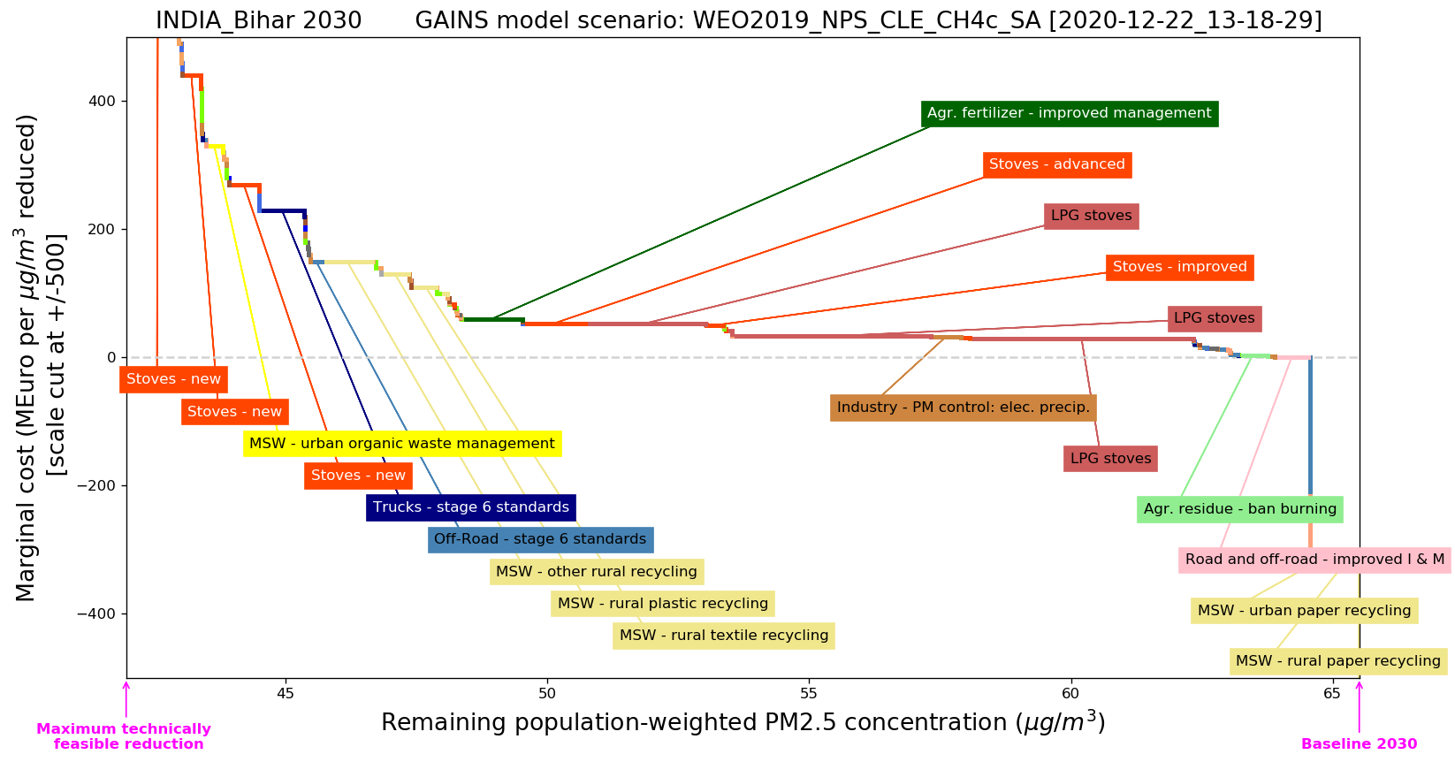
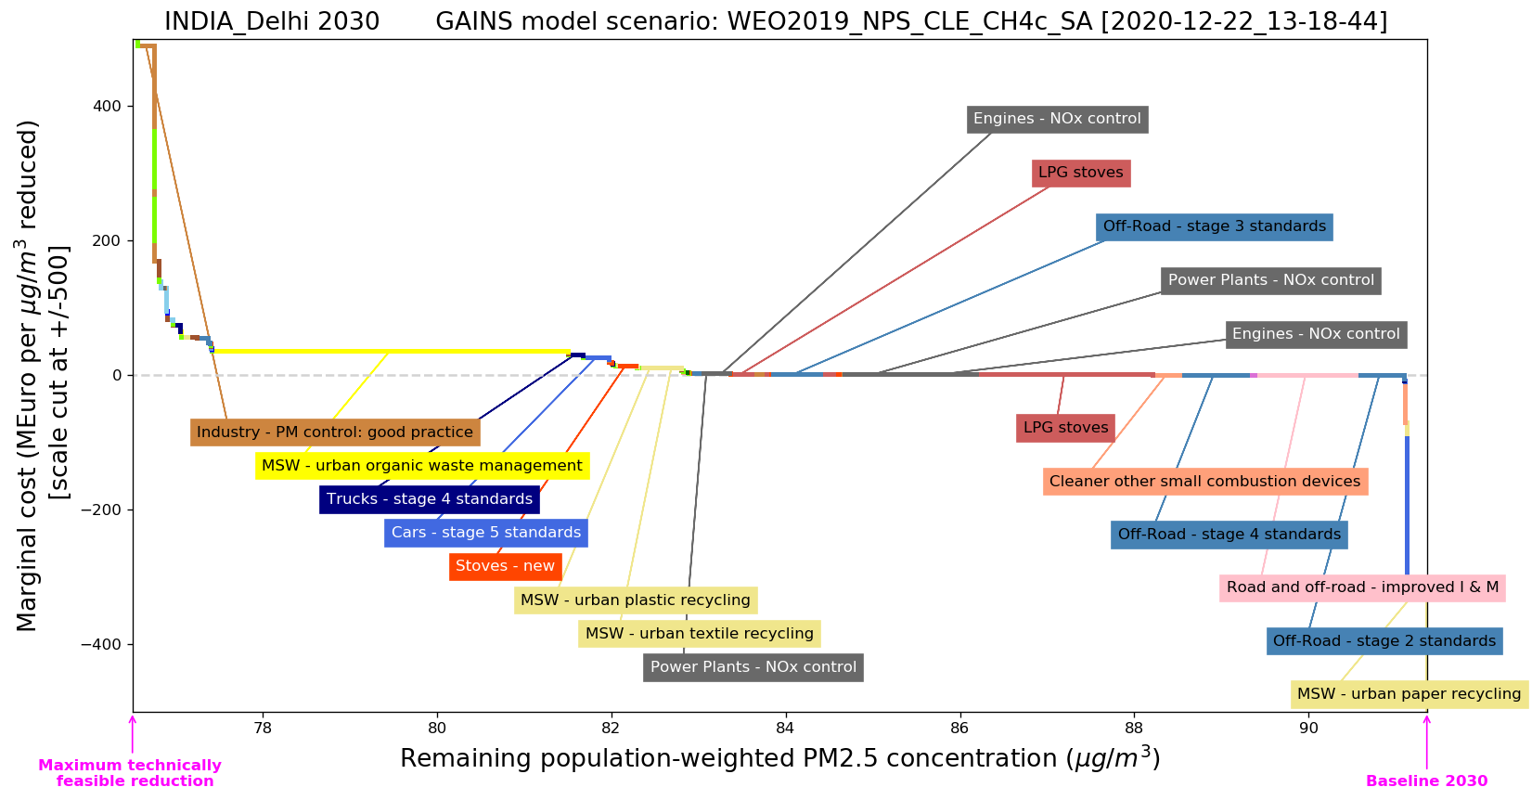
Option 2: Most effective low-cost measures in each region
Based on region-specific cost curves for exposure reductions to PM2.5
In each region, all measures with marginal costs below 80 million Euro/µg.m-3 are selected
However, these cost curves consider only exposure reductions within the same region, and do not include spill-overs to other regions. Total exposure reductions (incl. impacts on other regions) could be twice as high.
Bihar Delhi NCT

Slide 34
Option 2: Most effective low-cost measures in each region

Slide 35
Option 3: Bring pop-weighted exposure in all regions below WHO IT1 (35µg.m⁻³)
This does not address hot-spots where local measures will be most effective
Allowing measures that are required/cost-effective for achieving the targets in other regions
This target requires action mainly in the IGP, Bangladesh and Pakistan, while in other areas it will be
attained already by full application of current policies
Distribution of costs – largest efforts with excessive costs in regions with highest concentrations, even if a large share originates from natural sources

Slide 36
Option 3: Bring pop-weighted exposure in all regions below WHO IT1

Slide 37
Option 4: 90% towards WHO IT1 in all regions
Target: Reduce current (here: 2030 baseline) exceedance of WHO IT1 by 90% in all regions
  A cooperative approach, all regions take the cost-effective measures
  to enable a 90% reduction of WHO IT1 excess throughout SAR
  Some IGP States overachieve the 90% reduction due to the need to achieve target in Delhi

Slide 38
Option 4: Reduce 2030 exceedance of WHO IT1 by 90% in all regions

Slide 39
Exposure reductions vs costs

Slide 40
Distribution of costs in 2030 (% of GDP)

Slide 41
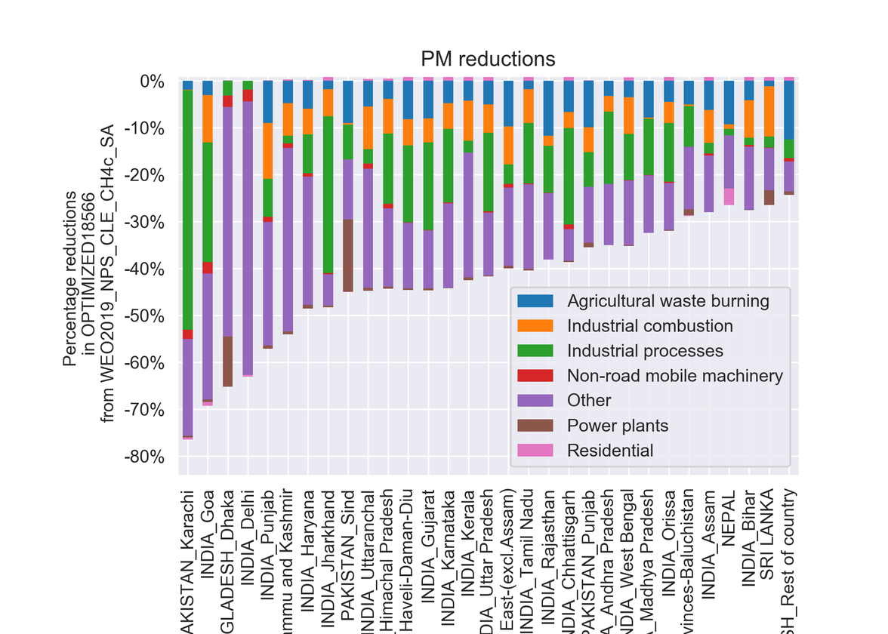
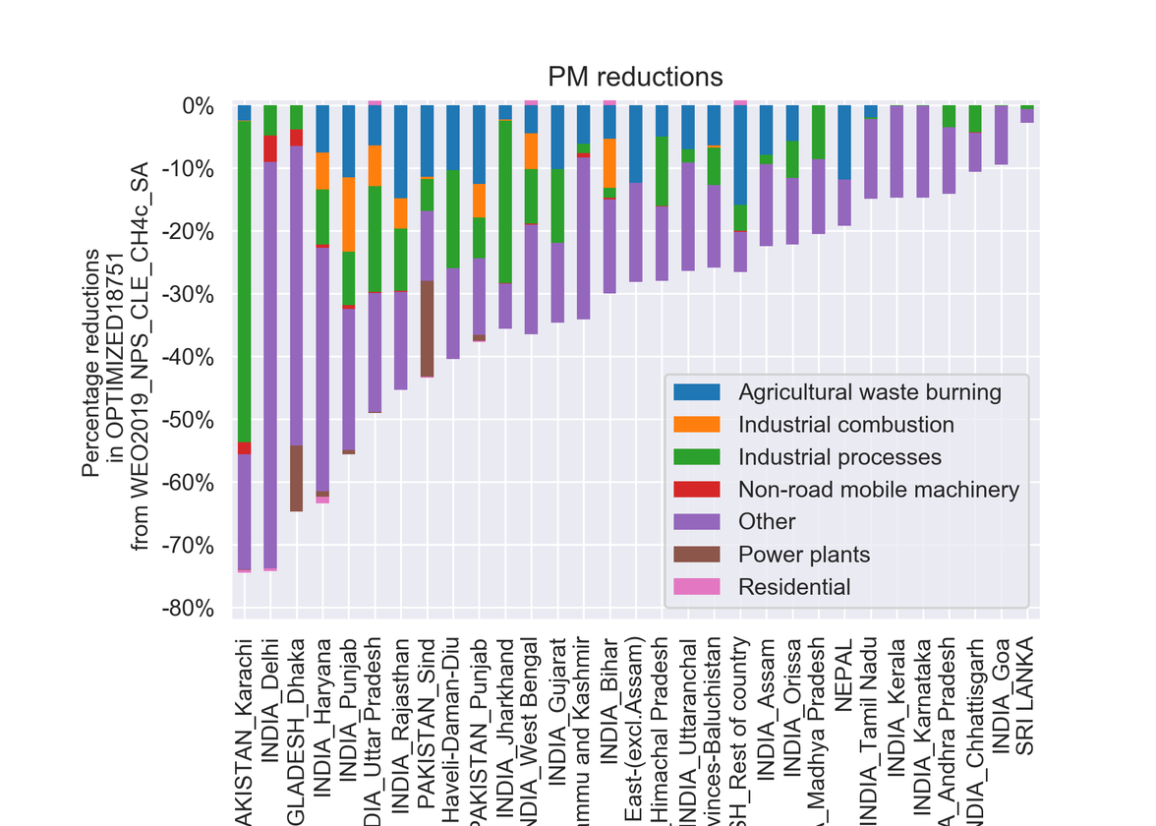
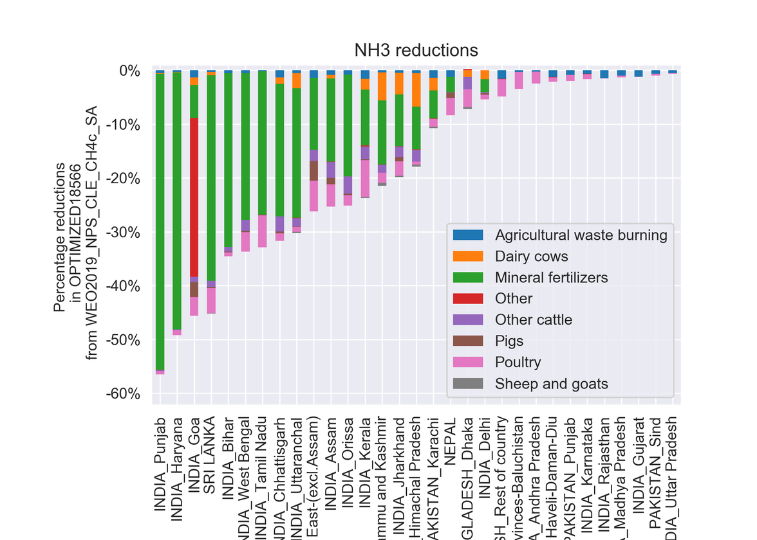
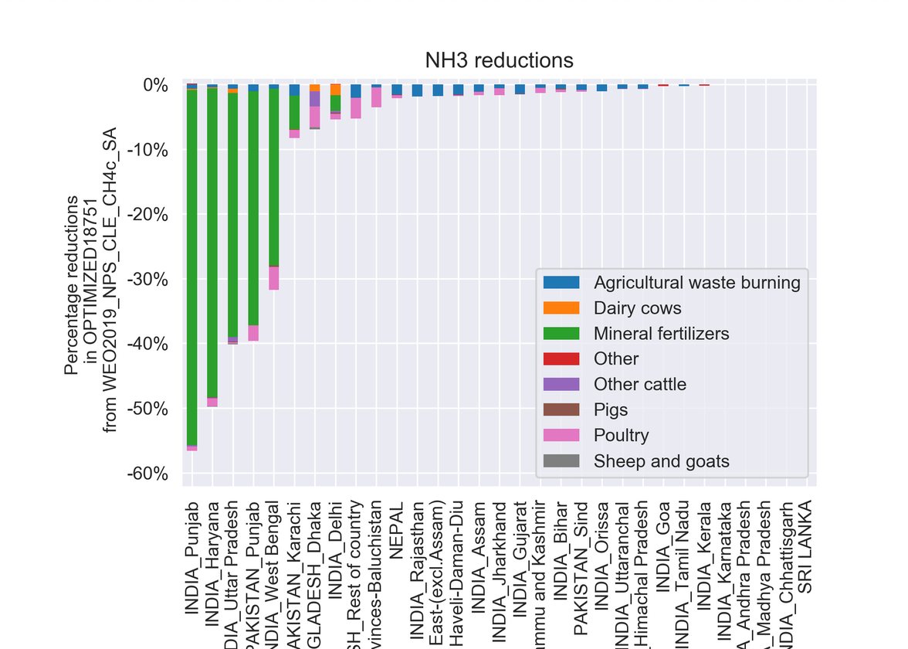
Emission reductions: 90% to WHO-IT1 vs Low-cost scenario
Effective low-cost measures 90% towards WHO IT1

Slide 42
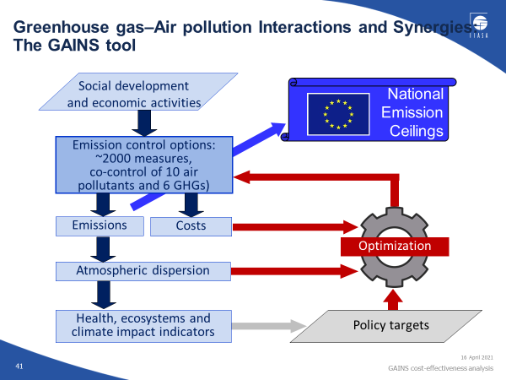

Slide 43
The iterative process:
11 GAINS reports supporting the
EU Thematic strategy on Air Pollution
2
Report on causes for recent emission reductions
1
6
7
8
9
10
11
Report on Current Legislation Emissions
Report on Agriculture
Report on modeling compliance in GAINS
3
Report on Compliance with EU Air quality
4
Report on Mobile Source
Report on policy scenarios
Report on Scenarios for cost-effective controls
Report on Households
Report on final policy scenarios
5
Report on Health end Environmental Impacts
June 2012
February 2014

Slide 44
The iterative process:
5 additional GAINS reports supporting the
EU Thematic strategy on Air Pollution
11
12
13
14
15
16
Report on final policy scenarios
Report on resulting urban air quality
Report on adjusted historic emission data
Report on bilateral consultations
Report on updates in the input data
Report on a flexibility mechanism
February 2014
January 2015

Slide 45
Conclusions

Slide 46
Conclusions
Cost-effective solutions typically save money vis-à-vis other approaches
Optimization techniques can help to identify such solutions
The GAINS cost-effectiveness analysis has been used in many regions of the world to guide policy makers
It is useful to separate the goal of overall cost-effectiveness from questions of distribution
The choice of environmental/health impact targets – type and ambition level – is a political one. (Cost-effective) scenario analysis can reveal advantages and disadvantages of the options.

