Slide 1
The GAINS (Greenhouse gas - Air Pollution INteractions and Synergies) Model
Pallav PUROHIT (E-mail: purohit@iiasa.at)
IIASA - Air Quality and Greenhouse Gases (AIR) Program
GAINS IGP Training Session
19 October 2020

Slide 2

The GAINS Model
Global
  IEA/WEO, IEA/ETP, POLES, MESSAGE, LEAP, etc.
Regional
  PRIMES, AIMS
National
  IIMA – AIMS, GCAM/IIMA, MARKAL;
  TERI – MARKAL;
  IRADe – CGE model;
  CEEW - GCAM/IIMA;
  NITI Aayog – MESSAGEix
  CSTEP
Energy activity projections
Decision making on air quality management
National emission ceilings
Emission control options: ~2000 measures,
co-control of 10 air pollutants and 6 GHGs)
Emissions
Costs
Optimization
Atmospheric dispersion
Health, ecosystems and climate impact indicators
Policy targets

Slide 3
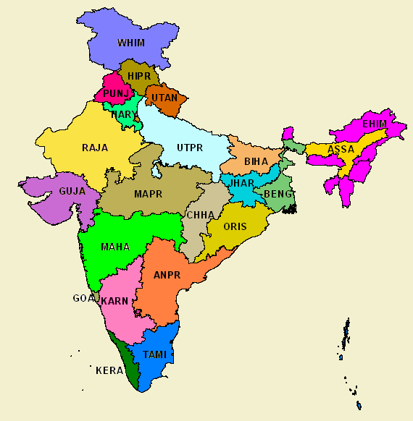
GAINS India: 23 Administrative regions
ANPR: Andhra Pradesh (including Telangana); ASSA: Assam; BENG: West Bengal; BIHA: Bihar; CHHA: Chhattisgarh; DELH: Delhi NCT; EHIM: North East (excl. Assam); GOA: Goa; GUJA: Gujarat; HARY: Haryana; HIPR: Himachal Pradesh; JHAR: Jharkhand; KARN: Karnataka; KERA: Kerala; MAHA: Maharashtra; MAPR: Madhya Pradesh; ORIS: Odisha; PUNJ: Punjab; RAJA: Rajasthan; TAMI: Tamil Nadu; UTAN: Uttarakhand: UTPR: Uttar Pradesh; WHIM: Jammu and Kashmir.
EHIM: Arunachal Pradesh, Manipur, Meghalaya, Mizoram, Nagaland, Sikkim and Tripura.

Slide 4

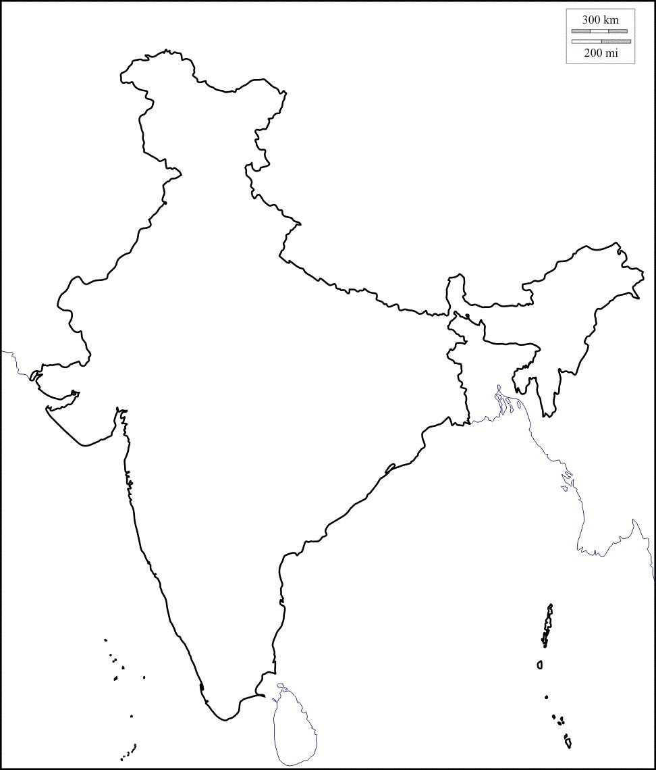

Model linkage

Slide 5
Mapping to the GAINS structure: Example

Slide 6
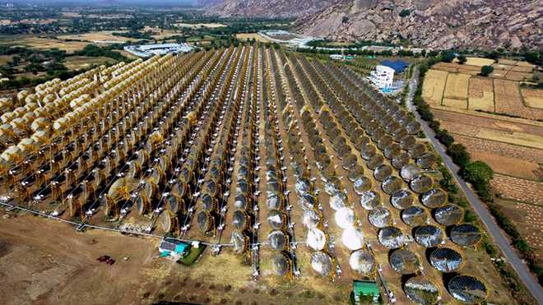
Household energy
Household energy end-use activities
Fuel use for household cooking
Cooking
Heating (water + space)
Lighting (electricity/kerosene)
Heating and cooling
  Air conditioners/Desert cooler/Fan
  Refrigerators/Freezer
  Electric heaters
Ironing (cloths)
Other
  Washing machines
  Radio/VCR/VCD Player/TV/Laptop/Mobile, etc.
Solid fuels
  Fuelwood, agri-residues, cow dung, lignite/coal, charcoal
Liquid fuels
  Kerosene, LPG
Gaseous fuels
  NG, Biogas, Producer gas
Electricity
Solar (thermal)
  Box/Concentrator type
Notes:
Nestled in the foothills of the Aravallis in Rajasthan is a solar power plant which not only caters to the power needs of a township of 10,000 people but also generates power enough to cook over 35,000 meals a day.

Slide 7
Household energy consumption for cooking
Annual primary energy requirement for cooking
  APE_{cooking} = 365*A_{fw}*CV_{fw}
Annual useful energy requirement for cooking (annual)
  AUE_{cooking} = 365*A_{fw}*CV_{fw}*η_{stove,fw}
  _{(5*18*13.5% = 12.15)}
Calorific value of fuelwood (MJ/kg)
Efficiency of traditional cookstove (%)
Average fuelwood consumption (kg/HH/day)
Daily useful energy requirement for cooking was 12.13 MJ/HH/Day (ABE, 1984)
An average of 138 kg of LPG is required per household per annum to meet their cooking energy needs
≈9–10 LPG cylinders of 14.2 kg each in a year (IISD/IRADe, 2016)
≈11.3 to 12.5 MJ/HH/Day

Slide 8
State-wise distribution of households by type of fuel used for cooking in rural and urban areas in India
Source: Census (2011)

Slide 9

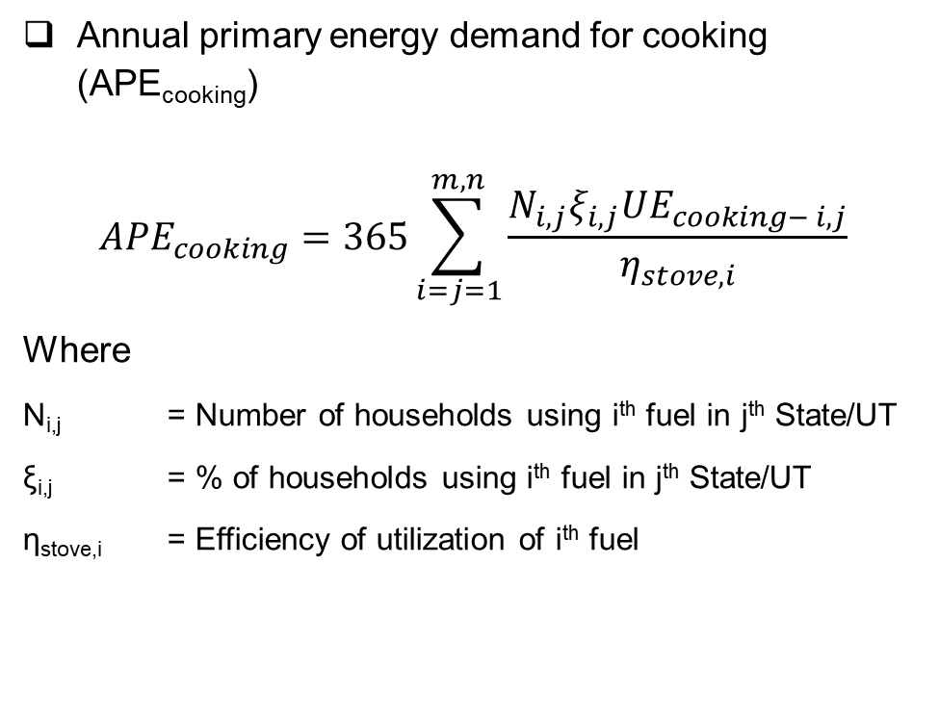
Household energy demand for cooking in India
Annual primary energy demand for cooking (APE_{cooking})
$${APE}_{cooking}=365\sum_{i=j=1}^{m,n}{\frac{N_{i,j}ξ_{i,j}{UE}_{cooking− i,j}}{η_{stove,i}}}$$
Where
N_{i,j} = Number of households using i^{th} fuel in j^{th} State/UT
ξ_{i,j} = % of households using i^{th} fuel in j^{th} State/UT
η_{stove,i} = Efficiency of utilization of i^{th} fuel
Data sources
  Census of India;
  NSSO;
  CSO;
  NCAER;
  Demographic and Health Survey (DHS)/IIPS

Slide 10
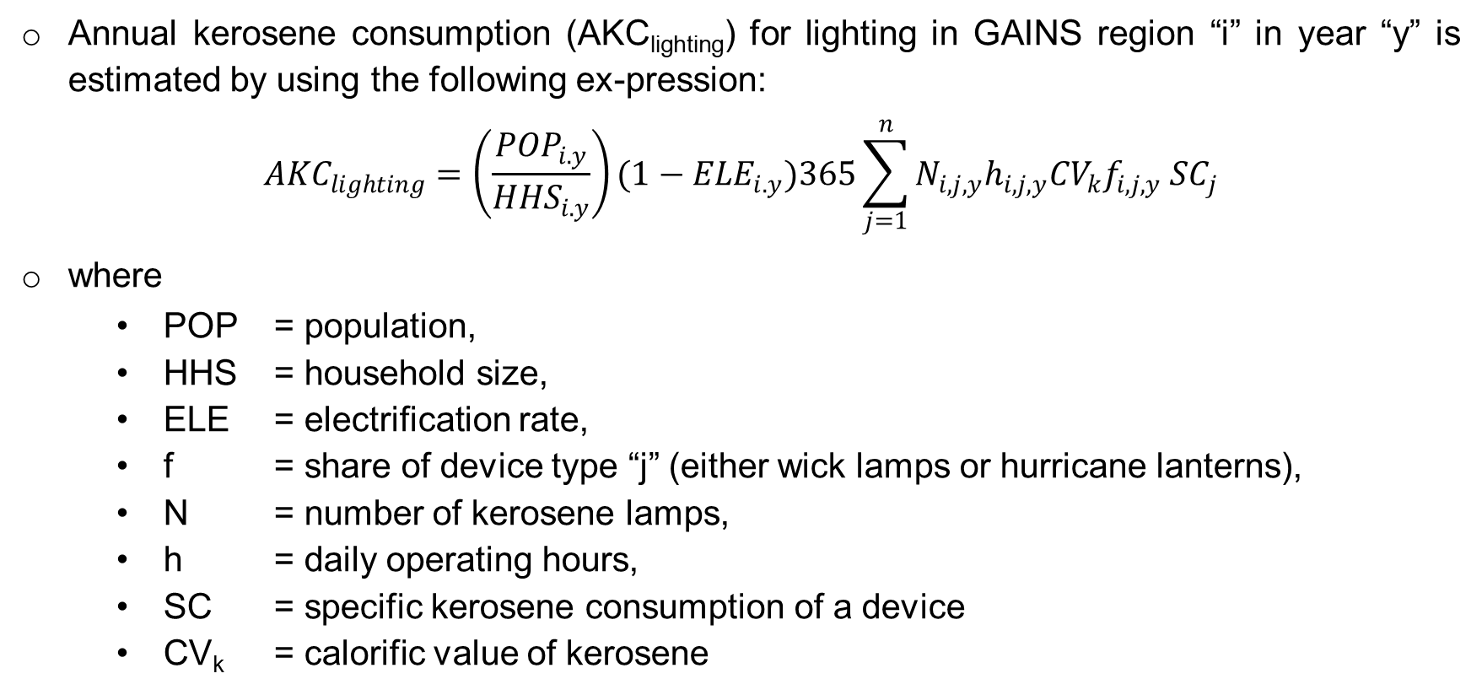
Kerosene lighting
Annual kerosene consumption (AKC_{lighting}) for lighting in GAINS region “i” in year “y” is estimated by using the following ex-pression:
$${AKC}_{lighting}=\left(\frac{{POP}_{i.y}}{{HHS}_{i.y}}\right)(1−{ELE}_{i.y})365\sum_{j=1}^{n}{N_{i,j,y}h_{i,j,y}{CV}_{k}{f_{i,j,y} SC}_{j}}$$
where
  POP = population,
  HHS = household size,
  ELE = electrification rate,
  f = share of device type “j” (either wick lamps or hurricane lanterns),
  N = number of kerosene lamps,
  h = daily operating hours,
  SC = specific kerosene consumption of a device
  CV_{k} = calorific value of kerosene

Slide 11

Diesel generators
Fossil fuel-burning backup generators in developing countries produce as much energy as 700-1,000 coal-fired power stations, consume US$50 billion in annual spending, and emit dangerous chemicals into homes and businesses.
Data and Information gaps
  Number of diesel generators (residential, commercial, industry, agriculture, etc.)
  Capacity factor
  Age (New/Old)
  Type (Large/small)

Slide 12
Application rates of abatement measures: % of capacity/activity

Slide 13
What is a GAINS control strategy?
A set of numbers (weighted averages) that tell you for each emission source to what extent which control technology is being applied
  Represents what kind of technologies are used
  Represents what policies are planned or implemented, and how this changes over time
For each technology: value is between 0% and 100%
Sum over all technologies (incl. ‘no control’) = 100%
  Total activity is either controlled or not
  % is always relative to activity
  For power plants activity means energy input

Slide 14

How do I calculate a control strategy?
Example: Coal-fired power plants
STEP 1: Start with capacities: Total = 800 MW_{el}
250 MW_{el}
500 MW_{el}
50 MW_{el}

Slide 15
How do I calculate a control strategy?
Step 2: Calculate fuel input per year, using
    Operating hours per year
    Conversion efficiency
250 MW_{el}
500 MW_{el}
2,000 hours/yr, 30% efficiency
6.0 PJ/yr = 20%
4,000 hours/yr, 35% efficiency
50 MW_{el}
20.6 PJ/yr = 69%
6,000 hours/yr, 32% efficiency
3.4PJ/yr = 11%

Slide 16
How do I calculate a control strategy?
Step 3: Determine control technology in operation
6.0 PJ/yr = 20%
20.6 PJ/yr = 69%
e.g. lime stone injection
e.g. flue gas desulfurization
3.4PJ/yr = 11%
e.g. no control

Slide 17
How do I calculate a control strategy?
Apply control strategy here

Slide 18
How do I calculate a control strategy?
No control = 11%
Lime stone injection = 20%
Flue gas desulphurization = 69%

Slide 19

Pathways towards clean air in India
Pallav PUROHIT (E-mail: purohit@iiasa.at)
IIASA - Air Quality and Greenhouse Gases (AIR) Program
GAINS IGP Training Session
19 October 2020

Slide 20
Air Pollution & Health
Air pollution poses a major threat to human health and climate. The combined effects of ambient and household air pollution cause about 7 million premature deaths every year (UN, 2019), largely as a result of increased mortality from stroke, heart disease, chronic obstructive pulmonary disease, lung cancer and acute respiratory infections.
Exposure to ambient particulate matter is a leading risk factor for environmental public health in India. It is estimated that only about 1% of the Indian population is exposed to less than the global WHO guideline level of 10 μg/m³ annual mean PM_{2.5} (IEA, 2016), and the majority of the population faces exposure of more than 35 μg/m³, i.e., above the highest Target Level 1 defined by the World Health Organization (WHO).
If no additional measures are taken to change the ongoing regular air pollution crises, deaths from air pollution in India will rise from 1.1 million in 2015 to 1.7 million deaths annually in 2030 and 3.6 million deaths annually by 2050 (HEI, 2019).

Slide 21
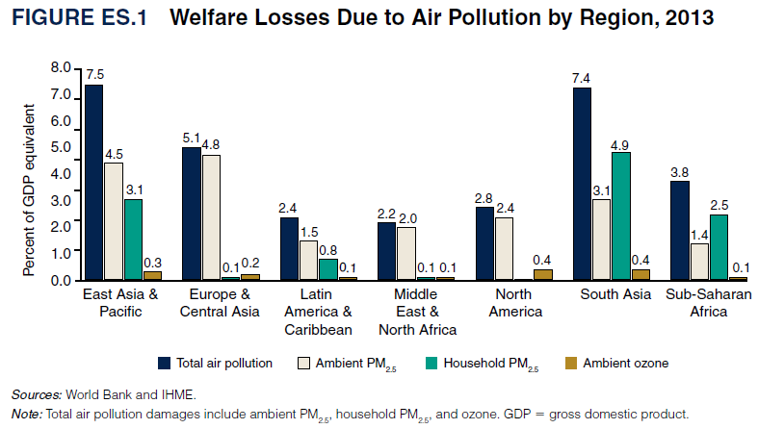
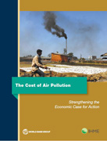
Exposure to air pollution costs the world’s economy some 5.1 trillion USD per year in welfare losses
INDIA: 2013 welfare losses equivalent to 7.7% of GDP
Source: World Bank (2016)

Slide 22
India has the most polluted cities on earth
Average level of fine particulate matter (PM_{2.5}) pollution in 2018
Source: WHO Global Ambient Air Quality Database (update 2018)

Slide 23
India has the most polluted cities on earth
Average level of fine particulate matter (PM_{2.5}) pollution in 2018
NAAQS
WHO guideline
Source: WHO Global Ambient Air Quality Database (update 2018)

Slide 24
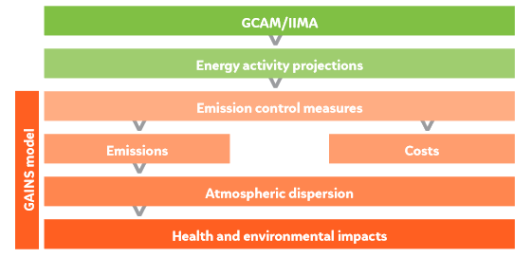
The Methodological Approach: Soft linking GCAM-IIMA and GAINS
Buildings
Industry
Transport

Slide 25
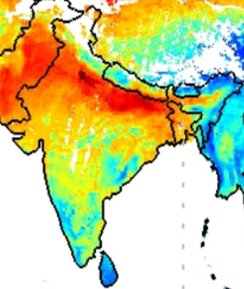
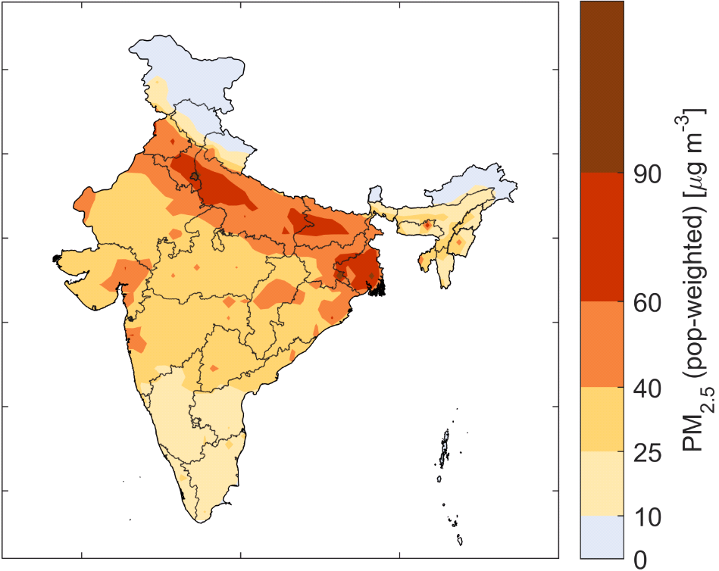
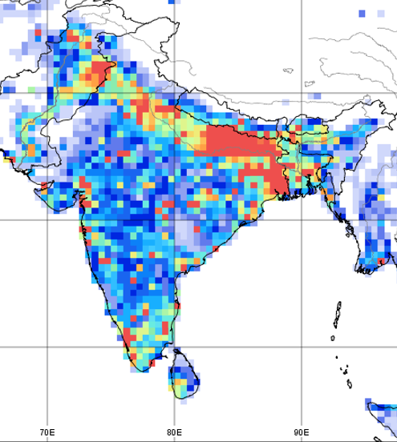
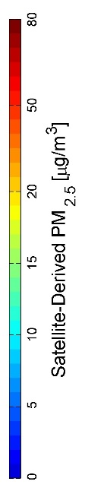
Air quality management needs to address urban and rural areas
Satellite-derived PM_{2.5}
Computed ambient levels of PM_{2.5}
Emission densities of PM_{2.5}, 2015
PM_{2.5} (kt/year)
Source: NASA
Source: IIASA/GAINS
Source: IIASA/GAINS
While current ambient PM_{2.5} monitoring in India reveals high levels in urban areas, remote sensing, comprehensive air quality modelling and emission inventories suggest large-scale exceedances of the NAAQS also in rural areas.
Household fuel combustion, small industries, burning of garbage and agricultural waste, etc., cause high emissions in rural areas too.
Pollution from rural areas is transported into the cities (and vice versa), where it constitutes a significant share of pollution.

Slide 26
Effective solutions require regional cooperation between cities and States
Origin of (population-weighted) PM_{2.5} concentrations in ambient air 2015
A large share of PM_{2.5} in ambient air originates from sources outside of cities and from other States, which are beyond the immediate jurisdictions of cities.
Cost-effective strategies require
regionally coordinated approaches,
and need to address urban and rural emission sources.
Source: IIASA/CEEW – Purohit et al. (2019)

Slide 27
Source-apportionment of PM_{2.5} in Delhi NCT
Emission controls:
Bharat IV from 2010
CNG for buses and three-wheelers
Enhanced penetration of natural gas
Improved public transport
Clean Air
Clean Air
Source: IIASA/NEERI – Amann & Purohit et al. (2017); Bhanarkar & Purohit et al. 2018

Slide 28
Effective solutions must address all sources that contribute to PM_{2.5} formation
A significant share of emissions still originates from sources associated with poverty and underdevelopment (i.e. solid fuel use in households and waste management practices).
Any effective reduction of PM_{2.5} levels in ambient air and the resulting health burden needs to balance emission controls across all these source sectors.
A focus on single sources alone will not deliver effective improvements and is likely to waste economic resources to the detriment of further economic and social development.
*Secondary particles formed in the atmosphere from agricultural NH₃ emissions through chemical reactions with SO₂ and/or NO_{x} emissions;
**Including Telangana
Source: IIASA/CEEW – Purohit et al. (2019)

Slide 29
Macro-economic development and energy consumption

Slide 30
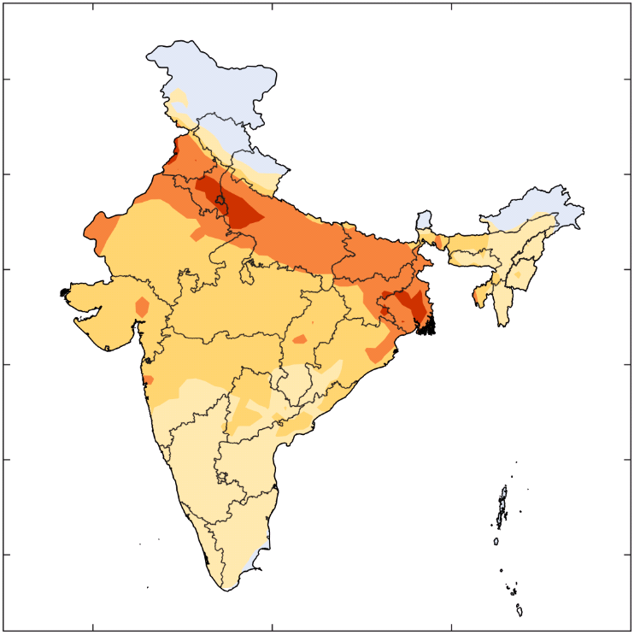
Compliance with current legislations will be essential for stabilizing pollution levels as the economy grows
Computed ambient levels of PM_{2.5}
2015
2030 with
current
legislations
Current emission controls are effective, but their impacts are compensated by rapid economic growth.
By 2030, effective implementation and enforcement of the 2018 legislation could allow a three-fold increase in GDP without further deteriorating air quality.
Source: IIASA/CEEW – Purohit et al. (2019)

Slide 31

Policies and measures are available that could bring air quality more in compliance with the NAAQS
-Advanced Emission Control Technology Scenario
Computed ambient levels of PM_{2.5}
2015
2030 with
current
legislations
2030 with
advanced controls
Advanced technical emission controls can deliver additional air quality improvements, but will not be sufficient to achieve the NAAQS everywhere
  NAAQS-compliant air quality to 60% of the Indian population
Source: IIASA/CEEW – Purohit et al. (2019)

Slide 32
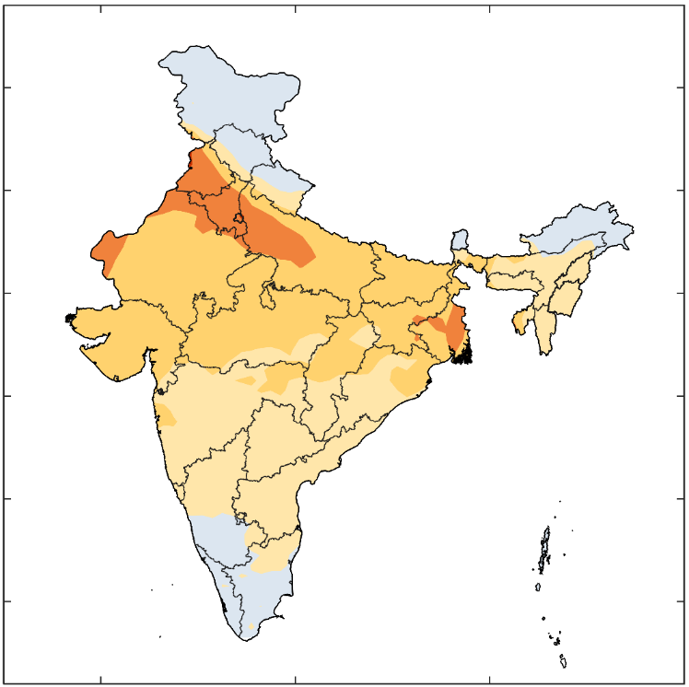
Policies and measures are available that could bring air quality more in compliance with the NAAQS
-Sustainable Development Scenario
Computed ambient levels of PM_{2.5}
2030 with
current
legislations
2015
2030 with
development
measures
A package of development measures that are usually taken for other policy priorities can deliver significant co-benefits on air quality.
  NAAQS-compliant air quality to about 85% of the Indian population.
Source: IIASA/CEEW – Purohit et al. (2019)

Slide 33
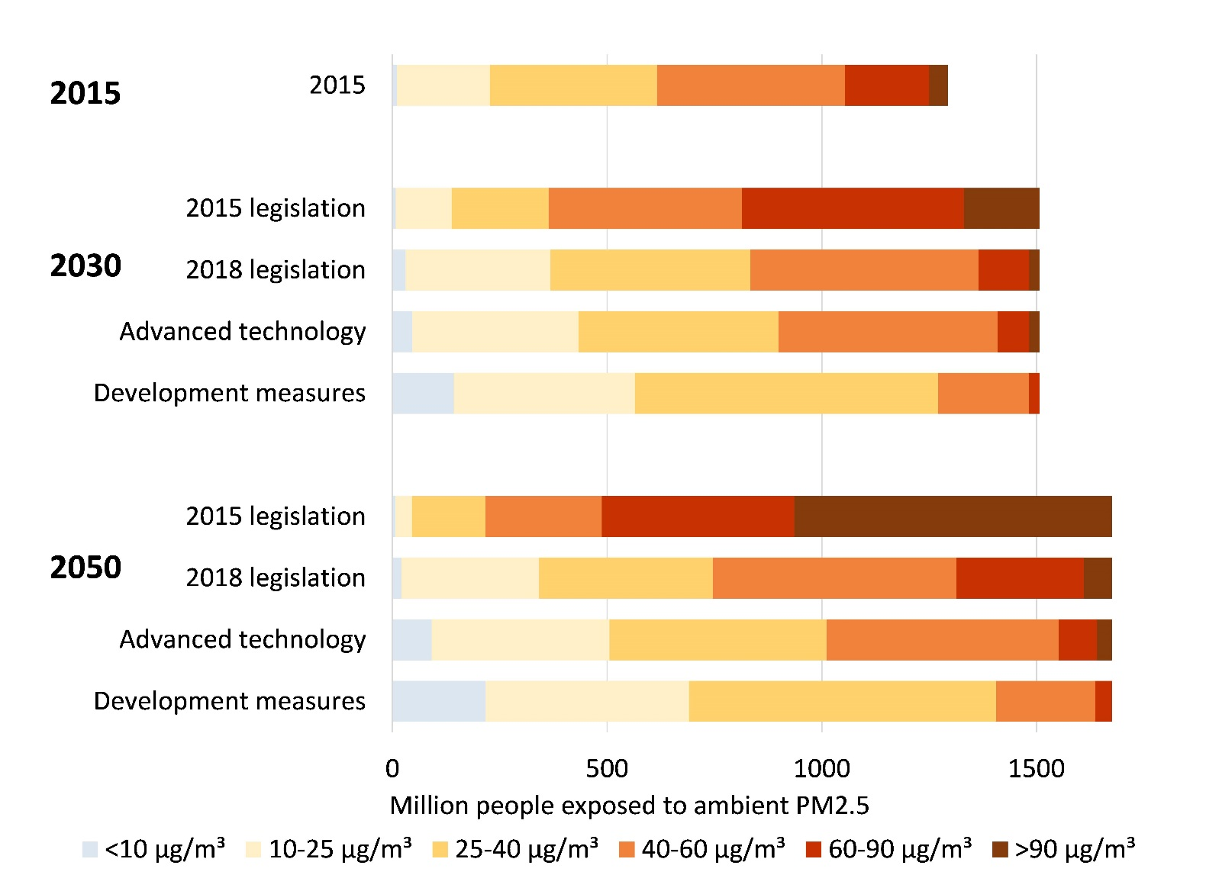
Policies and measures are available that could bring air quality more in compliance with the NAAQS (Contd…)
Source: IIASA/CEEW – Purohit et al. (2019)

Slide 34
Air pollutant emission control costs
Air pollution emission control costs accounted for about 0.7% of the GDP in 2015. This share will increase to 1.4-1.7% of GDP in 2030. More than 80% of total costs emerged for mobile sources.
In 2050, with an almost 10-fold increase in GDP, air pollution controls will consume 1.1-1.5% of the GDP.
Source: IIASA/CEEW – Purohit et al. (2019)

Slide 35
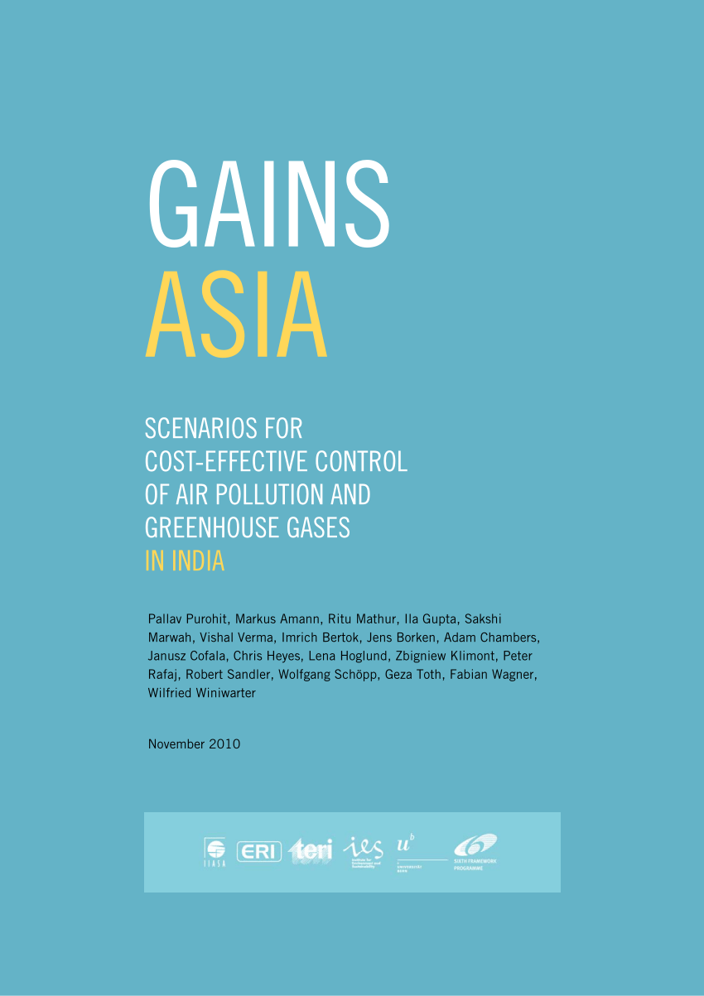
The GAINS cost-effectiveness approach can reduce costs for improving air quality by up to 55%
Emission control costs for reducing
PM health impacts in India by 53%
Full application of advanced emission control technologies can reduce health impacts in India by 53% in 2030
The GAINS optimization can identify the most cost-effective portfolio of measures – these achieve the same health improvements at 45% of the costs
With GAINS
optimization
Source: IIASA/TERI – Purohit et al. (2010)

Slide 36
Sustainable development measures can deliver a wide range of benefits
In the sustainable development scenario, India’s CO₂ emissions would be about 60% lower in 2050 than in the baseline case.
Even without dedicated measures focused on methane, CH₄ emissions would be 40% lower in 2050 compared to the baseline case.
Black carbon emissions would decline by 80% in the development scenario in 2050 compared to 2015.
Source: IIASA/CEEW – Purohit et al. (2019)

Slide 37
Priority measures
Access to clean fuels and technologies for cooking (e.g., promotion of LPG/electric stoves)
Effective implementation of current policy measures (e.g., FGD in power plants, BS-VI from 2020)
Improved waste management and agricultural production practices
Substituting coal with natural gas and renewables (solar/wind) in power generation and industry
Improvements in energy efficiency (power, industry, transport and residential/commercial)
Advanced emission controls (e.g., HED and ESP Stage-II for PM and SCR for NOx control in power plants)
Enhanced public transport (e.g., metro) and increased incentives for greater adoption of electric vehicles
Emission control on non-industrial sources (e.g., road dust)
Coordination of urban, rural and inter-State responses

Slide 38

The GAINS tool is available online to explore cost-effective strategies that maximize multiple benefits
Access on the Internet: http://gains.iiasa.ac.at
Thank you! purohit@iiasa.ac.at

