Slide 1
How cost-effectiveness modelling is used to support policy making for Regional Air Quality Management in the EU
Markus Amann
Program Director Air Quality and Greenhouse Gases
GAINS-IGP training session
October 8, 2020

Slide 2
Some important features
PM2.5 particles and ozone precursor emissions travel
in the atmosphere for about a week, over ~100s-1000 km
Many European countries are similar sized to
Indian States

Slide 3
Cities alone cannot achieve clean air
Netherlands
WHO guideline
Source: IIASA GAINS

Slide 4
Some important features
PM2.5 particles and ozone precursor emissions travel
in the atmosphere for about a week, over ~100s-1000 km
Many European countries are similar sized to Indian States
A country/province cannot rule over its neighbors

Slide 5
EU air quality management structure
Institutions | Scale (km) | Responsibilities
Europe-wide (EU) | ~1500 | Air Quality Limit Values (uniform) Uniform, source-specific emission limit values (BAT) National emission ceilings
National governments | 200-1000 | Transposition into national laws
City administrations | 20-50 | Licensing Air quality monitoring Air quality management plans Local short-term action plans

Slide 6
Some important features
PM2.5 particles and ozone precursor emissions travel
in the atmosphere for about a week, over ~100s-1000 km
Many European countries are similar sized to Indian States
A country/province cannot rule over its neighbors
There are large differences among countries/provinces in pollution levels, economic wealth, industrial structures, energy systems, etc.
The costs for further emission reductions differ across countries/sectors

Slide 7
There are large differences in the contributions of different sources to ambient PM2.5
Netherlands
Poland
WHO guideline
How to balance emission controls across regions and sectors?
Source: IIASA GAINS

Slide 8


Greenhouse gas–Air pollution Interactions and Synergies:
The GAINS tool
Social development
and economic activities
National
Emission
Ceilings
National emission ceilings
Emission control options: ~2000 measures,
co-control of 10 air pollutants and 6 GHGs)
Emissions
Costs
Optimization
Atmospheric dispersion
Health, ecosystems and climate impact indicators
Policy targets

Slide 9
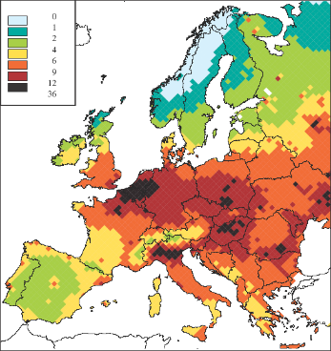
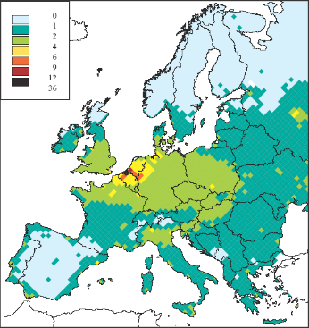
Costs for reducing health impacts from fine PM
Analysis for the EU Clean Air For Europe (CAFE) programme
16000
14000
12000
10000
Annual Cost €Millions
8000
6000
4000
2000
0
0%
10%
20%
30%
40%
50%
60%
70%
80%
90%
100%
Health improvement (Change between baseline and maximum measures)

Slide 10
Cost-effective PM2.5 emission reductions for a 50% reduction of health impacts, by sector and country

Slide 11
Emission control costs for achieving the EU air quality targets

Slide 12
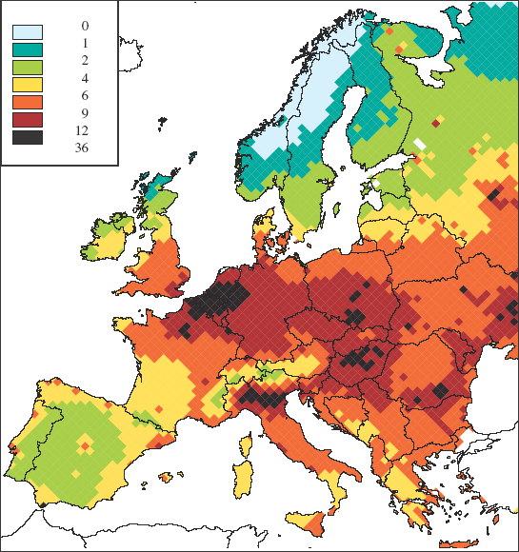
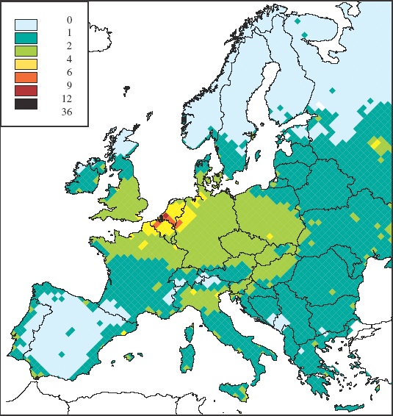
Cost savings from the GAINS approach
Estimates presented by European industry associations
Courtesy of Les White
16000
14000
12000
GAINS
cost-
effectiveness
approach
10000
Annual Cost €Millions
8000
“Equal
technology”
approach
6000
4000
2000
0
0%
10%
20%
30%
40%
50%
60%
70%
80%
90%
100%
Health improvement (Change between baseline and maximum measures)

Slide 13
Cost-benefits vs cost-effectiveness analysis
Cost-benefits analysis
Cost-effectiveness analysis
For which measures are the (marginal) monetized benefits larger than their costs?
Emission control
measures
Which set of measures delivers the policy target
at least cost?
Emission control
costs
Physical benefits
e.g., air quality, prem. deaths
Policy choice: Targets
(e.g., achieve AQ limit values, or reduce health impacts by 50%)
Policy choice:
Monetary value (€) of human life, ecosystems, etc.
Monetization of
(health) benefits (€/life)
Monetized benefits
(€/year)

Slide 14
An alternative view on clean air benefits:
Productivity gains from cleaner air

Slide 15
Key messages
Effective PM2.5 strategies must address all sources
In contrast to cost-benefits analyses, a cost-effectiveness analysis does not rely on (sometimes controversial) monetary valuations of human life and healthy ecosystems
Cost-effective packages of measures imply differentiated requirements for each country/province
The GAINS model identifies cost-effective packages of policy intervention measures, by country/province/sector/pollutant

