Slide 1
GAINS-IGP Training Session
October 8-23, 2020

Slide 2
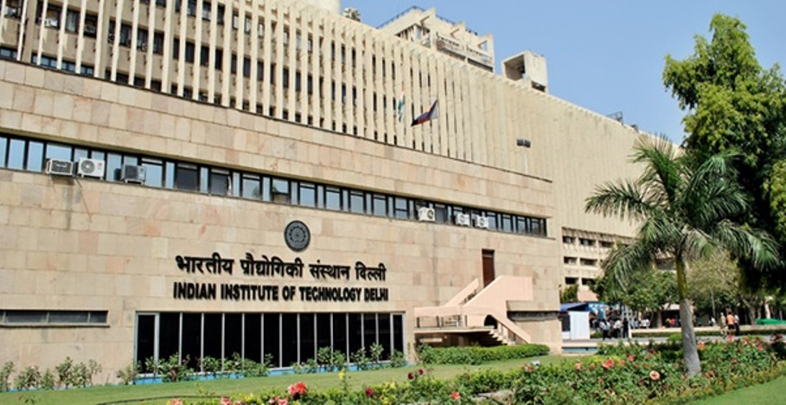
The GAINS teams
IIASA:
Markus Amann – Program Director
Rober Sander – Software management
Janusz Cofala – Energy and stationary sources emissions
Zig Klimont – Agriculture, PM, VOC emissions
Jens Borken-Kleefeld – Transport emissions
Pallav Purohit – Indian statistics
Parul Srivastava – Atmospheric dispersion
Gregor Kiesewetter – Atmospheric dispersion
Fabian Wagner – Cost-effectiveness, optimization
Wolfgang Schöpp – Software management
Peter Rafaj – Energy statistics
Wilfried Winiwarter – Agricultural emissions
IIT-Delhi:
Dr Sagnik Dey
Dr Hemant Kaushal
Ms Lovleen Arora
Ms Priyanka
Dr Palak Balya
Dr Pallavi Joshi
Dr Bipasha Ghosh
Dr Himanshu Lal
Dr Prachi Singh
Mr Gautam Saw
Mr Rajeev

Slide 3
Agenda Daily sessions from 14:00-16:00 IST
Oct 8: Introduction, GAINS input to AQM
Oct 9: The GAINS model concept
Oct 12: Software management, user interface
Oct 13: Data handling
Oct 14: Transport sector
Oct 15: Transport and waste sectors
Oct 16: Agriculture
Oct 19: Power sector and large industry
Oct 20: Small industries, process emissions
Oct 21: Atmospheric dispersion and impact assessment
Oct 22: Cost effectiveness analysis
Oct 23: Feedback, next steps

