Slide 1
Agriculture in GAINS
Focus on ammonia emissions and mitigation opportunities
Zbigniew Klimont
(klimont@iiasa.ac.at)

Slide 2
Source apportionment of PM_{2.5} in Delhi 2015
Amann et al., 2017; Atmospheric Environment

Slide 3
Origin of PM2.5 - 2009
Netherlands
average of the urban AIRBASE stations
Lyon, Centre Ville
Source: IIASA GAINS

Slide 4
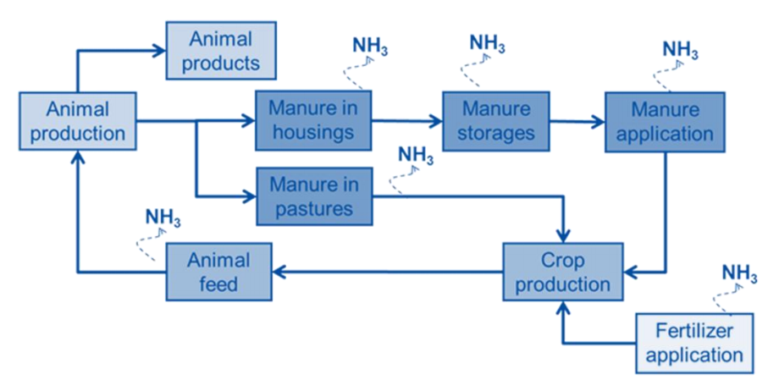
Key sources of ammonia emissions in the various steps of the livestock production and animal manure management chains
Source: TSAP report #3

Slide 5
NH₃ emissions from livestock farming, by emission stage
Source: IIASA GAINS

Slide 6
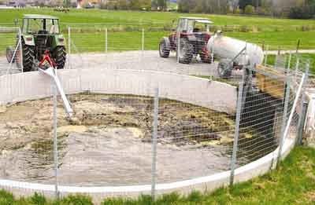
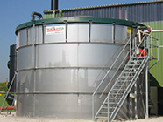
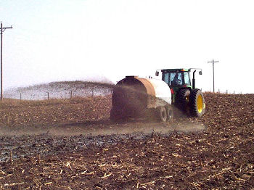
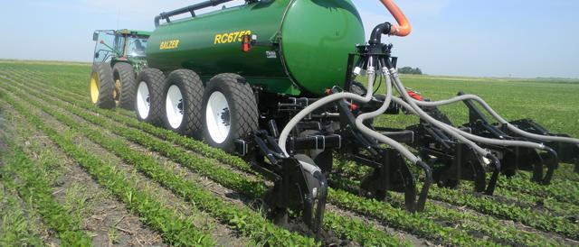
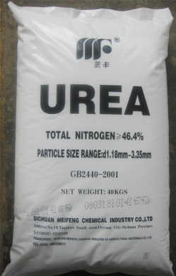
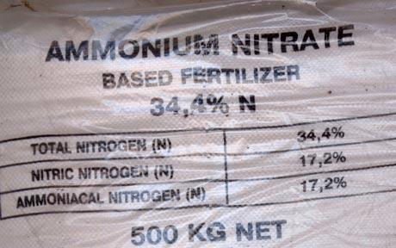
NH₃: Key measures for achieving the proposed NECs
Improved storage of manure (e.g., closed tanks) at large farms
Improved application of manure on soil, e.g., trailing hose, slot injection (for large farms)
Improved application of urea fertilizer or substitution by ammonium nitrate

Slide 7
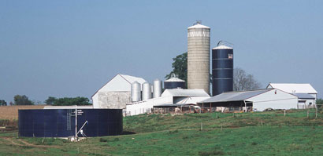
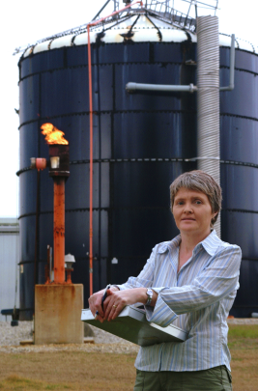
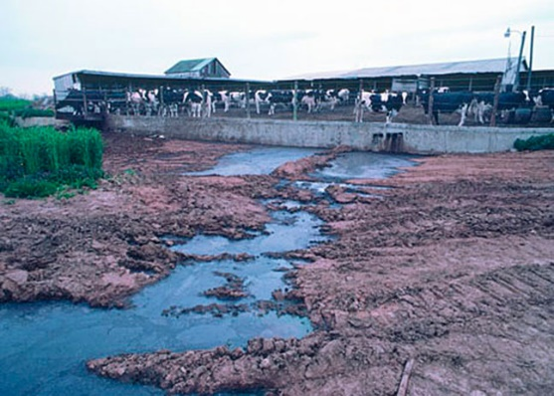
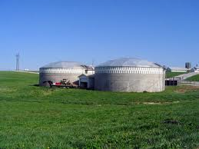
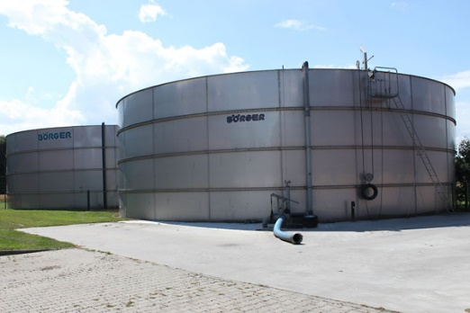
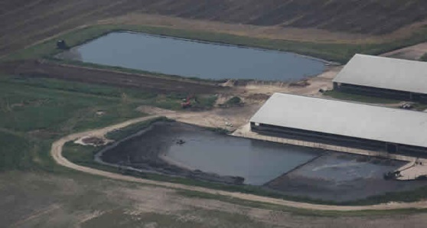
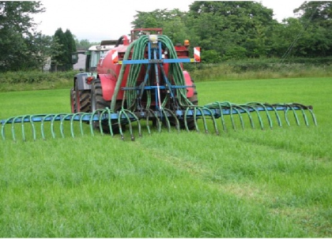
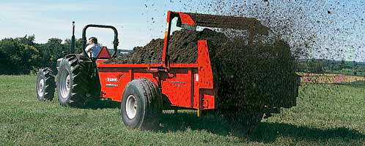
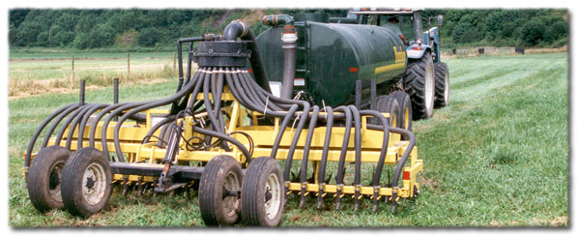
There are proven ways of better managing the manure ‘resource’ –
it will reduce demand for mineral fertilizer too
Improved storage of manures, e.g., closed tanks, anaerobic digestion
Improve application of manures on soil, e.g., trailing hose, slot injection

Slide 8
80% of NH₃ emissions emerge from 5% of the farms in the EU
Zero LSU (livestock units) refers to arable farms without animals
NH₃ emissions # of farms
Farm sizes:
Source: IIASA-GAINS

Slide 9
Distribution of farm sizes – 2010
(only holdings with animals) Source: EUROSTAT

Slide 10
NH₃ emissions from livestock farming by farm size
Source: IIASA-GAINS, based on EUROSTAT

Slide 11
Farm sizes have changed rapidly in the past –
Prospects for 2030 not included in TSAP analysis
In Switzerland, continuation of the trend towards larger farms – assuming
CLE legislation - would lead to 5% lower NH₃ emissions in 2030

Slide 12
Agriculture in GAINS
Principles of emission and cost calculation

Slide 13
Key sources of ammonia emissions in the various steps of the livestock production and animal manure management chains
Source: TSAP report #3

Slide 14
GAINS - Agricultural module
Farm size
Storage time
Other
Manure
system
Excretion rate
and volume
Abatement
technologies
(efficiency, costs, etc.)
Housing period
Livestock
(base year
and
forecasts)
Current
practice
Emission
factor
Control
strategies
Emissions
and
Costs
Volatilization
rate, etc.
Fertilizers
(base year, forecasts)
Climatic zone
% N loss
Soil type
Other activities
(base year, forecasts)
Emission
factor
Legend:
- Data asked for and statistics
- Data assumed in the model but available for review
- Data available from guidebooks
- Result of calculation

Slide 15
Emission calculation
where:
EL_{i,l} ammonia emissions from livestock farming in country (i) and year (l) [kt NH3/year],
i,j,k,l country, livestock category, abatement technique, year;
s emission stage (four stages)
L animal population [thousand heads];
ef emission factor [kg NH3 / animal per year];
η reduction efficiency of abatement technique;
X implementation rate of the abatement technique
Source: Klimont and Winiwarter (2011)

Slide 16
Emission factors at each stage are influenced by the nitrogen losses at previous stages
ef₁ = Nx₁ v₁ (2a)
ef₂ = Nx₁ (1 – v₁) v₂ (2b)
ef₃ = Nx₁ (1 – v₁ – (1 – v₁) v₂) v₃ (2c)
ef₄ = Nx₄ v₄ (2d)
where:
ef_{1,2,3,4} NH3-nitrogen loss at distinguished emission stages, i.e., housing (1), storage (2),
application (3), and grazing (4),
Nx_{1,4} N excretion during housing (1) and grazing (4),
v_{1,2,3,4} N volatilization rates at distinguished emission stages
Source: Klimont and Winiwarter (2011)

Slide 17
Key categories of emission sources
  Animal categories (by housing type)
    Dairy cows, Other cattle, Pigs, Laying hens, Other poultry, Sheep and goats, Fur animals, Horses, Buffaloes, Camels
  N-Fertilizer application (urea and other fertilizers)
  Fertilizer production
  Stationary combustion
  Transport
  Open burning of agricultural waste
  Other

Slide 18
Ammonia emission factors uncontrolled/reference system
Emission stage specific (livestock), estimated from national parameters (can change over time):
  N excretion,
  N volatilization rate,
  Production efficiency (e.g., milk production),
  Housing period,
  Climatic conditions,
  Soil type,
  Other…

Slide 19
Categories of emission control options
Low nitrogen feed
Low emission housing
Air purification
Covered storage (low and high efficiency)
Low ammonia application (low and high efficiency)
Improved application or substitution of urea fertilizer
Incineration of poultry manures
Combinations of the above options
+ options to control non-CO₂ GHG (CH₄, N₂O)

Slide 20
Multi-pollutant measures (interactions); examples^{*)} expected emission reduction (↓), potential increase (↑)
Agricultural sources:
  Low emission pig housing – NH₃, CH₄ ↓ N₂O ↑
  Covered storage of slurry – NH₃, N₂O ↓ CH₄ ↓↑
  Covered storage of FYM – NH₃, N₂O, CH₄ ↓
  Storage, solids separation – CH₄ ↓, NH₃ ↑↓
  Injection/incorporation of manures – NH₃ ↓ N₂O ↑
  Anaerobic digestion (biogas) – CH₄, CO₂, N₂O ↓ NH₃ ↓↑
  Slurry acidification – NH₃, CH₄ ↓
  Open burning of agricultural residues – VOC, PM, CO, NH₃, CH₄ ↓
  Variable Rate Technology (fertilizer application) – N₂O, NH₃, CO₂ ↓
  Cattle and sheep breeding (genetic selection) – CH₄, NH₃ ↓
^{*)} Extensive discussion of several measures available in Sommer et al. (2013)

Slide 21
Example of emission control options and their default removal efficiencies

Slide 22
Examples of applicability rates
[% of livestock]
Country/animal/technology | Low N feed | Low emission housing | Covered storage (high) | Low NH3 application (high)
Norway
Pigs (slurry/straw) | 100/100 | 0/0 | 15/0 | 0/0
Dairy cattle (slurry/straw) | 0/0 | 100/0 | 15/0 | 50/25
United Kingdom
Pigs (slurry/straw) | 100/100 | 60/0 | 15/0 | 35/100
Dairy cattle (slurry/straw) | 0/0 | 68/0 | 21/0 | 29/100
Hungary
Pigs (slurry/straw) | 100/100 | 100/0 | 0/0 | 60/100
Dairy cattle (slurry/straw) | 0/0 | 23/0 | 30/0 | 57/100
Switzerland
Pigs (slurry/straw) | 100/100 | 48/0 | 35/0 | 6/80
Dairy cattle (slurry/straw) | 100/100 | 43/0 | 20/0 | 6/80

Slide 23
Cost categories distinguished in GAINS
Investments (function of the average farm size)
I = c^{f}+c^{v}/ss or I = (c^{f}*st*mp/ar²) + c^{v}/(ss*ar)
where:
c^{f}, c^{v} - investment function coefficients
ss, ar - average farm size, animal rounds per year,
st, mp - storage time, manure “production”
Fixed operating costs: OM_{fix}= I*fk
  fixed percentage (fk) of investments, includes:
  maintenance, insurance, administrative overhead;
Variable operating costs (OM^{var}) e.g., increase in feed price, energy, water and labour use, costs of waste disposal

Slide 24
Investment cost
ci^{f}, ci^{v} – investment function coefficients
ss – average farm size
i,k,l – livestock category, abatement technique, country
or for storage
st – storage time
mp – manure ‘production’ per year
ar – production cycles per year
Source: Klimont and Winiwarter (2011)

Slide 25
Annualized investments
i,k,l – livestock category, abatement technique, country
lt – lifetime of abatement technique
q – interest rate (4%)

Slide 26
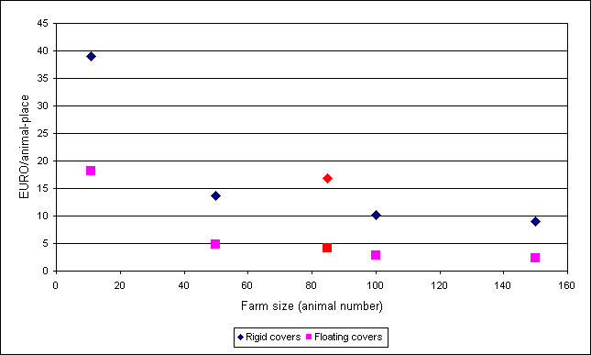
Examples of investment functions
(storage of cattle manure)
UK
Poland

Slide 27
Operating costs
fk – percentage of investment costs
Q – quantity of p
c – unit price of a given p
p – parameter type (additional energy, labour, waste disposal, etc.)
Source: Klimont and Winiwarter (2011)

Slide 28
Costs of low ammonia application options
C^{m} – Cost of option k per m³
ci^{f}, ci^{v} – cost coefficients for a specific option k
Q^{mh} – manure application rate for option k
i,k,l – livestock category, abatement technique, country
S^{m} – share of option k
Source: Klimont and Winiwarter (2011)

Slide 29
Unit costs
ca – unit costs per animal-place
ar – production cycles per year
sb – capacity utilization factor
ŋ_{k} – removal efficiency of option k
Cost efficiency can be evaluated if
the annual costs are related to the abated emissions
ef_{i,l} – emission factor for livestock category i and country l
ŋ_{k} – removal efficiency of option k

Slide 30
Marginal cost
cn_{k} – unit costs for option k
ŋ_{k} – removal efficiency of option k

Slide 31
Example of a cost curve
+Air purification
+Housing
Storage and application
Urea subs.

Slide 32
Costs differ by country
Agricultural practice
Implementation of measures
Farm size
Climate
Internal cost structure (labour cost, …)
→ GAINS needs input!
Notes:
32

Slide 33
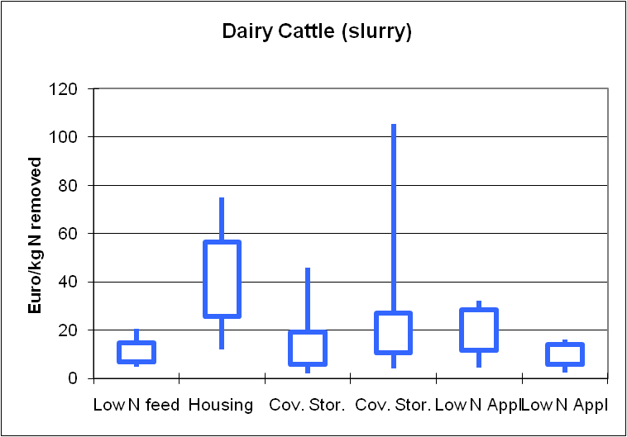
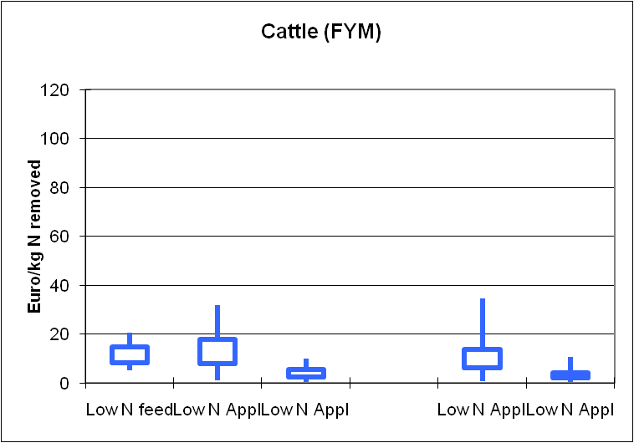
GAINS unit costs ranges (1)
Dairy cattle
Other cattle
Low to medium efficiency
High efficiency
Notes:
33

Slide 34
Some problems and uncertainties (NH₃)
Issues with statistical data; inconsistencies between national and international data
Lack of local information about feed, efficiency, measurements of emission rates
Poor information on housing systems in place and their future evolution
Contradictory information on how existing legislation is or will be implemented
Emissions from non-agricultural sources often not reported
Better information on current practices could lead to significant improvements, i.e., development of regional emission factors

Slide 35
Example of European cost data in GAINS (1)
Abatement option | Application area | Investments [€/animal-place] |  | Total costs* [€/animal/year]
 |  | Farm size **
 |  | Small | Typical | Small | Typical
Low nitrogen feed | Dairy cows | n.a. |  | 45
 | Pigs | 2.7 |  | 8
 | Laying hens | n.a. |  | 0.1
 | Other poultry | n.a. |  | 0.12
Bio-filtration and | Pigs | 200-300 | 170 | 50-70 | 38-40
bio-scrubbers | Laying hens | 4.7 |  | 1.5-2.0
 | Other poultry | 4.7 |  | 2.0-2.5
Housing adaptation | Dairy cows, Other cattle | 450-550 | 400 | 90-110 | 75-90
 | Pigs | 90-94 | 89 | 21 | 19
 | Laying hens | 0.8 |  | 0.2-0.25
 | Other poultry | 1.8 |  | 0.28
Stripping/adsorption | Industry | 625 €/t NH₃ removed
n.a.: not applicable
* - Taking into account fixed and variable operating costs
** - The following stable sizes are assumed:
Pigs - small (<50 animals/farm), typical (~170)
Dairy cows - small (<20 animals/farm), typical (~35)
Other cattle - small (<30 animals/farm), typical (~40)

Slide 36
Example of European cost data in GAINS (2)
Abatement option | Application area | Investments [ECU/animal-place] |  | Total costs* [ECU/animal/year]
 |  | Farm size **
 |  | small | typical | small | typical
Covered storage - | Dairy cows | 200-400 | 160 | 40-60 | 18-40
high efficiency | Other cattle | 100-150 | 70 | 15-25 | 7-12
 | Pigs | 2-5 | 1 | 0.4-1 | 0.3
 | Laying hens | 0.4 |  | 0.06
Covered storage - | Dairy cows | 100-200 | 80 | 20-30 | 9-20
low efficiency | Other cattle | 50-75 | 35 | 7-13 | 3-6
 | Pigs | 1-3 | 0.5 | 0.2-0.5 | 0.15
 | Laying hens | 0.2 |  | 0.03
Low NH₃ application | Dairy cows | n.a. |  | 50-70
 | Other cattle | n.a. |  | 18-40
 | Pigs | n.a. |  | 5-8
 | Laying hens | n.a. |  | 0.15-0.3
 | Other poultry | n.a. |  | 0.04-0.06
 | Sheep | n.a. |  | 3-4
n.a.: not applicable
* - Taking into account fixed and variable operating costs
** - The following stable sizes are assumed: Pigs - small (<50 animals/farm), typical (~170);
Dairy cows - small (<20 animals/farm), typical (~35); Other cattle- small (<30 animals/farm), typical (~40)

Slide 37
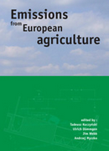

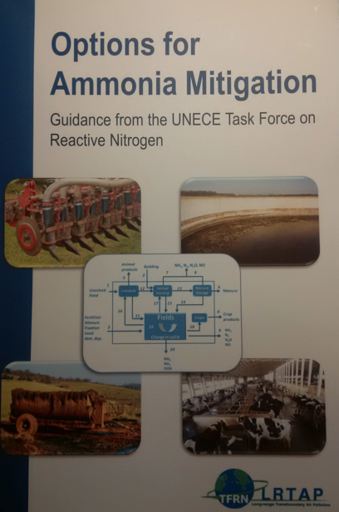
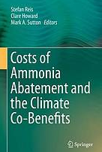
Further reading
IIASA reports produced in support of the EU Commission during its review of
the Thematic Strategy on Air Pollution (TSAP)
http://www.iiasa.ac.at/web/home/research/researchPrograms/MitigationofAirPollutionandGreenhousegases/TSAP-reports.html
Kuczynski et al [eds] 2005. Emissions from European Agriculture, Wageningen Academic Publishers, Wageningen, the Netherlands
M. Sutton, S. Reis and S.M.H. Baker [eds] 2009. Atmospheric Ammonia. Springer
Bittman S., Dedina M., Howard C., Oenema O., Sutton M.A. [eds] 2014. Options for ammonia mitigation: Guidance from the UNECE Task Force on Reactive Nitrogen. Centre for Ecology and Hydrology, Edinburgh, UK.
Reis S., Howard C., Sutton M.A. [eds] 2015. Costs of Ammonia Abatement and the Climate Co-Benefits, Springer Netherlands

